Slide 1
Unemployment

Slide 2
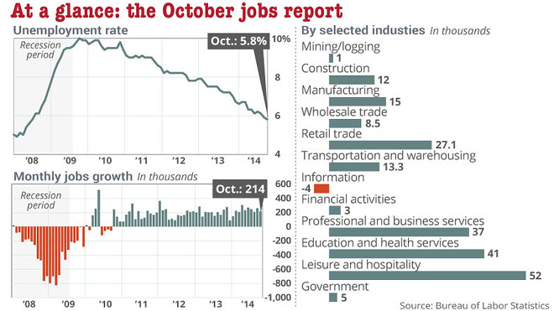

Slide 3

Examining Unemployment
How we figure it out…
Total US
Population
Total Civilian,
Noninstitutionalized
US Pop.
Non Labor Force
Total US
Labor Force
Employed
Unemployed
Military and
Institutionalized
…Full time Students
…Stay at Home Parents
…Retirees

Slide 4
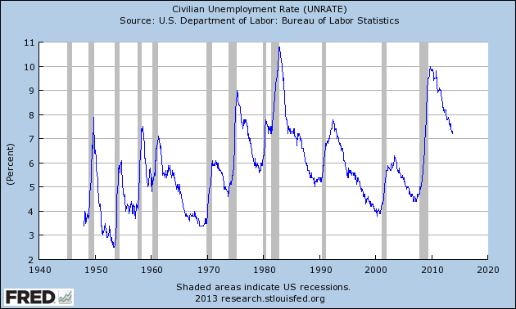
Unemployment Rate over time

Slide 5
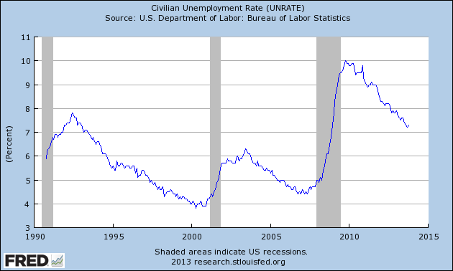
Unemployment Rate today…

Slide 6
Types of Unemployment

Slide 7

Frictional Unemployment
Occurs when people take time to find a new job…after changing jobs
People returning to the workforce after time away

Slide 8


Seasonal Unemployment
Occurs because of slow downs or shut downs of business
Based on production schedules

Slide 9

Structural Unemployment
Workers skills don’t match the jobs that are available
Skills are no longer needed

Slide 10
Causes of Structural unemployment
Development of new technology
  Ice delivery
Discovery of new resources
  Whale oil
Changes in consumer demand
  Cobblers?
Globalization
  Car manufacturing and Mexico
Lack of education
  Technology issues

Slide 11
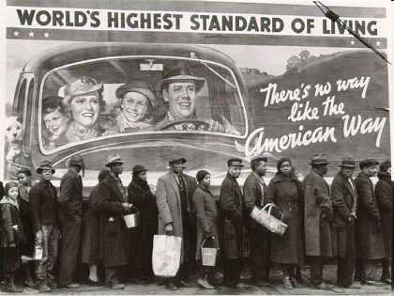
Cyclical Unemployment
Slow down of the entire economy causes demand for labor to drop
  The Great Depression and 25%

Slide 12
Other things to consider
Full employment
  About 4% is what we want!
Underemployment
Discouraged workers
Very high unemployment for a very long time…
  Crash is harder and faster

Slide 13
Formulas…

Slide 14
http://www.macrotrends.net/1377/u6-unemployment-rate

Slide 15
Unemployment Data and statistics

Slide 16
Factors relating to Unemployment
Occupation
Age
Race
Gender
Education
Longer term unemployment

Slide 17
Check out the data!
What does this tell us about our economy?
What factors are important?
Source: Bureau of Labor Statistics

Slide 18
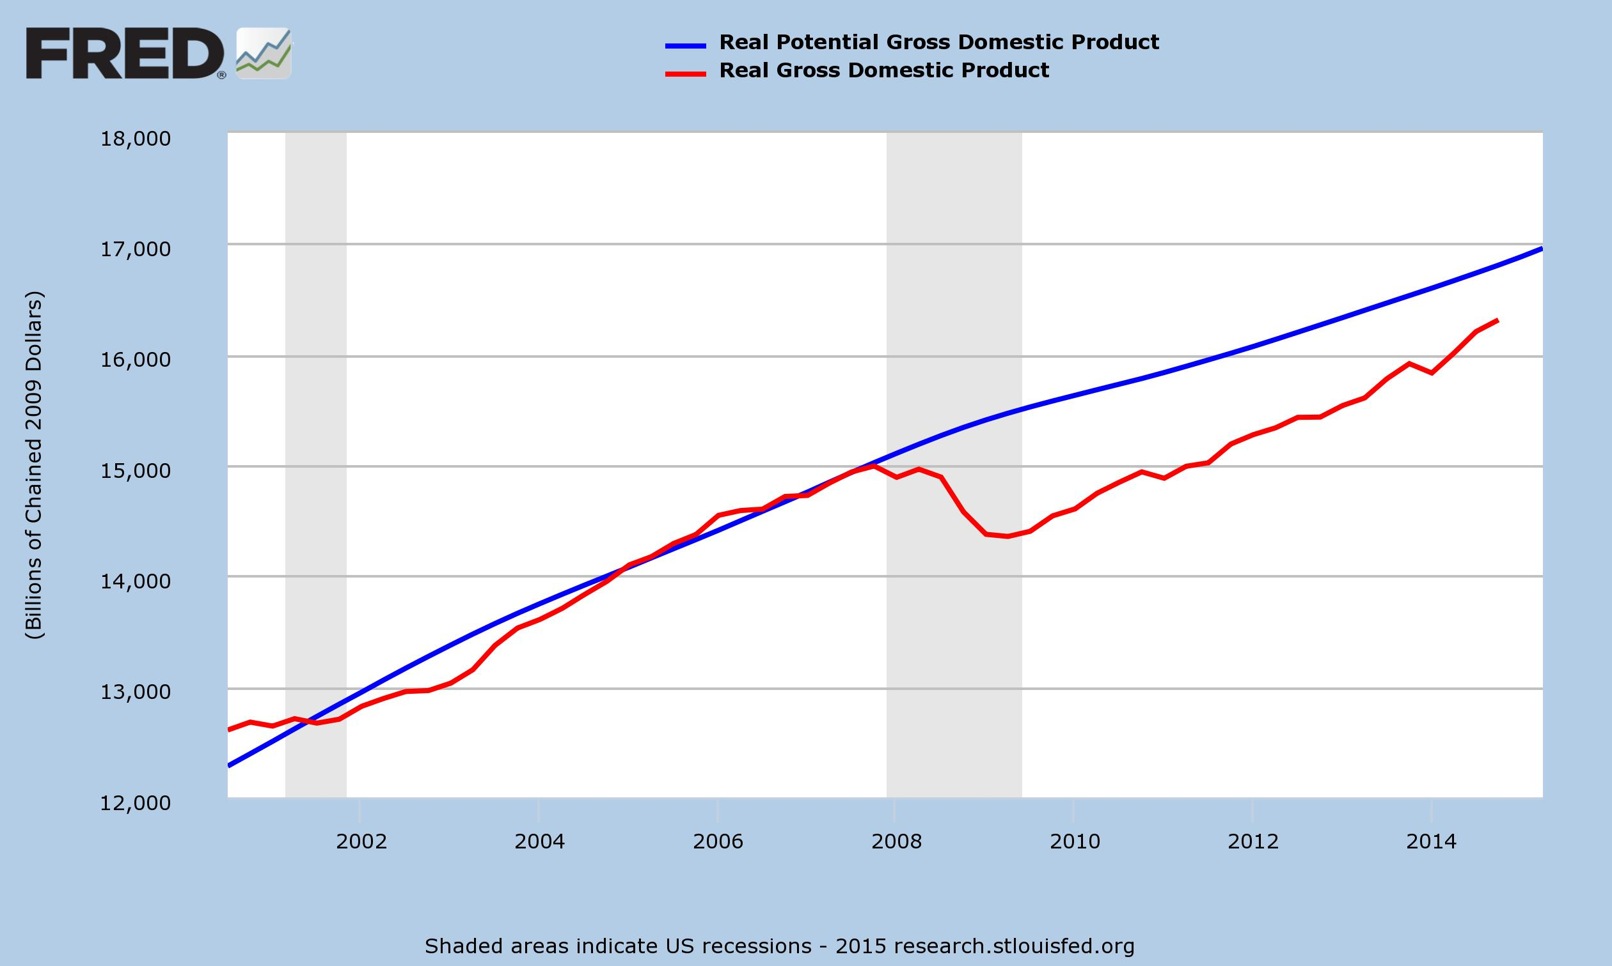
Okun’s Law

Slide 19
Calculate it now!
Key Question #8 on pg 151.
Assume that in a particular year the natural rate of unemployment is 5 percent and the actual unemployment rate is 9 percent. Use Okun’s law to determine the size of the GDP gap in percentage points.
If the potential GDP is $500 billion in that year, how much output is being forgone because of cyclical unemployment?

