Slide 1
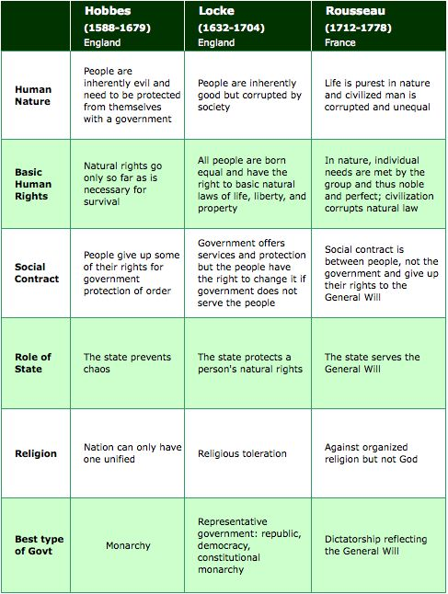

Slide 2
Openers…
Which is better: aggressively screening passengers boarding flights and surrendering freedoms in the name of safety, or holding onto those freedoms (privacy for example) at the expense of safety concerns.

Slide 3
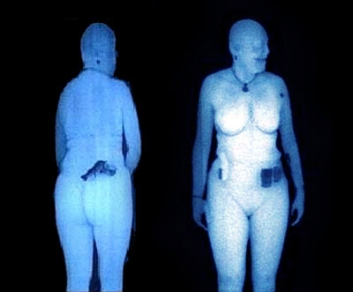

Slide 5
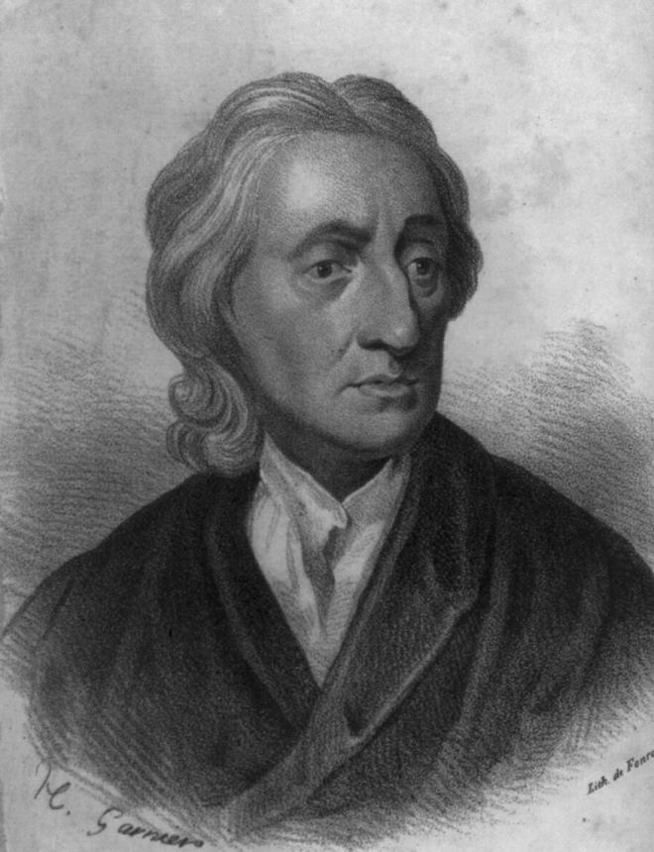
Social Contract Theory
The ideas behind the US government as seen in the Declaration of Independence

Slide 6
Social Contract Theory is about
1. Why people theoretically choose to give up some of their power in order to form a government
2. The purpose of government

Slide 7
Who are the main social contract theorists?
Thomas Hobbes
John Locke
Jean Jacques Rousseau,
All wrote about social contract theory in 1600s & 1700s.

Slide 8
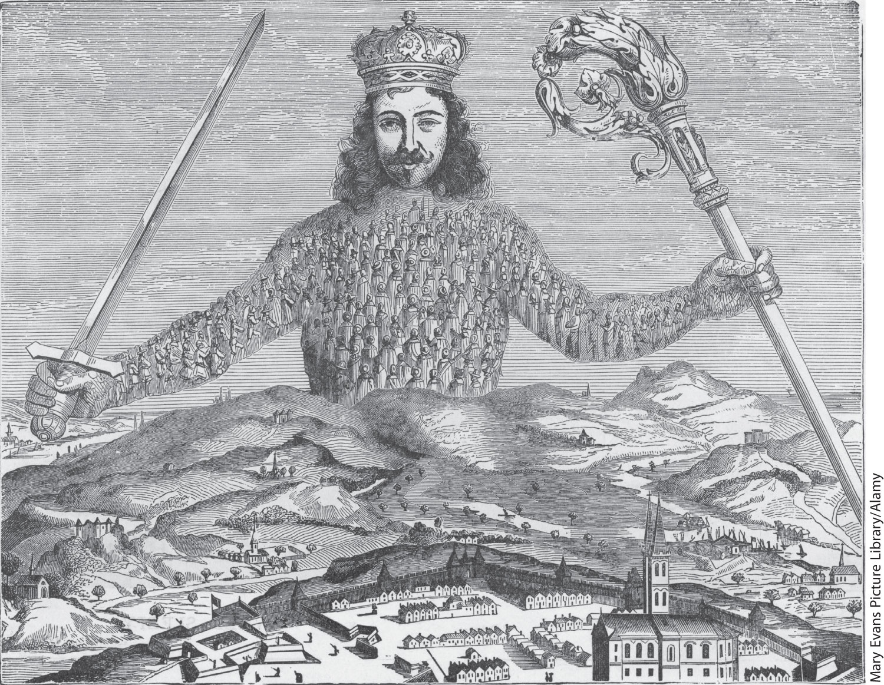
Leviathan, Hobbe’s All-Powerful Sovereign
Notes:
Leviathan, Hobbe’s All-Powerful Sovereign
This engraving is from the 1651 edition of Leviathan, by Thomas Hobbes. It shows Hobbes’s sovereign brandishing a sword in one hand and the scepter of justice in the other. He watches over an orderly town, made peaceful by his absolute authority. But note that the sovereign’s body is composed of tiny images of his subjects. He exists only through them. Hobbes explains that such government power can be created only if people ‘‘confer all their power and strength upon one man, or upon one assembly of men, that may reduce all their wills, by plurality of voices, unto one will.’’
Mary Evans Picture Library/Alamy

Slide 9
Islamic State in Iraq and Syria

Slide 10
John Locke’s ideas are the foundation of the Declaration of Independence

Slide 11
What is this state of nature?

Slide 12
What does “the state of nature” mean?
What life is “naturally” like before people created governments…

Slide 13
According to Locke, in the state of nature everyone
Is equal
Has liberty
Follows “natural laws of reason” -
don’t harm others’ LIFE/HEALTHor
LIBERTY or
PROPERTY / POSSESSIONS
Everyone has to preserve himself and others
Has executive power- everybody has the right to punish others for breaking these natural laws

Slide 14
The state of nature is dangerous!
If everybody has the right to punish people who break the natural laws then what is life like in the state of nature?
Violent! Chaotic!

Slide 15
Jack Johnson and Tom O’Leary

Slide 16
Trade State of Nature for Gov’t
State of nature can easily turn into a state of war, in which nobody’s life, liberty or property is safe. So…
Give up some liberties to leave the state of nature and form a civil society, to form a GOVERNMENT.
You give the GOVERNMENT your executive power to punish people who mess with your life, liberty or property.

Slide 17
The purpose of government according to John Locke is to…

Slide 18
Forming a government to protect yourself from the violence of the state of nature is called...
A social contract

Slide 19
Right to revolution
According to John Locke, people have a right to rebel or change the government when it no longer protects their LIFE, LIBERTY & PROPERTY.
This what the Founding Fathers used as the reason for declaring independence from England.

Slide 20
How does this exist in a modern context?

Slide 21
The Concepts of Freedom, Order, and Equality
Freedom
Freedom of : absence of constraints on behavior
Freedom from: Fight against exploitation and oppression; equality

Slide 22
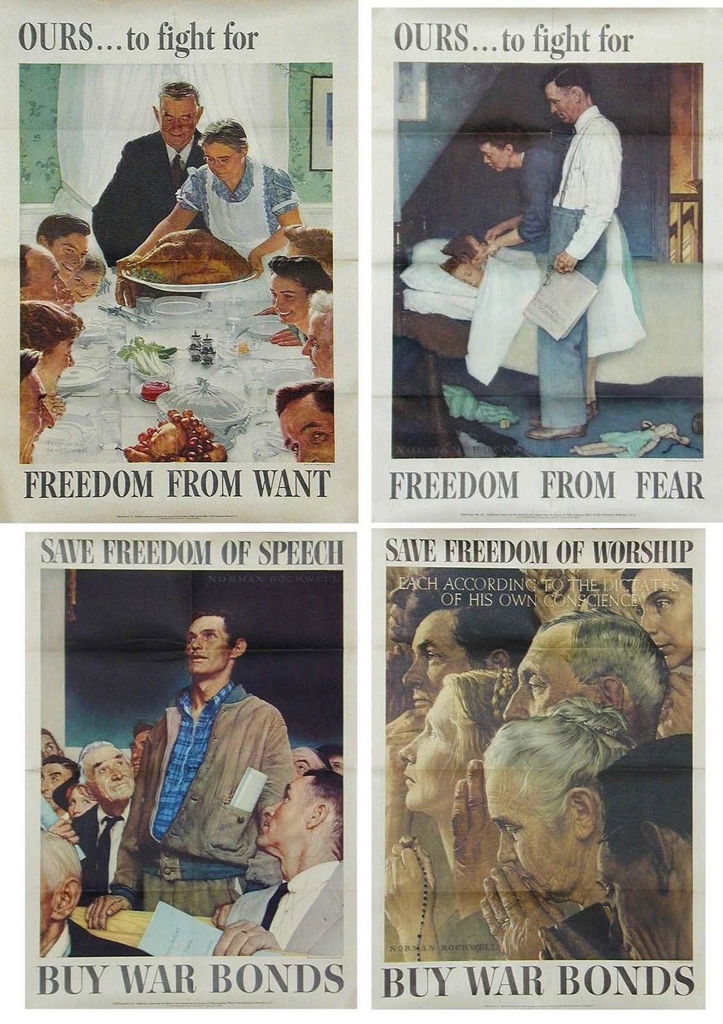
#diversity

Slide 23
The Concepts of Freedom, Order, and Equality
Order
Preserving life and protecting property
Preserving social order
Police power –authority to safeguard residents’ safety, health, welfare, and morals

Slide 24
The Concepts of Freedom, Order, and Equality
Equality
Political equality: one person, one vote
Social equality: wealth, education, and status
Equality of opportunity: each person has the same chance to succeed
Equality of outcome: society must ensure people are equal socially and economically
Government-supported rights

Slide 25
So how do we balance…?
Equality
Order
Freedom

Slide 26
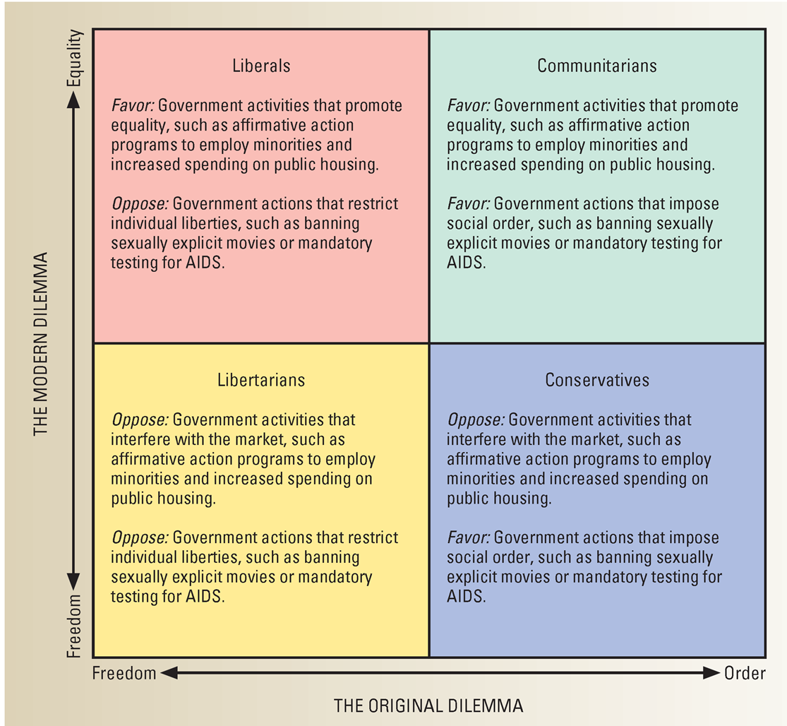

Slide 27
Closer…
Which is better: to let all citizens keep the same share of their income or to tax wealthier people at a higher rate to fund programs for poorer people?

