Slide 1
Presidential Power
Enumerated, Implied, and Theories of Power
How much power is too much?

Slide 2
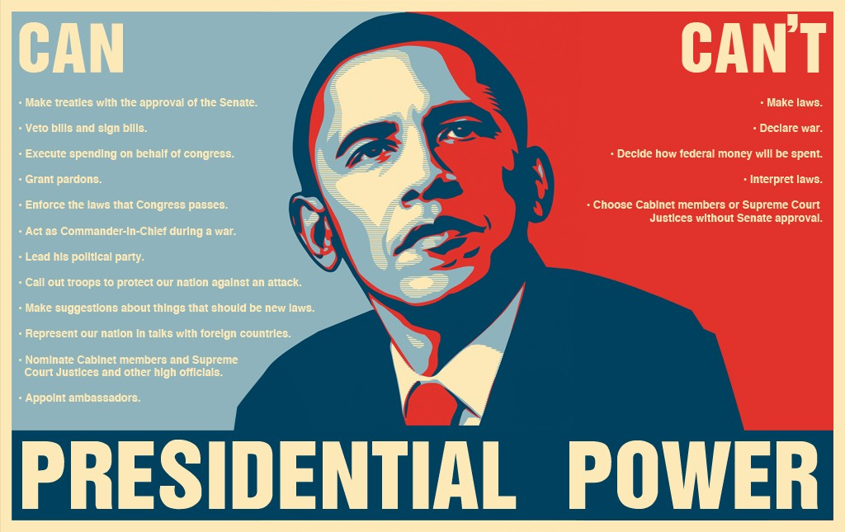

Slide 3
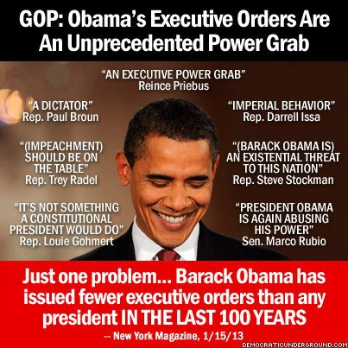

Slide 4
Presidential Unilateral Action
Execution of the laws or legislation?

Slide 5
Types
Executive Orders
Presidential Memoranda
Presidential Proclamations
National Security Directives
Impoundment
Signing statements

Slide 6
Executive Orders
A directive issued to officers of the executive branch, requiring them to take or stop taking an action, alter policy, change management practices, or accept a delegation of authority.

Slide 7
Executive Orders
Informal in history
Pres directs Fed gov’t and bureaucracies.
Carry power of law
Can be revoked or amended by subsequent administrations
Limited in scope,

Slide 8
Examples of Executive Orders
Executive Order 9066: FDR issued on 2/19/1942, authorizing the Secretary of War to prescribe certain areas as military zones.
EO 9066 cleared the way for the deportation of Japanese Americans to internment camps.
Obama Executive Order: just issued EO to raise the minimum wage for workers hired under new federal contracts to $10.10 an hour.

Slide 9
Executive Order: To General Winfield Scott
The military line of the United States for the suppression of the insurrection may be extended so far as Bangor, in Maine. You and any officer acting under your authority are hereby authorized to suspend the writ of habeas corpus in any place between that place and the city of Washington.
ABRAHAM LINCOLN.
By the President:
October 14, 1861

Slide 10
Executive Orders SCOTUS found Unconstitutional
Youngstown Sheet and Tube v. Sawyer 343 U.S. 579 (1952)
Truman's 1952 Executive Order # 10340 unconstitutional. The order asserted President's Commander-in-Chief power to authorize government seizure and operation of steel mills in order to prevent a work stoppage during wartime.

Slide 11
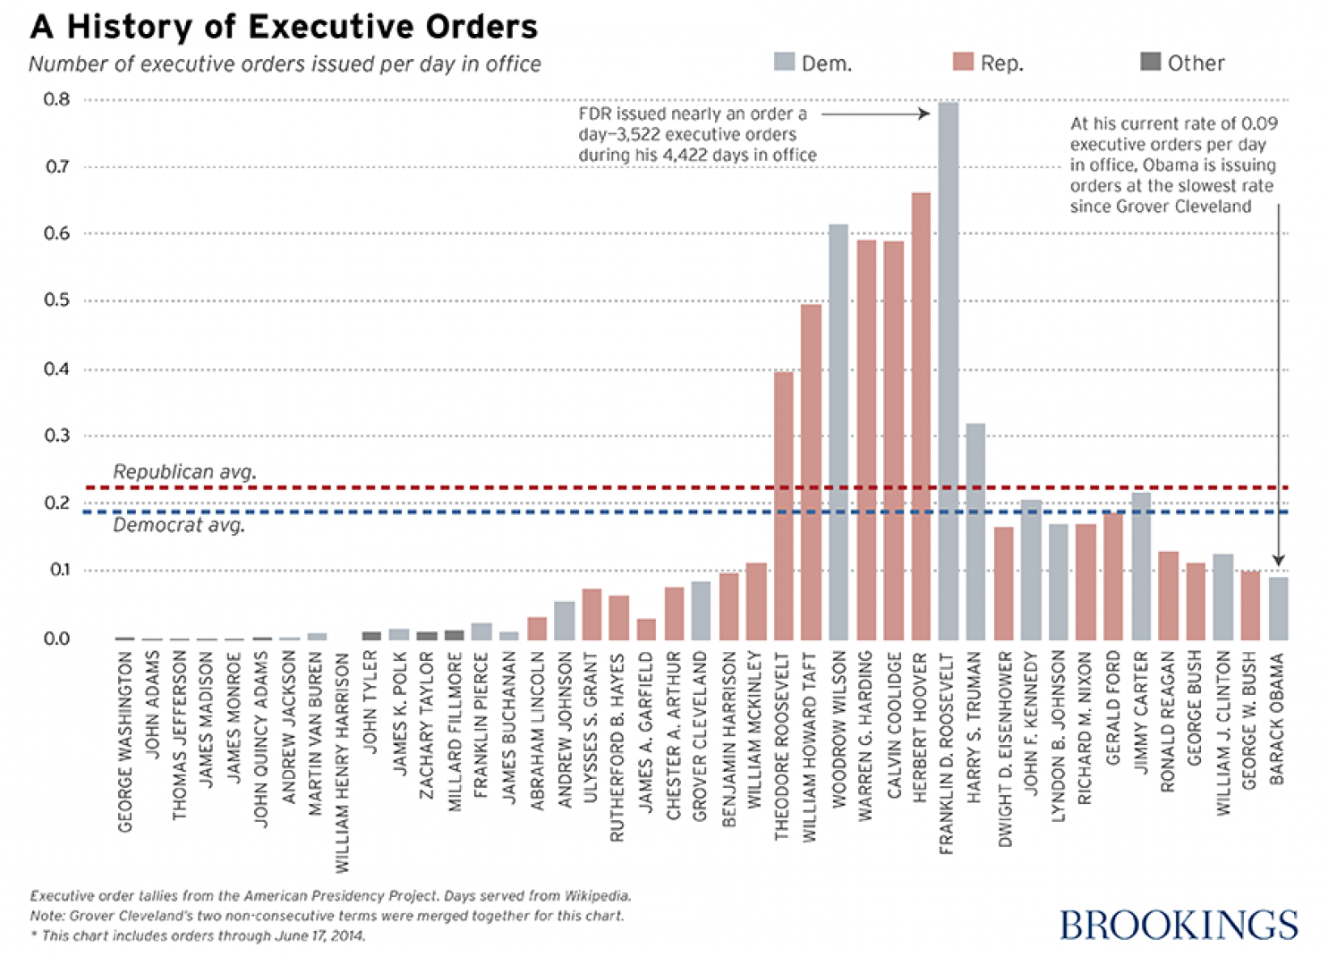
Average Executive Orders per year (Washington through Obama)

Slide 12
Presidential Proclamations
States a condition, declares law and requires obedience, or recognizes an event. (Also pardons)
Binding on the public.
Published in the Federal Register

Slide 13
Presidential Memoranda
Pronouncement directed to executive branch officials
No publication in Federal Register
Below the radar of media

Slide 14
National Security Directives
Formal declaration to an agency or department head of a presidential national security decision, requiring follow-up.
Designed at the National Security Council
Not published.
Mostly classified.
Congress exclusion

Slide 15
Impoundment
The president refuses to spend funds appropriated by Congress
Congress has restricted this practice (1974, 1987)
He can only defer spending if:
A “special contingency”
To achieve savings through more efficient operations
He can only propose to permanently rescind funds, but Congress must approve within 45 days

Slide 16
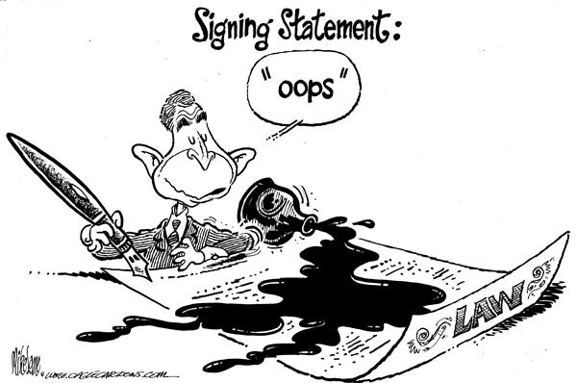

Slide 17
Signing Statements
Traditionally innocuous
Since 1980s, provide the president’s interpretation of a law, announce Constitutional limits on implementation of it, or indicate directions about how to administer it.
Since 1986, part of official legislative history
Used as de facto line item veto since Reagan

Slide 18
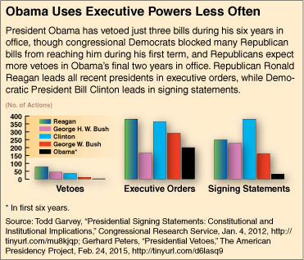

Slide 19
Your turn!

Slide 20
Why take unilateral action?

Slide 21
Why take unilateral action?
Quick in an emergency situation
Pay debts to important groups without committing many resources
Don’t attract much attention
Signing statements prevent vetoes of complex/end of session legislation

Slide 22
Problems?

Slide 23
Why not take unilateral action?
Contribute to accumulation of power in executive hands
Make it more difficult for successors to govern
Undermine existing administrative law procedures

Slide 24
Theories of Presidential Powers
Who is this creepo?

Slide 25
In your opinion which is the most appropriate?
Abraham Lincoln
Theodore Roosevelt
William Howard Taft
Prerogative Theory
When nation is at stake, POTUS may take any action necessary, regardless of Constitutional legality
Stewardship Theory
POTUS, representing the entire nation, must act as a steward
Restricted or Literalist Theory
POTUS only allowed to exercise powers granted by Constitution or Statutory Laws

