Slide 1
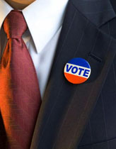
Whether to Vote: A Citizen’s First Choice
Deciding Whether to Vote
Legitimacy-
Political Efficacy:
Civic Duty:

Slide 2
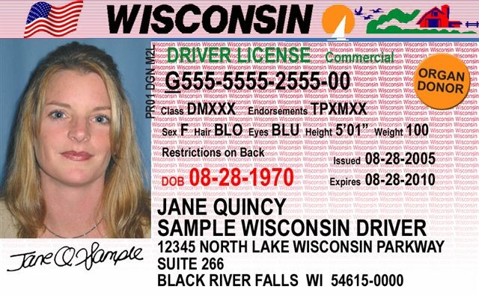
Registering to Vote
In 1888, West Virginia had 159,000 votes but only 147,000 eligible voters
States adopted voter registration to prevent fraud (North Dakota has no registration)
Biggest indicator of voting is voter registration
Motor Voter Act 1993 required states to offer voter registration when citizens obtain their driver’s licenses.
Recent proposals would require ID

Slide 3
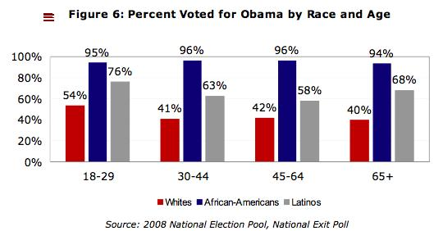
Whether to Vote: A Citizen’s First Choice
Who Votes?
These factors increase the likelihood of voting:
Age
Income
Education
Marriage
Caucasian
Female
Union Member
Government Worker
Northerner

Slide 4
Sample Question
Which of these would be most likely to vote?
A. a middle-aged professor at a private university
B. a young southerner without a high school diploma
C. a northerner with a high school diploma who is a union member
D. a 63-year-old government worker with a doctorate
E. a well-educated senior citizen who used to work for a big corporation
Answer: D

Slide 5
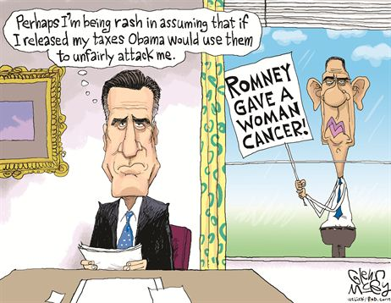
The Evolution of Campaigning
Candidate Centered Election

Slide 6
Nominations
Nomination for Congress and State Offices
Primary Election
Utilized by 40 states to nominate candidates for all state and national offices
Closed primaries
Open primaries
Modified

Slide 7
Nominations
Nomination for President
Each party chooses presidential nominee at national convention
Selecting convention delegates
Presidential primary
Caucus/convention
Campaigning for the Nomination

Slide 8
http://www.c-spanclassroom.org/Video/341/Iowa+Democratic+Presidential+Caucus.aspx

Slide 9
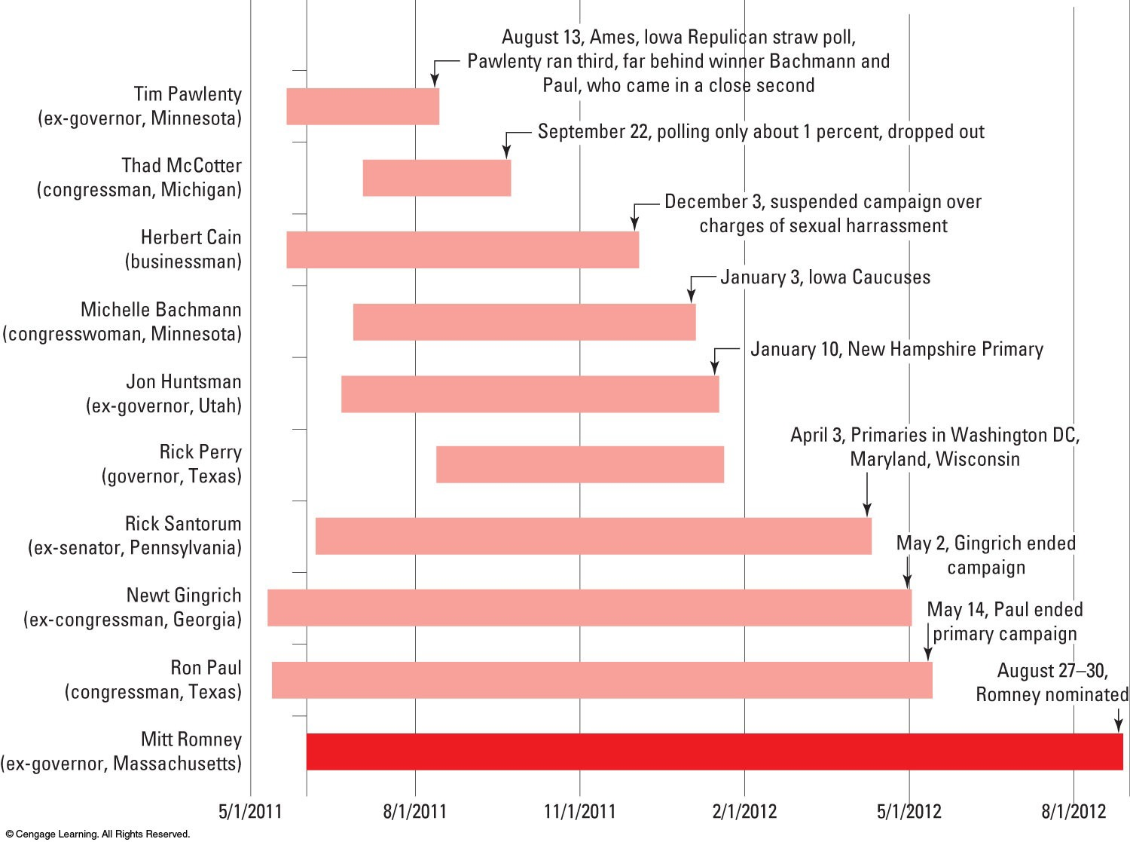
Notes:
Figure 9.1 From Many to Two: Presidential Hopefuls Starting and Dropping Out
Over three hundred candidates filed with the Federal Election Commission (FEC) to run for president in 2012. The graph lists the ten Republicans who filed with the FEC as presidential candidates and who received significant early attention. As usual, some candidates withdrew before the delegate selection process began and others dropped out afterward for lack of support. By late January, only four hopefuls were competing in the numerous televised debates.
Source © Cengage Learning

Slide 10
Making candidates campaign…
With no incumbent, nominating process is contested in BOTH
An incumbent POTUS encounters little to no intraparty opposition
Many candidates seek the nomination
Iowa and New Hampshire DO matter
Favored by most = party’s nomination
Little owed to the party…

Slide 11
The Mandate Theory of Elections
The Mandate Theory of Elections is
Policy voting is
Retrospective voting is

Slide 12
Elections
Presidential Elections and the Electoral College
The Electoral College: Structure
The Electoral College: Politics
The Electoral College: Abolish It?
More on this Later…

Slide 13
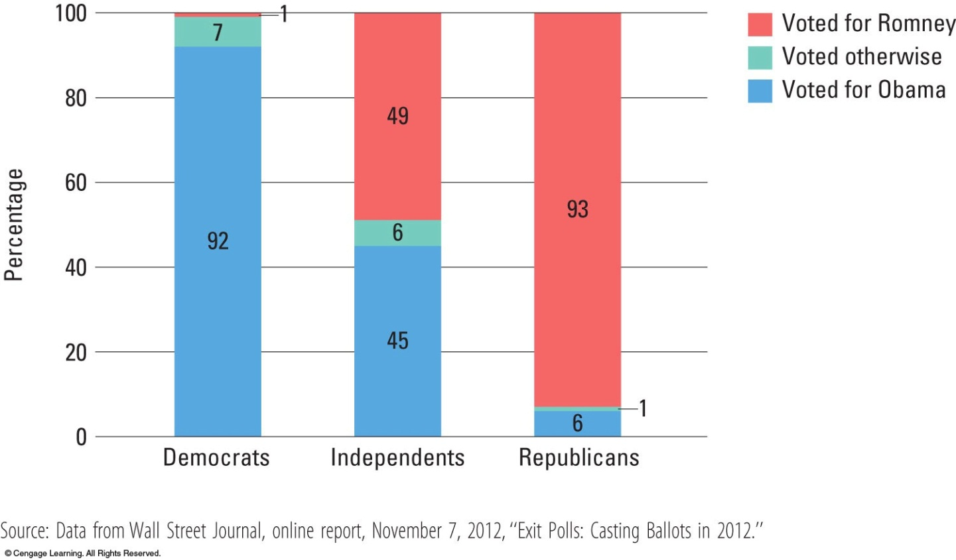
Explaining Voting Choice
Party Identification
Most of electorate decides vote before party conventions, generally based on party identification
Notes:
Figure 9.4 Effect of Party Identification on the Vote, 2008
The 2008 election showed that party identification still plays a key role in voting behavior. The chart shows the results of exit polls of thousands of voters as they left hundreds of polling places across the nation on election day. Voters were asked what party they identified with and how they voted for president. Those who identified with one of the two parties voted strongly for their party’s candidate.
Source: Data from Bob Davis, “Voters Cast Their Ballots With the Economy in Mind, Exit Polls Indicate,” Wall Street Journal, NOVEMBER 5, 2008, http://online.wsj.com/article/SB122584499389399483.html#articleTabs%3Dinteractive.

