Slide 1
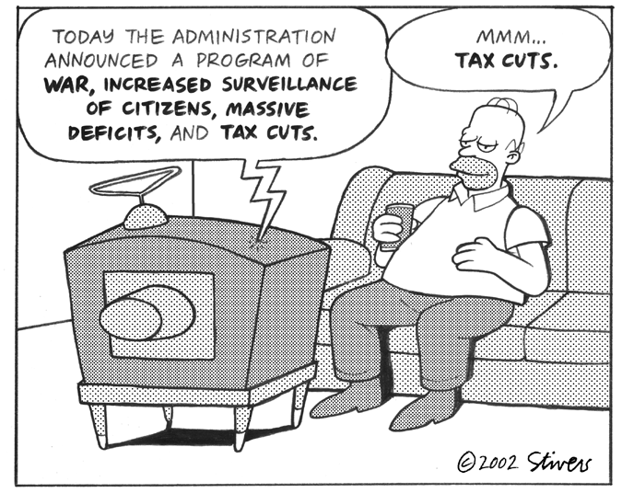
Making Public Policy

Slide 2
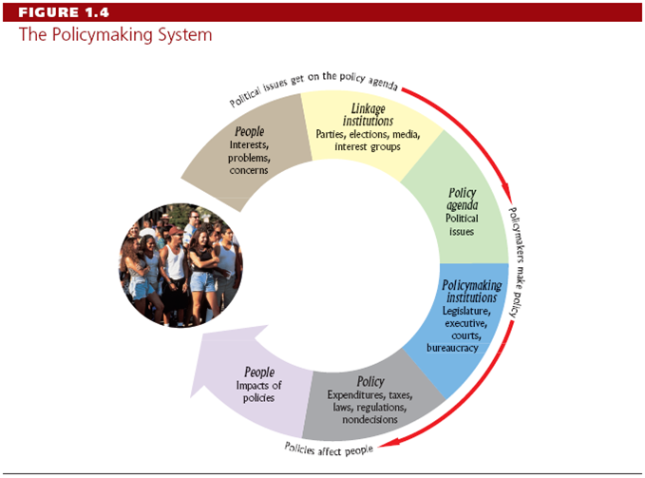

Slide 3
Political Agenda
Def: Decide what to decide
  Very short until 1930’s
    EX: taxes, energy, welfare, civil rights
“He who decides what politics is about, runs the country”

Slide 4
1) Shared political values
If…
  the majority of Americans feel poverty is caused by individuals, NOT social forces
Then…
  there will be no strong government movement to fight poverty

Slide 5
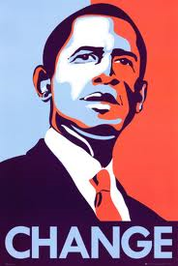
2) Custom & Tradition
“The devil you know is better than the devil you don’t know”

Slide 6
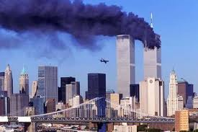
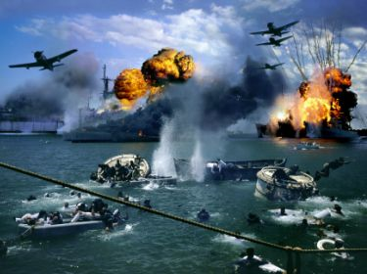
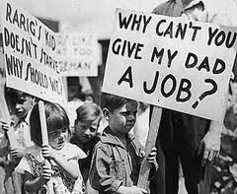
3) Events
War, Depression, Terrorism

Slide 7
4) Behavior of Political Elites
Changes in the thinking and speaking of…
  Politicians
  Judges
  Party Officials
  Media
    Expansion of government has been bi-partisan

Slide 8

Influence
Groups
  MADD
Institutions
  Supreme Court
Media
States

Slide 9
Cost / Benefit
How policies affect people
  Ex: Who is affected by new pollution restrictions for General Motors???

Slide 10
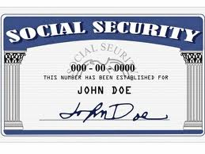
Majoritarian Politics
Def: a policy in which almost everybody benefits and almost everybody pays
  Social Security

Slide 11
Interest Group Politics
Def: a Policy in which one small group benefits and another small group pays
  EX: Labor Unions v Managements

Slide 12
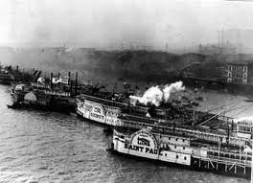
Client Politics
Distributed Cost→ Concentrated Benefits
  EX: Pork Barrel legislation→ local interests
    (rivers & Harbors)
      Result of Logrolling

Slide 13
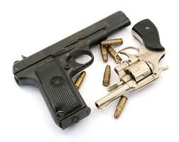
Entrepreneurial Politics
Large part of society benefits from a policy that imposes a cost to a small minority
Difficult to pass because a determined minority can stop it
  EX: Brady Handgun Bill, Anti-Pollution Bill

Slide 14
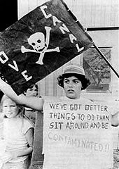
Superfund
Environmental clean-up program developed in response to Love Canal, Buffalo, NY

Slide 15
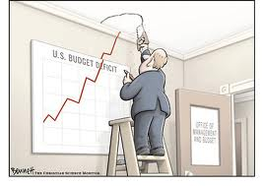
Economic Policy
The Government has spent more money than it has taken in every year since 1960.
WHY???

Slide 16
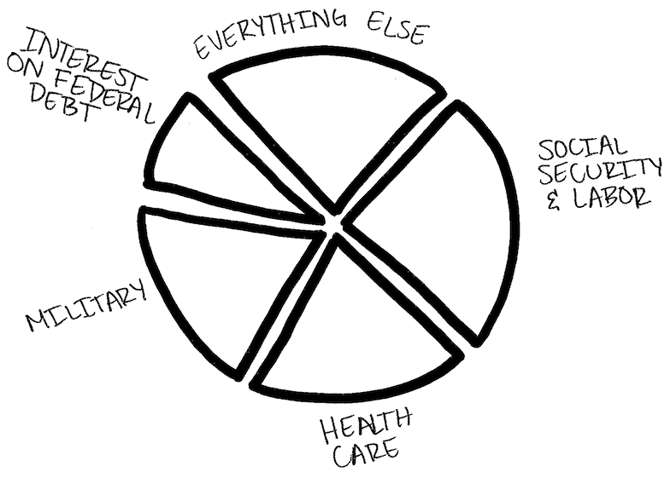

Slide 17
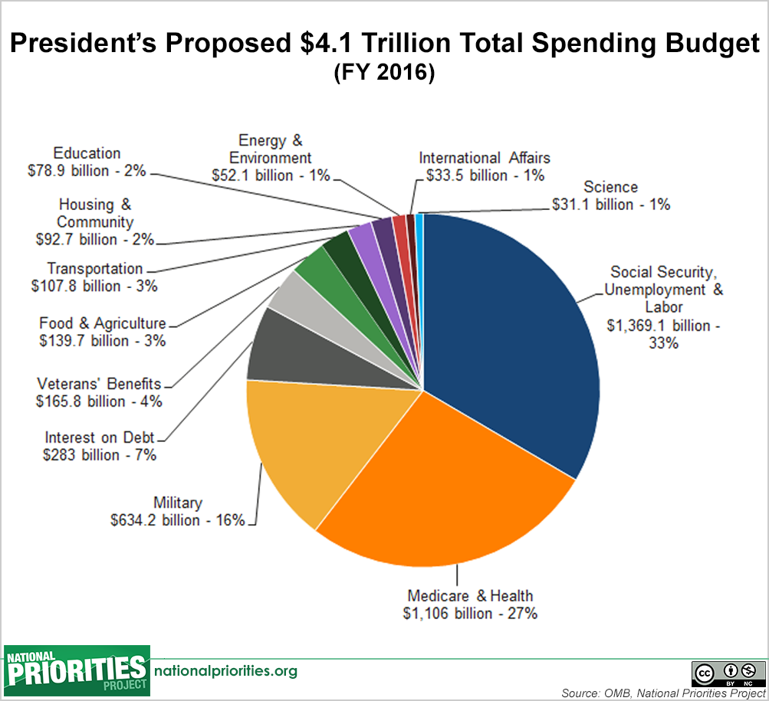
https://www.nationalpriorities.org/interactive-data/trade-offs/

Slide 18
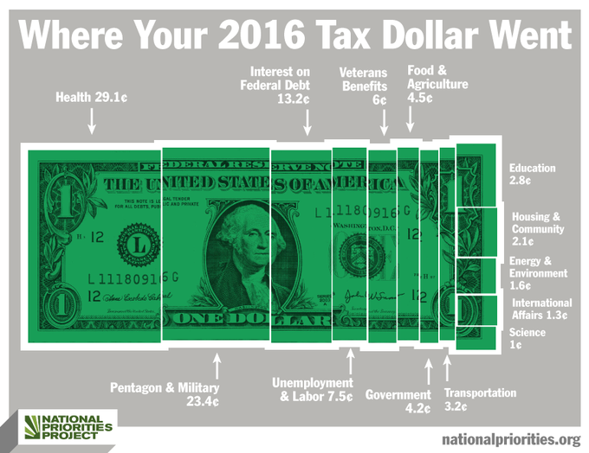

Slide 19
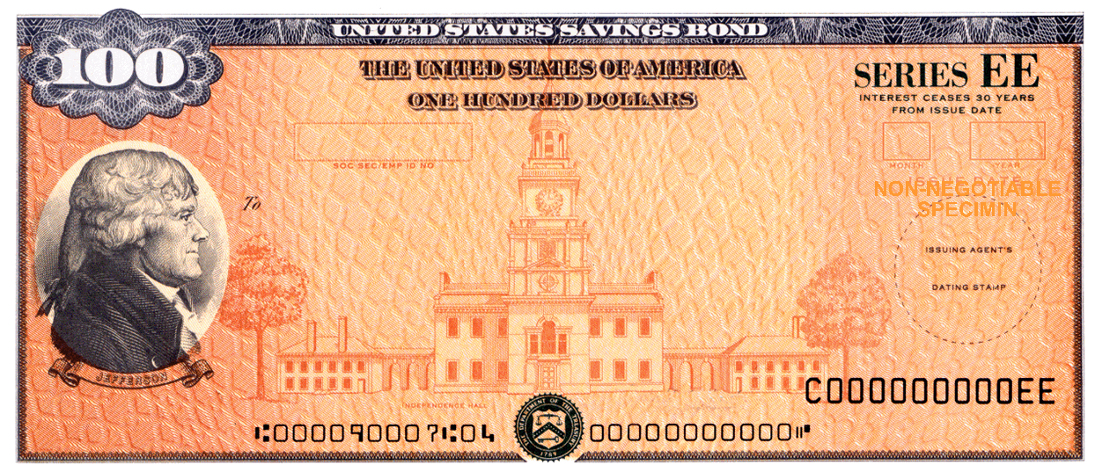
Economic Reasons
Treasury bonds
Only the interest must be paid
  10% is less than families pay on car payments, mortgage, or school loans

Slide 20
Political Reasons
Conservatives want lower taxes & fewer services
Liberals want more services & higher taxes
    Stalemate leads to no change

Slide 21
Definitions
Deficit: When the government spends more than it raises in taxes in a given year
National debt: the sum of all deficits
Gross domestic product: The total of all goods and services produce in the economy during a given year

Slide 22
Politics of Economics
Why do people care about other people’s jobs almost as much as their own when voting for a candidate????

Slide 23
Politics of Economics
What can the elected officials do to affect the Economy????

Slide 24
Politics of Economics
What can the elected officials do to affect the Economy????
Either control inflation OR Unemployment
Keep taxes low OR Create jobs
Keep taxes low OR Reduce the deficit

Slide 25
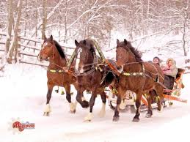
Troika
Council of Economic Advisors (CEA)
Office of Management and Budget (OMB)
Secretary of the Treasury

Slide 26
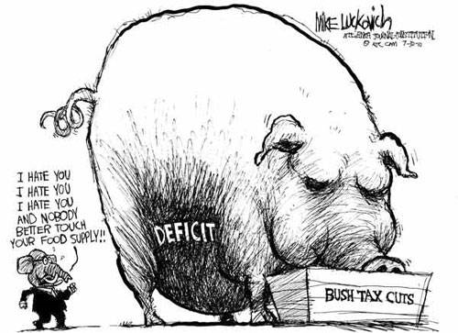
Definitions
Monetary Policy – managing the economy by altering the supply of money and interest rates. WHOSE JOB??
Fiscal Policy – managing the economy by the use of tax and spending laws. WHOSE JOB??

Slide 27
Federal Budget
Def: Document that states tax collections, spending levels, and the allocation of spending among purposes
  Congressional Budget Act of 1974
    Budget must be submitted to Congress in February
    House Budget Committee analyzes
    Senate Budget Committee analyzes
    Congressional Budget Office analyzes
      Approved and sent back to president to sign in May

Slide 28
Definition
Entitlements- A claim for government funds that cannot be changed without violating the rights of the claimant.
  Social Security, Medicare, Veterans’ Affairs, Food Stamps
Discretionary Spending-Spending that is not required to pay for contracts, interest on the national debt, or entitlement programs

Slide 29
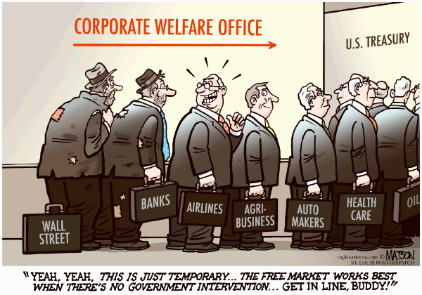
Social Welfare

Slide 30
Social Welfare Programs
Program | Medicare Social Security Unemployment | Food Stamps Temporary Assistance to Needy Families Supplemental Security Income Medicaid Earned Income Tax Credit (1975 law that gives working families w children money if their income is below certain level)
Type | Majoritarian- Nearly everyone pays, nearly everyone benefits | Client- Few benefits, nearly everyone pays
Means Tested? | Not means tested- All incomes | Means tested- Certain incomes
Biggest Problem | Who will pay? How much will they pay? | Who should benefit? How should they be served

Slide 31
Problems
Number and cost receiving Social Security benefits has sharply increased
So politically unpopular that cancelling SS is rarely discussed
  What are the solutions for fixing the problem of funding for social security?
    Pg. 515

Slide 32
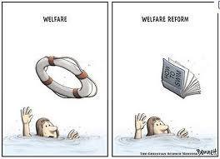
Aid to Families with Dependent Children (ADFC)
Supported after WWII, on a temporary basis
Program was cancelled in the 1990’s
  Public viewed that people were taking advantage

Slide 33
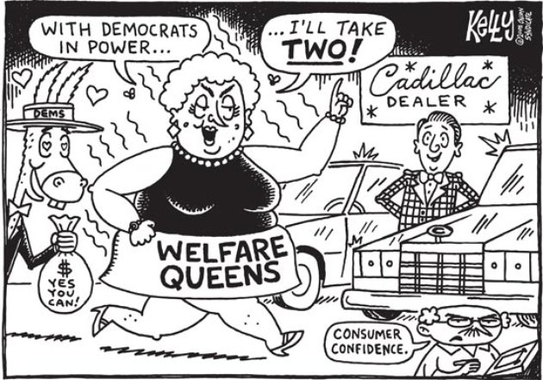
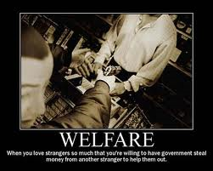
1. Who is entitled to welfare
Who deserves benefits?
How much is fair?

Slide 34
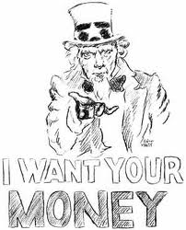
2. America is slower to give…
Americans hate giving away their money
  How does America compare to other modern nations in welfare?

Slide 35
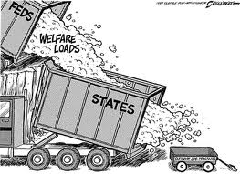
3. Federalism
Welfare not specified in the US Constitution
States began to use welfare before nation
  When did the nation start to give out welfare??

Slide 36

4. Non-Governmental Agencies
Non-governmental / Non-profit agencies compete for grants in order to deliver welfare programs
  Charitable choice

Slide 37
*Def
Insurance Program- A self-financing government program based on contributions that provide benefits to unemployed or retired persons
Assistance Program-A government program financed by general income taxes that provides benefits to poor citizens w/out requiring contribution from them

Slide 38

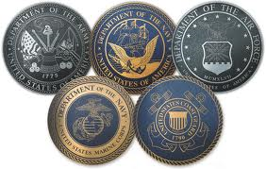
Military &
Foreign Policy
When and why does America get involved???

Slide 39
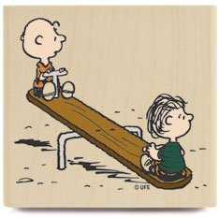
When and why does America get involved???
How democratic is the other nation?
What is the potential cost?
What is the potential cost?

Slide 40
How can America get involved???
Military occupation
Military assistance/ alliance
Military AID
Trade Agreements
Trade Embargo
Tariffs
Blockade
Which are majoritarian/client

Slide 41
Majoritarian | Client
Decided by President | Decided by Congress

Slide 42
Foreign Policy in the Constitution
President | Congress
Commander in Chief | Appropriate Funds
Appoints Ambassadors | Confirms Appointments
Negotiates Treaties | Ratifies Treaties
Deploys Troops | Declares War
Controls Departments State Defense CIA NSA FBI | Regulate International Commerce
Executive Agreements

Slide 43
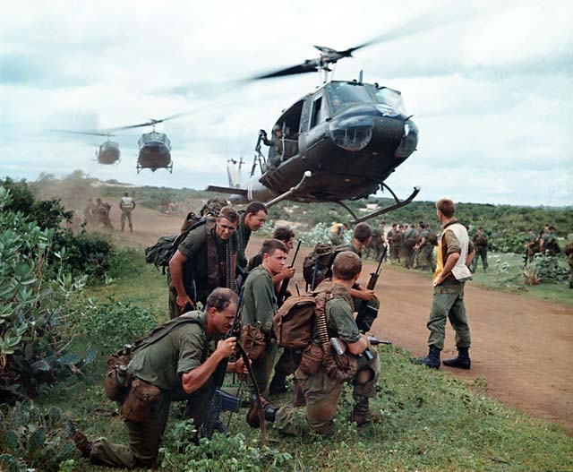
Presidential Strengths and Weaknesses
President always given the benefit of doubt
Additional Presidential actions/ inactions on pg 528-529

Slide 44
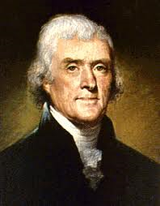
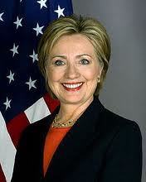
Secretary of State
Originally the major decision maker on foreign policy
  President gradually gained power
  Foreign policy bureaucracy
    CIA,FBI,NSA,DEA,NSC, DNI

Slide 45
Public Opinion
Heavily influenced by political elites
  Media, Gov Agencies, College Professors
Pre-WWII → Isolation
  Tradition
Post-WWII → Continued US force
  Unanimously Supported/Successful/Dominant
‘Rally Around the Flag’
  Pearl Harbor/ Bay of Pigs/ 9-11
Vietnam War
  At the beginning →College (+) / No College (-)
  At the end→ College (-) / No College (+)

Slide 46
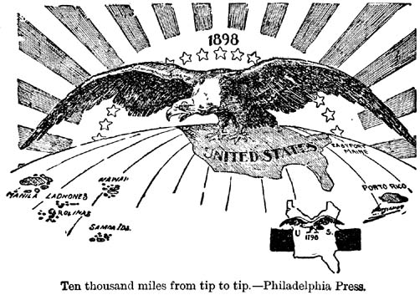
Human Rights
Does the US have the right/responsibility to intervene in cases of genocide/human rights violations?
  If so…at what point & how much

Slide 47
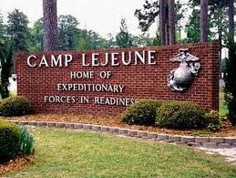
Military Spending
A) Personnel
B) Big Ticket Items
  Battleships
C) Readiness
D) Bases

Slide 48
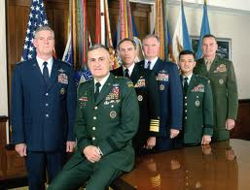
Joint Chiefs of Staff
Representatives from..
  Marine Corps, Army, Navy, & Air Force
  Responsible for strategy

Slide 49

Environmental Policy
MOST love the environment but Few are willing to change their lifestyles to protect it…
Examples???

Slide 50
Problems & Conflicts
1. MOST love the environment but Few are willing to change their lifestyles to protect it…
2. Scientific uncertainty
  Is global warming man-made or natural???
3. A few loud activists may create a few villains & distort public opinion
4. Conflict in views and regulations between states and other countries

Slide 51
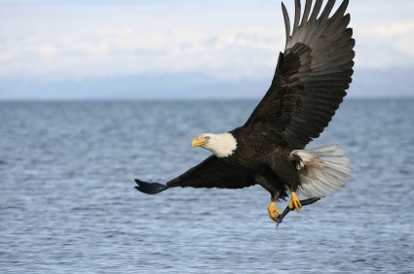
Environmental Protection Agency (EPA)
Created in 1970 in response to 1969 oil spill
  Enforce environmental laws
    Clean Air Act (1990)
    Water Quality Improvement Act (1985)
    Endangered Species Act (1973)

Slide 52
Environmental Policy
Acid Rain | Entrepreneurial
Pollution from Automobiles | Majoritarian
Agricultural Pesticides | Interest group
Industrial Pollution | Client Politics
Global Warming | Entrepreneurial

