Slide 1
Inflation

Slide 3
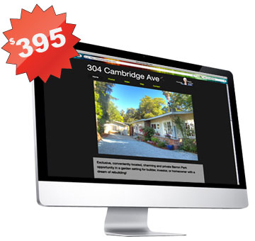
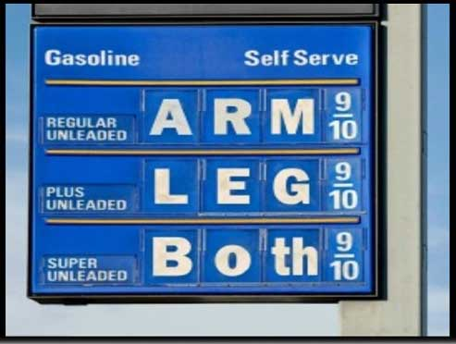
Definition…
Put simply… it is the RISE in overall PRICE LEVEL
While individual prices may go up and down, it is the general price level that matters most.

Slide 4
Purchasing power of the $ is a key measure…
When I was your age…
Can of soda was $.50
Now it costs $1.25 - $1.50

Slide 5
Types of Inflation (#1)
Anticipated inflation
Level of inflation people expect to occur and already built into their economic decisions
To plan for this workers will demand higher wages to keep their purchasing power the same as prices rise
Unanticipated inflation
Level of inflation that is not expected or is unforseen
Causes a redistribution of money in the economy because people haven’t prepared

Slide 6
Unanticipated Inflation hurts/helps…
Borrowers gain / lenders lose
Money being paid back at a later date buys less
This is why it might be a good time to buy a house (actually, last summer was!)
People on fixed incomes
Prices go up, and purchasing power goes down
Government borrows money
They are biggest borrower of money in the economy and gain from inflation (even though they are trying to prevent it!)

Slide 7
Consider interest Rates and inflation…
It doesn’t always follow that a people who borrow money will gain from inflation!
We have to consider nominal and real interest rates
If the nominal interest rate on a loan is 8% and the inflation rate is 5% then the REAL INTEREST RATE is ????????
Remember… Nominal is just the number as it appears
“real” is that number adjusted for inflation!

Slide 8
Who is Hurt and Who is helped by unanticipated Inflation?
H = the person or group is HURT by unanticipated inflation
G = the person or group GAINS from unanticipated inflation
U = it is UNCERTAIN if the person or group is affected by unanticipated inflation (explain how they might be HURT or how they might GAIN)
In-Class assignment… GO!

Slide 9
Questions…
Banks extend many fixed-rate loans
A farmer buys machinery with a fixed-rate loan to be repaid over a 10-year period
Your family buys a new home with an adjustable-rate mortgage
Your savings from your summer job are in a savings account paying a fixed rate of interest

Slide 10
Questions…
5. A widow lives entirely on income from fixed-rate corporate bonds
6. A retired couple lives entirely on income from a fixed-rate pension the woman recieves from her former employer
7. A retired man lives entirely on income from Social Security
8. A retire bank official lives entirely on income from stock dividends

Slide 11
Questions…
The federal government has a $14 trillion debt
A firm signs a contract to provide maintenance services at a fixed rate for the next five years
A state government recieves revenue mainly from an income tax
A local government receives revenue from fixed-rate license fees charged to businesses

Slide 12
Questions…
Your friend rents an apartment with a three year lease.
A bank has loaned millions of dollars for home mortgages at a fixed rate of interest.
Parents are putting savings for their child’s college education in a bank savings account.

Slide 13
The Costs of Unanticipated inflation
Everyone can plan for “anticipated inflation” by adjusting their spending/costs/etc.
Unanticipated inflation becomes a problem because of three sets of costs…
Shoe leather costs
Menu costs
Unit of account costs

Slide 14
Test it out!
Situation | Shoe leather costs | Menu costs | Unit of account costs
Your favorite local restaurant raises its prices and has to print new advertisements
Workers in Germany in 1922 are paid and shop three times a day due to hyperinflation
You have to change your automatic bill payment in your online banking account because the rent for your apartment went up
You remember when the price of gasoline was $1.25 per gallon
You work at your local grocery store and place new higher price stickers on the store’s shelves
Your weekly grocery bill increases, but the amount of groceries you purchase does not

Slide 15
For tomorrow!
Calculating Price Indicies
Converting nominal GDP to real GDP
rGDP per capita
Is the CPI a good measure?
Cost-Push inflation and Demand-pull inflation
Alternative measures for inflation (not CPI, but PPI, GDP deflator)

Slide 17
Price Indexes and the Aggregate Price Level
The aggregate price level is a measure of the overall level of prices in the economy.
To measure the aggregate price level, economists calculate the cost of purchasing a market basket.
A price index is the ratio of the current cost of that market basket to the cost in a base year, multiplied by 100.
Section 3 | Module 15

Slide 18
Calculating the Cost of a Market Basket
Calculating GDP and Real GDP in a Simple Economy
Section 3 | Module 15

Slide 19
Inflation Rate, CPI, and other Indexes
The inflation rate is the yearly percentage change in a price index, typically based upon Consumer Price Index, or CPI, the most common measure of the aggregate price level.
The CPI measures the cost of the market basket of a typical urban American family.
Section 3 | Module 15

Slide 20
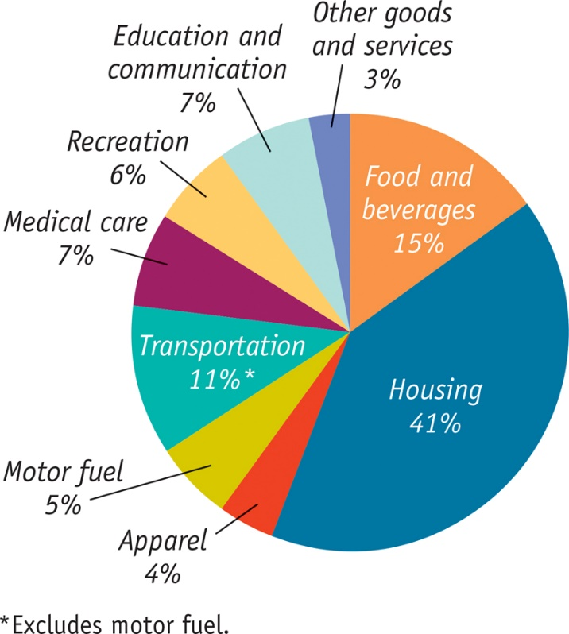
The Makeup of the Consumer Price Index in 2012
Section 3 | Module 15

Slide 21
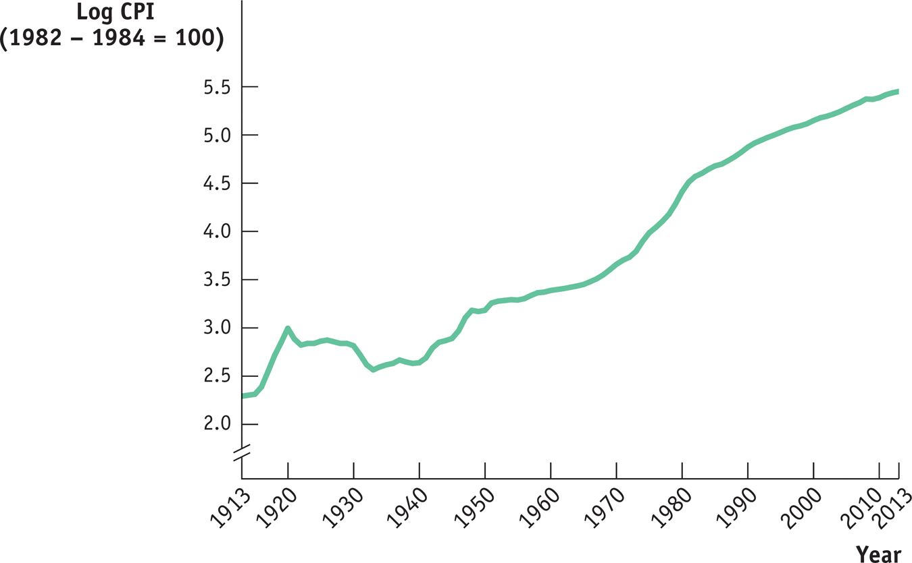
The CPI, 1913 – 2013
Section 3 | Module 15

Slide 22
Other Price Measures
A similar index to CPI for goods purchased by firms is the producer price index.
Economists also use the GDP deflator, which measures the price level by calculating the ratio of nominal to real GDP.
The GDP deflator for a given year is 100 times the ratio of nominal GDP to real GDP in that year.
Section 3 | Module 15

Slide 23
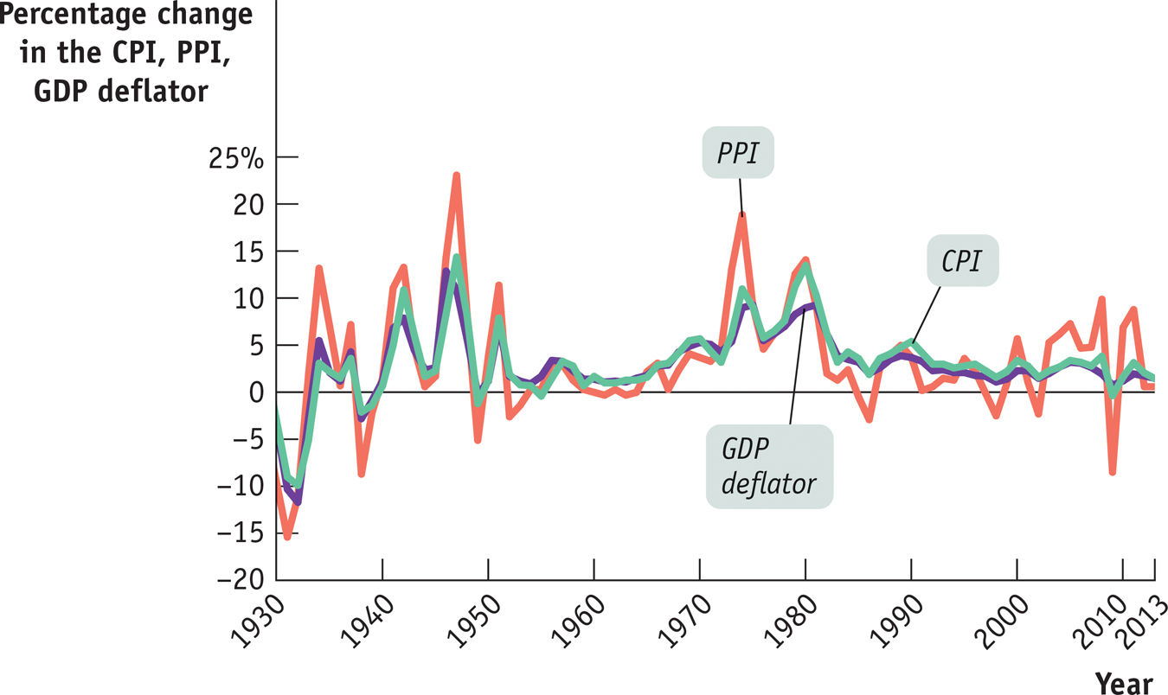
The CPI, the PPI, and the GDP Deflator
Section 3 | Module 15

Slide 24
Formulas to know!

Slide 25
How do we measure Inflation?
CPI
Core CPI
Producer Price Index
GDP Deflator

Slide 26
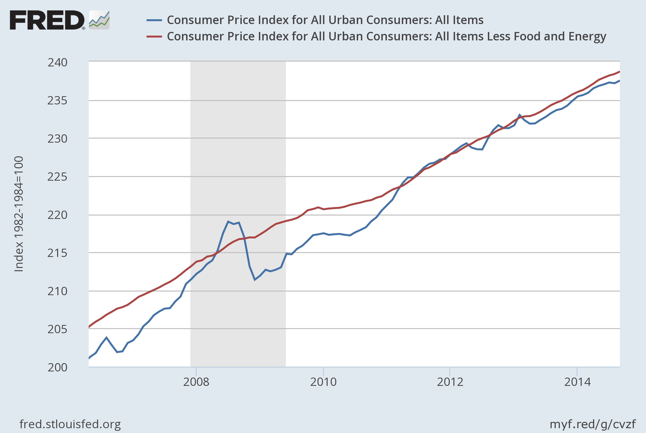
Notes:
Source: U.S. Bureau of Labor Statistics Release: Consumer Price Index The Consumer Price Index for All Urban Consumers: All Items (CPIAUCSL) is a measure of the average monthly change in the price for goods and services paid by urban consumers between any two time periods.(1) It can also represent the buying habits of urban consumers. This particular index includes roughly 88 percent of the total population, accounting for wage earners, clerical workers, technical workers, self-employed, short-term workers, unemployed, retirees, and those not in the labor force.(1) The CPIs are based on prices for food, clothing, shelter, and fuels; transportation fares; service fees (e.g., water and sewer service); and sales taxes. Prices are collected monthly from about 4,000 housing units and approximately 26,000 retail establishments across 87 urban areas.(1) To calculate the index, price changes are averaged with weights representing their importance in the spending of the particular group. The index measures price changes (as a percent change) from a predetermined reference date.(1) In addition to the original unadjusted index distributed, the Bureau of Labor Statistics also releases a seasonally adjusted index. The unadjusted series reflects all factors that may influence a change in prices. However, it can be very useful to look at the seasonally adjusted CPI, which removes the effects of seasonal changes, such as weather, school year, production cycles, and holidays.(1) The CPI can be used to recognize periods of inflation and deflation. Significant increases in the CPI within a short time frame might indicate a period of inflation, and significant decreases in CPI within a short time frame might indicate a period of deflation. However, because the CPI includes volatile food and oil prices, it might not be a reliable measure of inflationary and deflationary periods. For a more accurate detection, the core CPI (Consumer Price Index for All Urban Consumers: All Items Less Food & Energy [CPILFESL]) is often used. When using the CPI, please note that it is not applicable to all consumers and should not be used to determine relative living costs.(1) Additionally, the CPI is a statistical measure vulnerable to sampling error since it is based on a sample of prices and not the complete average.(1) For more information on the consumer price indexes, see: (1) Bureau of Economic Analysis. “CPI Detailed Report.” 2013; http://www.bls.gov/cpi/. Handbook of Methods - (http://www.bls.gov/opub/hom/pdf/homch17.pdf) Understanding the CPI: Frequently Asked Questions - (http://stats.bls.gov:80/cpi/cpifaq.htm) U.S. Bureau of Labor Statistics, Consumer Price Index for All Urban Consumers: All Items [CPIAUCSL], retrieved from FRED, Federal Reserve Bank of St. Louis; https://fred.stlouisfed.org/series/CPIAUCSL, January 27, 2017. Source: U.S. Bureau of Labor Statistics Release: Consumer Price Index The “Consumer Price Index for All Urban Consumers: All Items Less Food & Energy” is an aggregate of prices paid by urban consumers for a typical basket of goods, excluding food and energy. This measurement, known as “Core CPI,” is widely used by economists because food and energy have very volatile prices. The Bureau of Labor Statistics defines and measures the official CPI, and more information can be found here: http://stats.bls.gov:80/cpi/cpifaq.htm or here: http://www.bls.gov/opub/hom/pdf/homch17.pdf. U.S. Bureau of Labor Statistics, Consumer Price Index for All Urban Consumers: All Items Less Food and Energy [CPILFESL], retrieved from FRED, Federal Reserve Bank of St. Louis; https://fred.stlouisfed.org/series/CPILFESL, January 27, 2017.

Slide 27
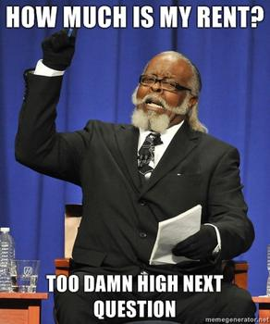

Slide 28
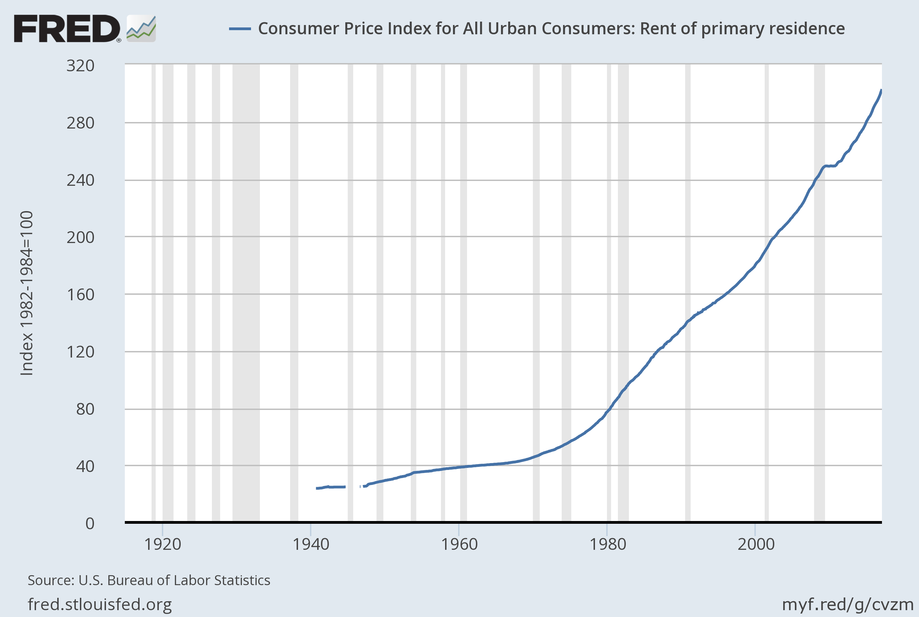
Notes:
Source: U.S. Bureau of Labor Statistics Release: Consumer Price Index U.S. Bureau of Labor Statistics, Consumer Price Index for All Urban Consumers: Rent of primary residence [CUUR0000SEHA], retrieved from FRED, Federal Reserve Bank of St. Louis; https://fred.stlouisfed.org/series/CUUR0000SEHA, January 26, 2017.

Slide 29
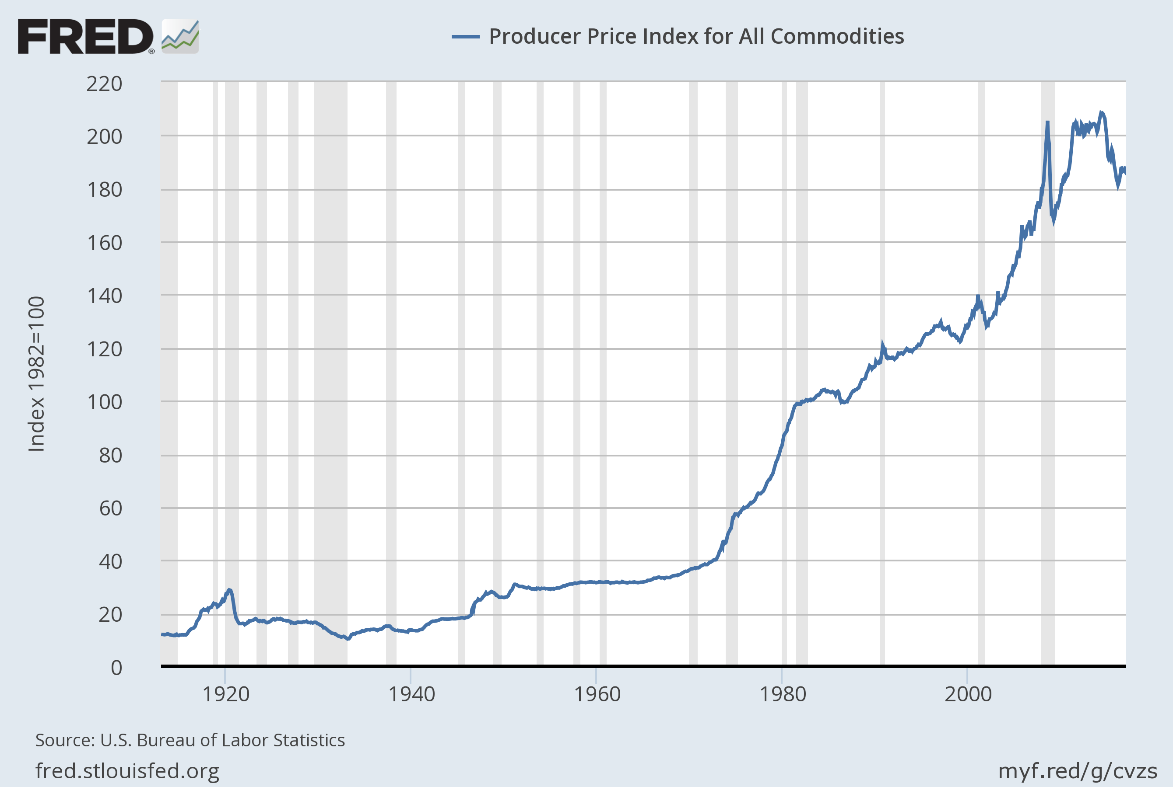
Notes:
Source: U.S. Bureau of Labor Statistics Release: Producer Price Index U.S. Bureau of Labor Statistics, Producer Price Index for All Commodities [PPIACO], retrieved from FRED, Federal Reserve Bank of St. Louis; https://fred.stlouisfed.org/series/PPIACO, January 26, 2017.

Slide 30
