Slide 1
Federalism
An attempt to share power and solve a Constitutional crisis

Slide 2
Gay Marriage
Speed Limits
Drinking Age
Who has the correct answers?
Legalization of Marijuana
Illegal Immigration/ Border Control
National Education policy

Slide 3
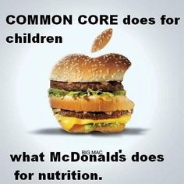
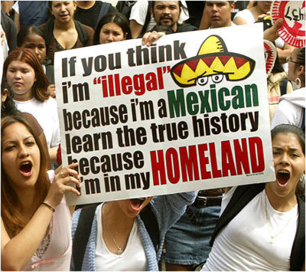
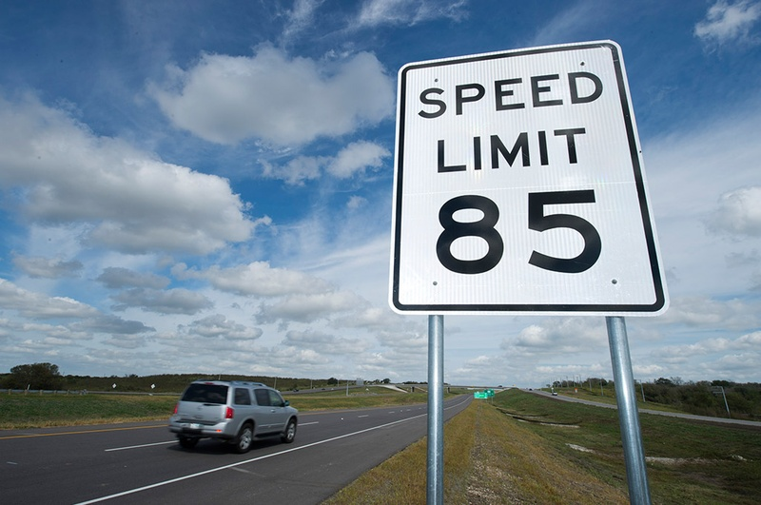
Gay Marriage
Drinking Age
Illegal Immigration/ Border Control
National Education policy
Speed Limits
Legalization of Marijuana

Slide 4
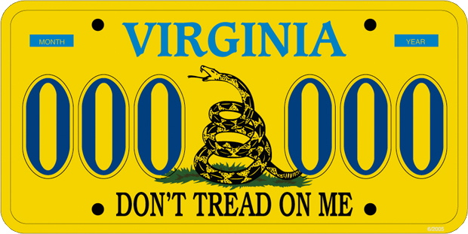
Which are they?
State citizens or national citizens?

Slide 5
What does the Constitution say?
Article IV… interstate relations
Article VI… Supremacy Clause
Article VII… State ratification
Amendment 10… reserved powers

Slide 6
A key question…
Who gives the national government its authority? Is it the states or is it the people?
“We the people…”
State ratification…

Slide 7
Nullification…
Gun laws, Montana, and federal regulation… ahhhh the interstate commerce clause
http://www.washingtonpost.com/posttv/national/states-race-to-nullify-federal-gun-laws/2014/08/29/74d1863e-2f99-11e4-be9e-60cc44c01e7f_video.html

Slide 8
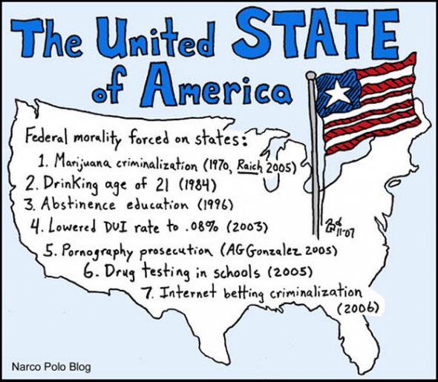
Federalism…four types
Is it really “sharing” of powers?

Slide 9
Things we will define…
Dual Federalism
Cooperative Federalism
Coercive Federalism
Devolution federalism

Slide 10
Dual Federalism
National government has limited / listed powers
The enumerated powers of Article 1, Section 8
National and state governments are sovereign in their own spheres
Relationship is characterized by tension, not cooperation

Slide 11
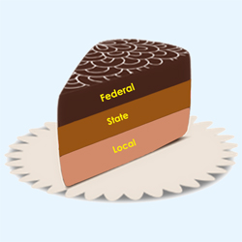
Dual Federalism =
Layer Cake Federalism

Slide 12
Cooperative Federalism
Assumption is that there is an overlap of power
Joint functions require cooperation
Routinely share power
Multiple places for policy entrepreneurs to influence actions

Slide 13
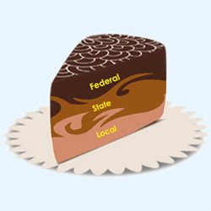
Cooperative Federalism =
Marble Cake Federalism

Slide 14
This relies on…

Slide 15
Basically…
Dual Federalism
Inflexible elastic clause
Robust and spacious 10th Amendment
Cooperative Federalism
Flexible Elastic Clause
10th Amendment is self-evident and obvious, doesn’t expand state power

Slide 16
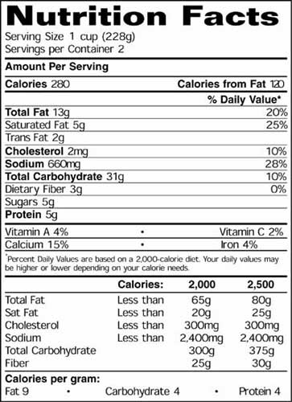
Coercive Federalism…
Preemption
Federal law in 1990 set standards for food labeling…
National Government beat states to the punch and had to follow federal rules… they couldn’t set their own

Slide 17
Coercive Federalism…
Mandates
An order by the national government that states must do something according to national standards
Affordable Care Act
Medicaid
Common Core State Standards
Speed limits
Drinking age

Slide 18
Cooperative Federalism has become Coercive Federalism

Slide 19
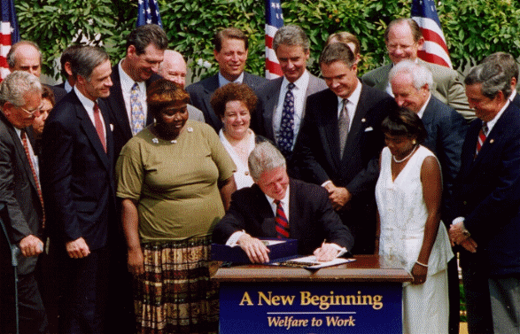
Devolution v. Federalism
Block grants v. categorical grants

Slide 20
Where does all of this have its roots?

Slide 21
http://goo.gl/Zf7LtE

Slide 22
Learning Prep…
Watch the “Types of Federal Grants” video for Block day
Pre-Test for Block day…

