Slide 1
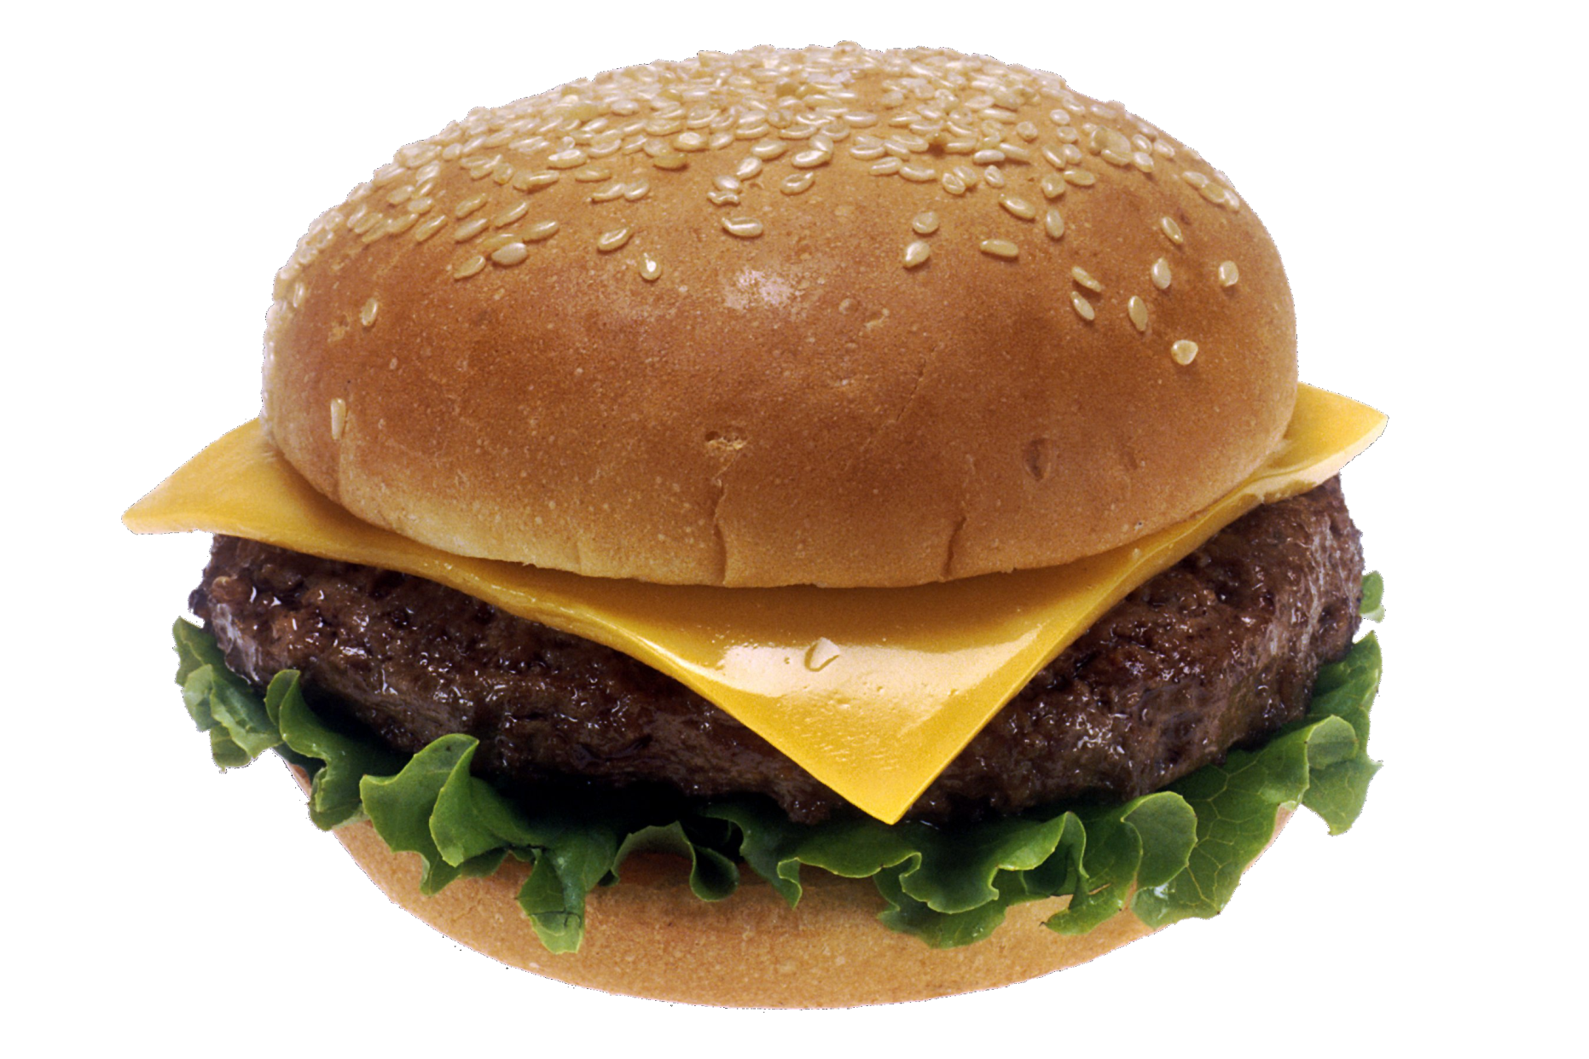
How many regulations are on your average fast-food cheeseburger?
Notes:
About 40,000 regulations between federal, state, and local governments

Slide 2
The Bureaucracy
Government’s Most Wasteful Component…or Is It?
Notes:
http://www.washingtonpost.com/blogs/post-partisan/wp/2012/12/06/senate-republicans-profiles-in-moral-cowardice/
http://phs.prs.k12.nj.us/ewood/amergov/USGov5th/chaptertwelve.htm
"Nuclear Option" in the Senate

Slide 3
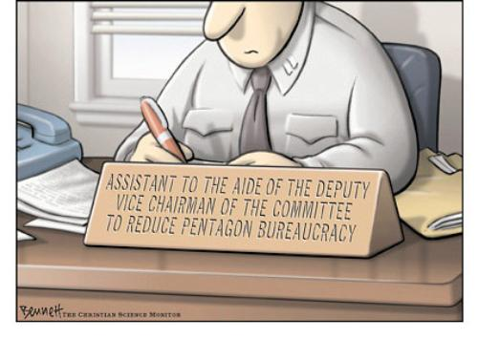
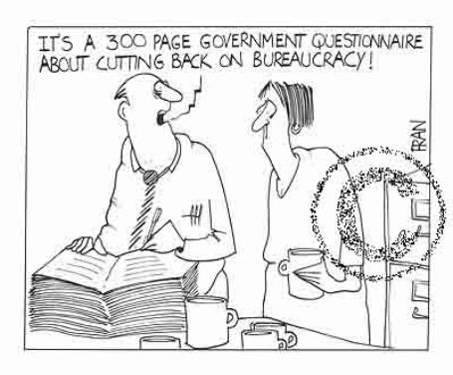
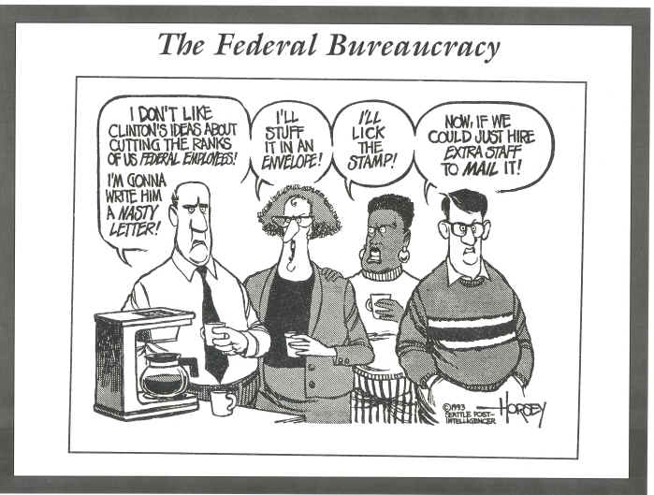

Slide 4
“A Bureaucracy” v. “The Bureaucracy”
“A Bureaucracy”
Model of organization…way of organizing large group of people
“The Bureaucracy”
a body of administrative offices working to implement policy
Consists of the various agencies of the federal government
Civil Servants: The people who do the day-to-day job of governing
The EPA inspector
IRS Agent
FDA Meat Inspector
CIA Intelligence Officer

Slide 5
The Bureaucracy
Large, complex organization with both appointed officials and “careerists”
Federal bureaucracy includes all of the agencies, people, and procedures thru which the fed. Government operates
Over 4.1 million federal employees
2.7 million civilian; 1.4 million fed. employees
Overseen by the Executive Branch
Crash Course: Bureaucracy Basics

Slide 6
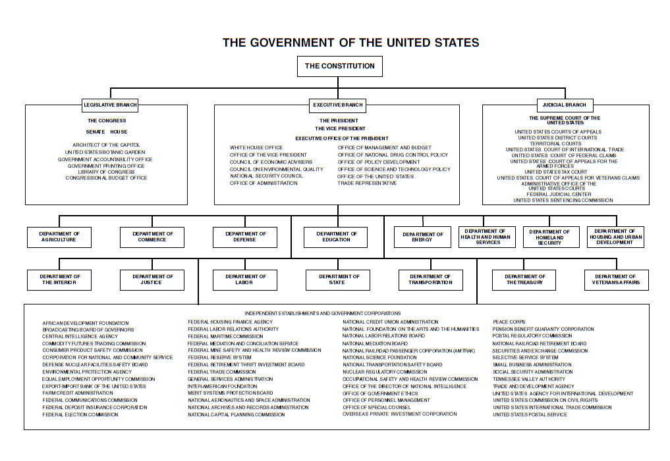

Slide 7
Characteristics of Bureaucracies
Hierarchical authority w/ clearly defined roles
Specialization/Division of Labor
Defined Duties/Responsibilities
Standardized Operating Procedures (SOPs)
Established rules/regulations must follow…
Paradox: Discretionary Authority
Employees are recruited/promoted based on relevant technical expertise
Some appointed officials
Emphasis is on estbl. Goals efficiently & effectively
What are some examples of bureaucracies?
Notes:
Mcdonald’s
IRS—Sec. of Treasury, Commissioner, Chief Counsel, debt collection agencies, employees that process tax returns
Education System—State legislature, superintendants, school board, principal, asst. principal, department chair, teachers

Slide 8
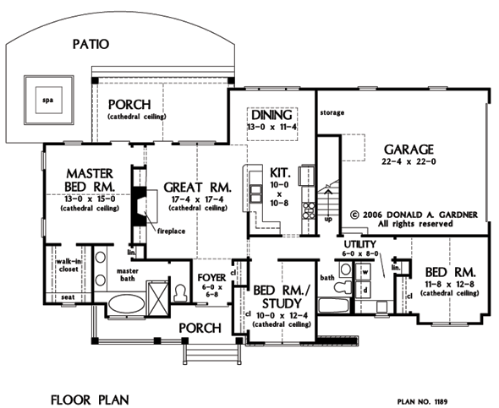
How Does Government Bureaucracy Impact You?
YOU HAVE 3 MINUTES TO LIST AS MANY WAYS THE BUREAUCRACY INFLUENCES YOU ON A DAILY BASIS…GO!
Notes:
Bathroom: EPA regulates clean water, sewage management, wastewater facilities; Consumer Protection Safety Commission: Cosmetics
Kitched: FDA/USDA food regulations, medicine, determine grade of meet (Taco Bell); D.of Energy: Refrigerator must have certain energy efficiency
Bedroom: Mattress (CPSC)…make safer cribs, mattress flammability standard which is good because if you’re in your house and there’s a fire and you are still laying in your bed you’ll have plenty of time to get up so you don’t get burned, radio (FCC)
Family Room: TV (FCC); Light bulb must be wattage it says (FTC), DVD protections v. Encryption
Garage: car must be equiped with airbags (D.oT)
Misc: Paint, toys must be lead free, no asbestos in insulation, elctricity brough thru power grid; building codes etc.

Slide 9
Formation
Creation
Article II
Hints at creation of executive departments
Begins w/ precedent set by Washington/Congress leg.
Today, formed by Congress
Determine agency goals/jurisdiction
Under control of Executive (President)
Function
Theory: Designed to make lg. org. work more efficiently/provide uniform, quality service
Reality: Can be inefficient b/c of size, many rules and regulations (red tape)
Result: Low public opinion…yet people report pos. experiences? What explains this?
How does it compare with the private sector?
Notes:
New departments are created by Congressional legislation, and must be signed into law by the president.

Slide 10
History & Reform
Expansion: Civil War, Depression, WWII
Andrew Jackson— Spoils System/Patronage
Pendleton Act-1883
Civil Service Act…Exams…jobs base on merit
Hatch Act
Further restricts pol. Activities of servants; can’t run for office or campaign
Goal: Depoliticize the workforce
Civil Service Reform Act of 1978
Created OPM to enforce civil service laws; Civil servants can’t be removed for political reasons
Whistleblower Act of 1989
Protects employees from retaliation for disclosing fraud/ mismanagement
Notes:
OPM—Office of Personnel and Management;

Slide 11
Federal & State Employees
# of federal government employees has remained constant since 1950
# of state/local government employees has increased steadily since 1950
How have Block Grants and Mandates contributed to the growth of state and local bureaucracies?

Slide 12
Sources of Bureaucratic Power
Essential: Need the work done by the agencies
Why?
Expertise: Have knowledge & skills public lacks
Discretion: Power resides in discretionary authority; Congress gives flexibility to agencies
Much of this power comes from structural need for Congress to compromise/be vague in passing legislation
Clientele Groups: the people who use or benefit from and agency
If people who use an agency (farmers/Dept. of Agr.) are politically powerful, then agency budgets are less likely to be cut, agency initiatives are more likely to be successful in Congress
Notes:
Clientele Group: can be Congress/Committees themselves
Why need bureaucracy? Congress too much to do; not time to regulate etc.

Slide 13
Conflicts/Trade-offs Inherent in Bureaucracy
Fairness v. Responsiveness
Do we want our bureaucracies to be fair and treat each individual or case as a special instance, or do we want them to be as responsive as possible?
Efficiency v. Effectiveness
Do we want our bureaucracy to select the most efficient way to do something, or do we want it to select the most effective?
Professional Independence v. Accountability/Consistency
What do we want our bureaucrats to have the professional independence to make decisions as needed, or do we want them to be accountable, and we can know what conditions/situations will yield what types of decisions?

Slide 14
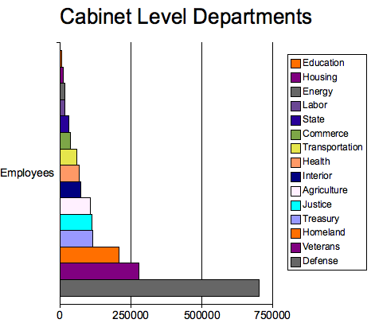
Federal Bureaucracy-4 Types
Cabinet-15 Departments
Advisors to the President
Why has cabinet been replaced by White House Office as President’s closest advisors?
Headed by Secretaries (Attorney General—Justice)
Appt. by Pres…Confirmed by Senate…short tenures…
Serve at President’s will
Broad Mission; Political Focus; Very Visible
Employ 60% of bureaucracy
Crash Course: Types of Bureaucracies

Slide 16
Regulatory Commissions
Regulatory Agencies (FCC, FTC, SEC, FED, EPA)
Regulate Some Aspect of the Economy; specific functions—Make rules for large industry/business
Leadership designed to be outside ctrl. of Congress/Pres.
Although Appt. by Pres./Confirmed by Senate
Commissioners usually serve long, staggered, overlapping terms… CANT BE REMOVED BY PRESIDENT during their terms in office
Make rules to protect public interest/Enforce rules to protect public interest
4th Branch of Government
Quasi-legislative, quasi-executive, quasi-judicial (ability to punish)
Notes:
Why do we have these? Would be too inefficient for Congress to do
Quasi-legslative: They can make rules and regulations, implement and spell out laws of Congress…EPA sets certain fuel economy standards on vehicles and tests automakers must use to determine fuel efficiency…Consumer Product Safety Commission—recalling unsafe products, enforces safety standards
Quasi Judicial: settle disputes in fields in which Congress has given them policing authority; SEC job to investigate financial fraud cases like with Madoff—should’ve caught ponzi-scheme ages ago

Slide 17
Reg. Agency: Federal Reserve
Federal Reserve Board
Primary responsibility is to set monetary policy
Board of Gov…14 yr. terms; Chairman…4 yr. terms
Monetary Policy
Set bank interest rates, control inflation, regulate money supply, and adjust bank reserve requirements
FED has much independence…keep monetary policy from politics…minimize influence of political parties and interest groups
How is fiscal policy different from monetary policy?
Who determines fiscal policy?

Slide 18
Independent Agencies & Govt. Corporations
Independent Executive Agencies
Smaller/more focused mission; serve exec. Branch/public good
Heads appointed by president/confirmed by Senate…but…
Operate outside of Cabinet…not intended to be as political
Leadership: Long tenure in office…across administrations
GSA, CIA, FEMA, NASA, EPA
Government Corporations
Provide a service can get from a private corporation
Financed by Congress; income goes back to business
Congress determines purpose
Examples?
U.S. Postal Service; TN Valley Authority; AMTRAK
Notes:
General Services Administration, National Science Foundation
Nearly one-fifth of all government spending goes to private contractors and consultants. Most contracts and grants are awarded without competitive bidding to favored firms or groups who provide unique services.

Slide 19
Impact
The Influence of the Bureaucracy Can Be Felt Most Directly in Public Policy through Implementation & Regulation

Slide 20
Regulation
Use of governmental authority to control or change practices in the private sector.
Regulations have force of law
Munn v. Illinois (1877) upheld right of government to regulate business
Under Reagan & George W. Bush, federal government saw periods of deregulation, especially in the business sector.
Colbert Report: The Word
Daily Show: Deaf Party Jam

Slide 21
Regulation
The federal bureaucracy makes rules that affect how programs operate, and these rules must be obeyed, just as if they were laws.
The rule-making process for government agencies occurs in stages.
After Congress passes new regulatory laws, the agency charged with implementing the law proposes a series of rules
Interested parties can comment on the rules, either at public hearings or by submitting documents to the agency.
After the agency publishes the final regulations, it must wait sixty days before enforcing those rules.
Congress can review and change the rules if it desires. If Congress makes no changes, the rules go into effect at the end of sixty days.

Slide 22
Regulations Process
A grant of power and a set of directions from Congress
A set of rules and guidelines are then est. by the regulatory agency itself
A means of enforcing compliance with congressional goals and agency regulations is est.
A set of penalties for noncompliance is est.

Slide 23
Policy Implementation
Bureaucrats shape implementation of policy!
Can implement policy with much discretion
Policy implementation: When Congress creates a new program, it does not establish all the details on how the policy will be implemented.
Congress passes enabling legislation, which grants power to an agency to work out the specifics. Although the agency must stay within some bounds, it has a great deal of latitude

Slide 24
Implementation
Implementation is the translation of policy goals into rules and standard operating procedures
Congress provides federal agencies with general mandates, leaving agencies with administrative discretion to set specific guidelines for a given problem or situation.
Discretionary Authority
Congress lacks expertise…defer to agencies
Make powers based on implied authority
Adds efficiency to the system
Decision making: Decentralized (Police)
Implementation can break down for numerous reasons
Conflicting goals, faulty program design, lack of financial resources, and fragmentation of responsibility, LACK OF POLITICAL SUPPORT, revolving door, Iron Triangles
Prior Dept. of Homeland Security…46 agencies involved in counter-terror
ATF: Video Clip 1
ATF: Video Clip 2

Slide 25
Bureaucracy…Free of Politics?
“A popular misnomer is that bureaucrats just carry out the laws passed by Congress and the president, without any discretion or political motives. In reality, bureaucracies are inherently political organizations with wide discretion. The political nature of bureaucracy stems in part from the fact that bureaucrats must answer to the president, who expects the bureaucracy to respond to his policy wishes, and Congress, which controls a bureaucracy's budget.” --Learner

Slide 26
Executive Control on Bureaucracy
President appoints senior agency heads and subheads
Way for President to exercise control over agency
Who a pres. Appts. Influences how agency will be managed
Can also exert influence by refusing to fill appointments/appt. weak nominee…Why would Pres. Do this?
OMB—Can recommend increases or decreases in budget
Screen rules proposed by exec. Branch agencies
Reduce/Strengthen enforcement
Executive Orders
Limits on Presidents Power
Senate has power to confirm appointments
Heads of Reg. Commissions serve long, staggered terms, can’t be removed by President (although appt. by pres./congress)
Civil Servants: Career officials-Serve across administrations
Agency heads often develop strong loyalty to their departments and thus don’t aggressively pursue president’s policy agenda
Agencies can stall on implementation; reduce enforcement; relax reg.
President calling for Reorganization Power

Slide 27
Judicial/I.G. Control of Bureaucracy
Courts
Judicial Review: can declare bur. actions unconstitutional
Decisions limiting bureaucratic practices
Interest Groups
May be consulted/write rules/regulations for their own industry
I.G. Lobby Bureaucracy & on behalf of Bureaucracy/ 1st Amendment
Speech, protests, media usage
Can secure Congressional support for bur. agencies
Litigation
Revolving Door…How is this at play?
Iron Triangles/Issue Networkds

Slide 28
Congressional Control of Bureaucracy
Congress (not just exec.) has authority over fed. Bureaucracy…creates checks and balances, but can lead to agencies playing one branch against another.
Create agencies…define them; change their jurisdiction
Power of the Purse…control budget
Pass legislation impacting bureaucracy
Approves Appointments
Bureaucratic overlap
Keep 1 agency from being all-powerful
Legislative Oversight
Hold leg. hearings to get info or investigate waste
Reorganize an agency/set new guidelines for an agency
Power of Purse
Sunset Provisions
Crash Course--Controlling Bureaucracies
Notes:
GSA Current Event—Connect to Legislative Oversight Daily Show: Money Gall
Daily Show: Google Gets "Fined“
Government Shutdown

Slide 29
How Does Bureaucracy Maintains Its Independence
Nature of the Bureaucracy
Large
Tenure protections/hard to fire
Specialized Units
Indep. Reg. commissions
Commissioners can’t be removed by presidents …long tenures
Public Policy Concerns
Expertise Required
Delegated authority…b/c Congress/Pres. Can’t handle it all…
Discretionary Authority…fill in gaps in legislation
Write Rules/Regulation

Slide 30
Bureaucracy and Policymaking
“In theory, federal bureaucracies merely carry out the policies enacted by Congress and the president. In practice, however, many scholars argue that the bureaucracy plays a significant role in federal policymaking via iron triangles and issue networks.”

Slide 31
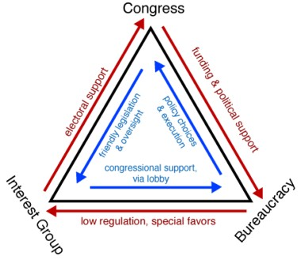
Iron Triangles
Iron Triangle: a close relationship between an agency, a congressional committee, and an interest group that all deal with the same policy are that often becomes a mutually advantageous alliance.
Iron Triangles Explained

Slide 32
Military Industrial Complex
“A vital element in keeping the peace is our military establishment. Our arms must be mighty, ready for instant action, so that no potential aggressor may be tempted to risk his own destruction...
This conjunction of an immense military establishment and a large arms industry is new in the American experience. The total influence — economic, political, even spiritual — is felt in every city, every statehouse, every office of the federal government. We recognize the imperative need for this development. Yet we must not fail to comprehend its grave implications. Our toil, resources and livelihood are all involved; so is the very structure of our society. In the councils of government, we must guard against the acquisition of unwarranted influence, whether sought or unsought, by the military-industrial complex. The potential for the disastrous rise of misplaced power exists and will persist.
We must never let the weight of this combination endanger our liberties or democratic processes. We should take nothing for granted. Only an alert and knowledgeable citizenry can compel the proper meshing of the huge industrial and military machinery of defense with our peaceful methods and goals so that security and liberty may prosper together.”
—President Eisenhower; January 17, 1961

Slide 33
Two Theories of Influence
Iron Triangles/Sub-Governments
Alliance of people from three groups: a congressional subcommittee that deals with an issue, the executive agency that enforces laws on that issue, and private interest groups.
Often, the members of the triangle know each other well, and people frequently move from one corner of the triangle to another.
The members of the iron triangle work together to create policy that serves their interests.
Promote private interests; Bur. Shapes policy to benefit interest groups
Issue Networks
Includes policy experts, media pundits, congressional staffs, White House aides, academics, and interest groups who regularly debate an issue…
Consist of wider range of people than iron triangle
Unite to promote a single issue in govt. policy…generally target bureaucratic agencies
How is the “Military Industrial Complex an example of an iron triangle?

Slide 34
Iron Triangles: Impact on Democracy
Impact on Democracy
Does allow people more access to govt…however…
Direct influence on public policy (legislation & executive enforcement)
How might iron triangles contribute to the budget deficit?
Revolving Door
How does the revolving door influence iron triangles?
Client Politics
Farmers defeat efforts to decrease pesticide use
Democratic Process?
Dominance of special interests?
Does it lead to voter apathy?

Slide 35
Misc. Info

Slide 36
Major Complaints…Are They Justified?
Red Tape
Complex/sometimes conflicting rules
Cause delay/confusion; excessive paperwork
Hurricane Katrina
Conflict
Agencies Work @ Cross Purposes
Duplication—2 or more agencies
Overlapping jurisdiction…leads to waste/ballooning budgets
Imperialism
Tendency of agencies to grow irrespective of costs/benefits
PTSD and Vietnam Vets
Criticisms of Bureaucracy
Veterans Benefits: Red Tape
Notes:
Duplication: Eggs fall under the jurisdiction of the FDA
The chickens fall under the USDA
For a moment during the evening hours of Feb. 9 last year, the war on drugs seemed to be working. An expensive U.S. radar system in the Bahamas spotted a small plane maneuvering suspiciously as it flew north. The U.S. customs Service quickly notified Op Bat, a special interdiction operation run by the Drug Enforcement Administration. Both Customs and Op Bat sent plans and helicopters in pursuit. As the suspected smuggler made his drop into the sea a Customs radar plan homed in.Then the fighting broke out—not with the smuggler, but among the drug agents. Each law-enforcement operation wanted to be the one to make the seizure. Op Bat told Customs to have its radar plane remain at the scene to watch the drugs. Customs refused. According to a confidential State Department cable obtained by Newsweek, a Customs Air Wing supervisor told Op Bat that the aircraft “were his…and they would follow his orders or he would call them home.”
OSHA (Occupational Safety and Health Administration) ordered a Massachusetts supermarket to put a nonskid floor in its workplace. The Agriculture Department made the market take it out again, and put in a tile floor for sanitation.
By herculean effort, the Environmental Protection Agency managed to reduce one of its forms to a single page. But it had to provide a 90-page instruction book for filling out the form.
Products made with egg products are once again under the FDA
The FDA regulates chicken broth, but beef broth is under the USDA’s watchful eye—except in the case of dried soups, in which case the agencies swap duties.
Responsibility for packaged baked beans depends on whether the meat in the can is pork chunks (FDA) or bacon (USDA).
And under which agency’s purview a pizza falls depends on whether it is of the cheese lover, meat lover, or seafood lover variety.

Slide 38
Myths of the Bureaucracy
T/F Americans dislike bureaucrats.
T/F Bureaucracies are growing larger each year.
T/F Most federal bureaucrats work in Washington D.C.
T/F Bureaucracies are ineffective, inefficient, and always mired in red tape.
T/F Private bureaucracies are more effective than government bureaucracies.
Futurama Song: Bureaucrats

Slide 39
Modern Bureaucracy
Political authority shared w/ Pres. & Congress
Agencies share functions with related agencies (federalism)
Growth in discretionary authority
Ability to choose courses of action and to make policies not set out in statute

