Slide 1
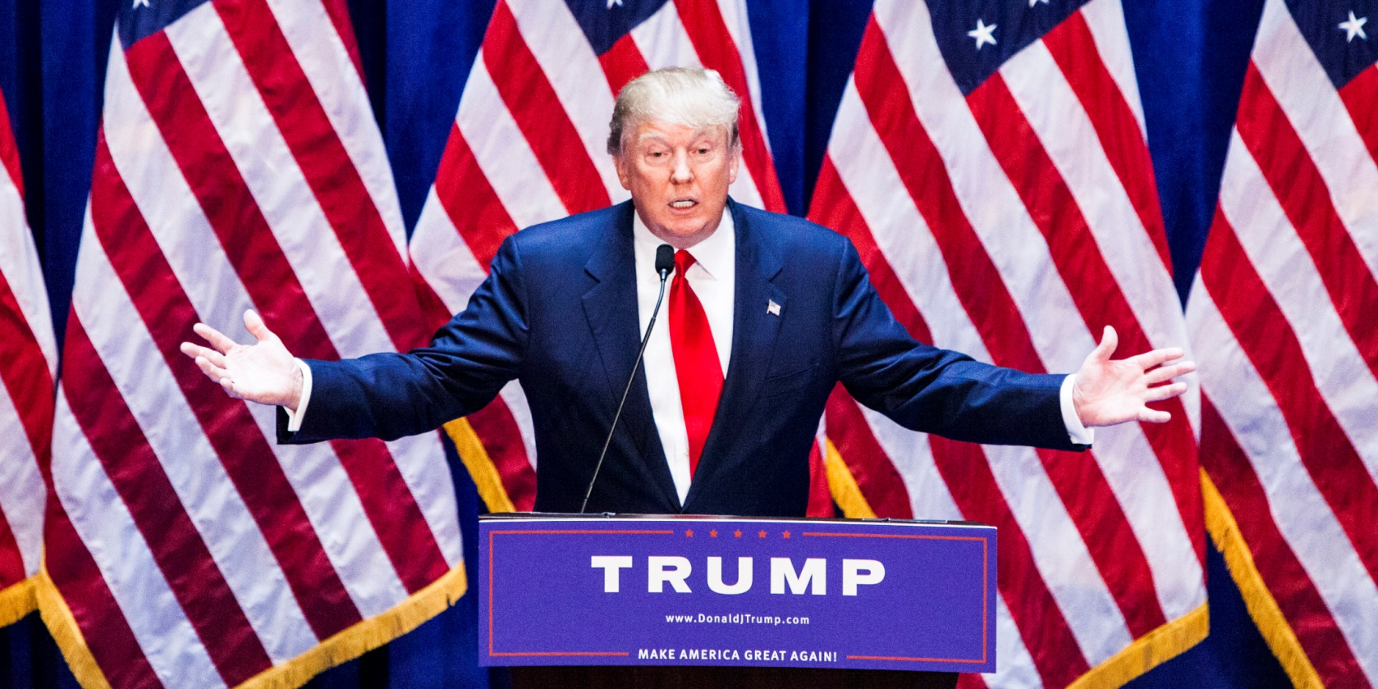
FAKE NEWS!!!!

Slide 2
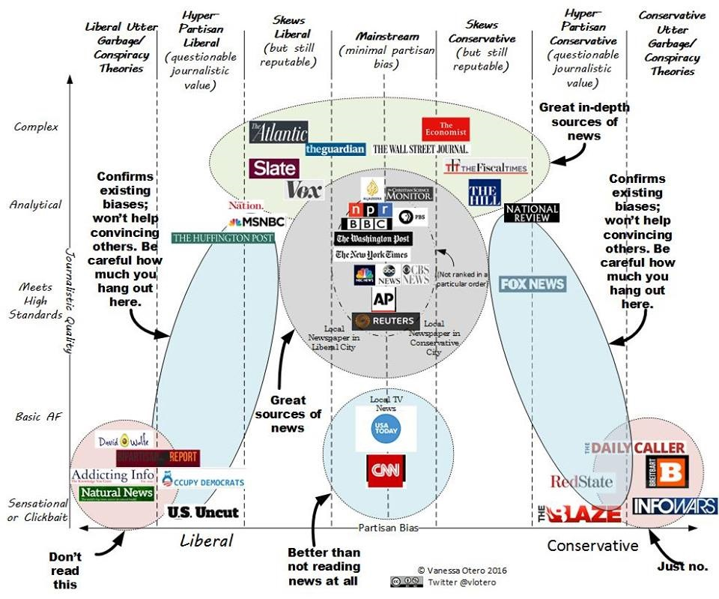

Slide 3
