Slide 2
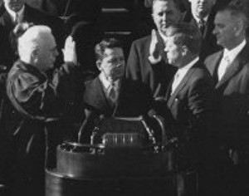
Constitutional Qualifications
Must be at least 35 years old
Must have lived in the United States for 14 years
Must be a natural born citizen

Slide 3
Presidential Benefits
$400,000 tax-free salary
$50,000/year expense account
$100,000/year travel expenses
The White House
Secret Service protection
Camp David country estate
Air Force One personal airplane
Staff of 400-500
Christmas at the White House, 2004

Slide 4
Presidential Roles
POTUS
Head of State
Cheif Executive
Chief Administrator
Chief Diplomat
Commander in Chief
Chief Legislator
Chief of Party
Chief Citizen

Slide 5
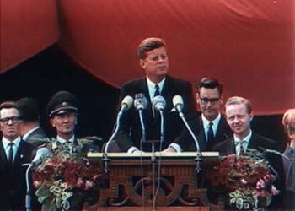
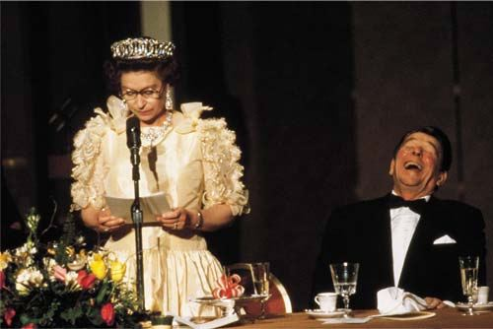
Head of State
Queen Elizabeth and President Reagan, 1983
President Kennedy speaks at Berlin Wall, 1963

Slide 6
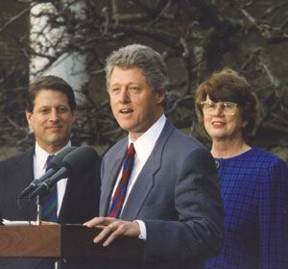
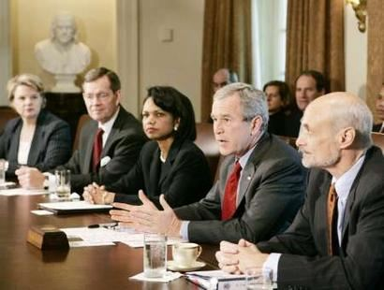
Chief Executive
President Clinton with Janet Reno, the first female Attorney General,
February, 1993
President Bush holds cabinet meeting
in October, 2005

Slide 7
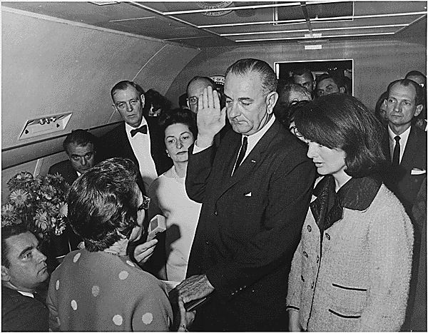
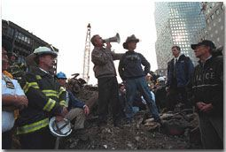
Chief Administrator
President Bush at Ground Zero after 9-11
Vice-President Johnson sworn in aboard Air Force One
after President Kennedy’s assassination, 1963

Slide 8
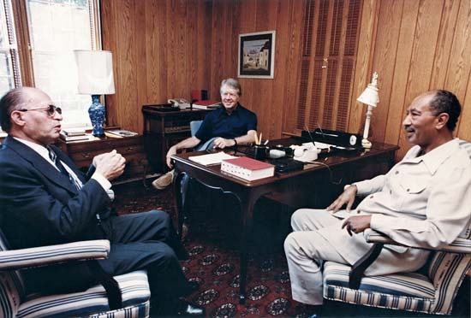
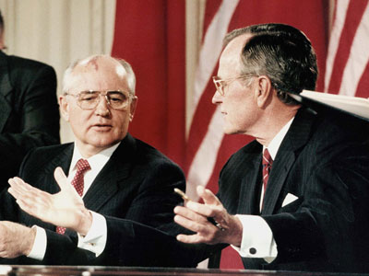
Chief Diplomat
President George H.W. Bush signing nuclear non-proliferation treaty with Gorbachev of the Soviet Union, 1990
President Carter and leaders of Israel and Egypt at Camp David, 1978

Slide 9
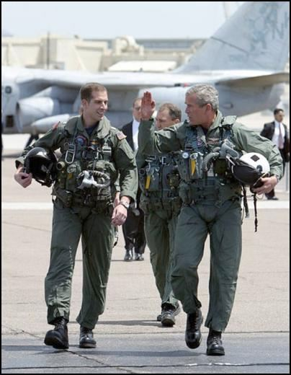
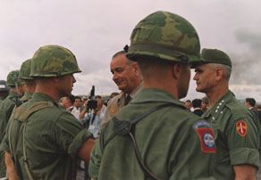
Commander-in-Chief
President Johnson decorates a soldier
in Vietnam, October, 1966
President Bush aboard U.S.S. Lincoln, May, 2003

Slide 10
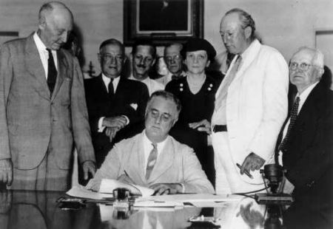
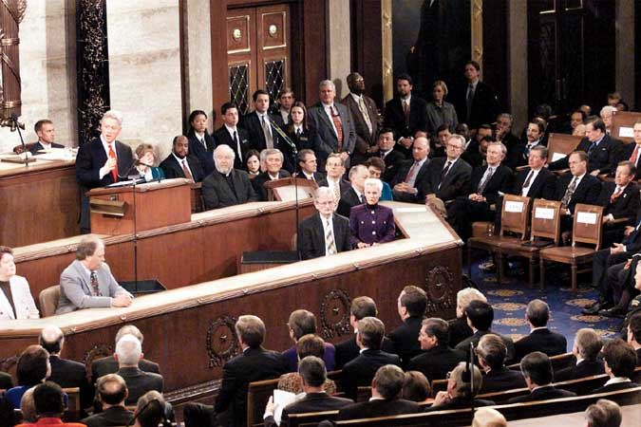
Chief Legislator
President Clinton delivers the State of the Union Address, 1997
President Roosevelt signs into law the Social Security Act, 1935

Slide 11
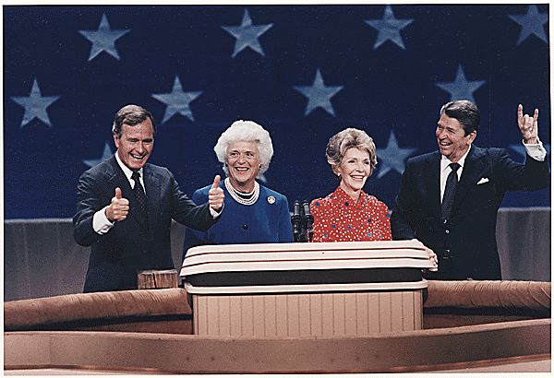
Chief of the Party
President Reagan & Vice-President Bush accepting their party’s nomination in 1980

Slide 12
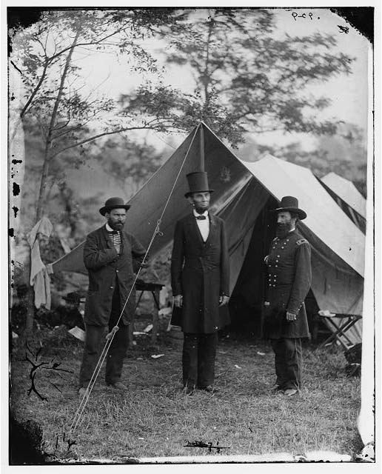
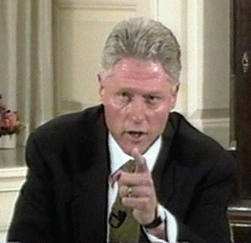
Chief Citizen
President Lincoln during the Civil War, 1862
President Clinton on national television claiming no sexual affair with Monica Lewinsky, 1999

Slide 13
Formal Powers of the President
Constitutional or enumerated powers of the presidency
Found primarily in Article II of the Constitution

Slide 14
Formal Powers: Commander-in-Chief
Commander in Chief of the Army & Navy
Commander in Chief of the state militias (now the National Guard)
Commission all officers

Slide 15
Formal Powers: Chief Executive
“Faithfully execute” the laws
Require the opinion of heads of executive departments
Grant pardons for federal offenses except for cases of impeachment
Nominate judges of the Supreme Court and all other officers of the U.S. with consent of the Senate
Fill vacancies that may happen during recess of the Senate

Slide 16
Formal Powers: Foreign Affairs
Appoint ambassadors, ministers and consuls
Make treaties subject to Senate confirmation
Receive ambassadors

Slide 17
Formal Powers: Chief Legislator
Give State of the Union address to Congress
Recommend “measures” to the Congress
Upon “extraordinary occasions” convene both houses of Congress

Slide 18
Formal Powers: Chief Legislator (cont.)
Presidential Veto
Veto Message within 10 days of passing the House of origin
Pocket Veto - President does not sign within 10 days
Congress can override with 2/3 majority from both Houses
Veto Politics
Congressional override is difficult (only 4%)
Threat of veto can cause Congress to make changes in legislation

