Slide 1
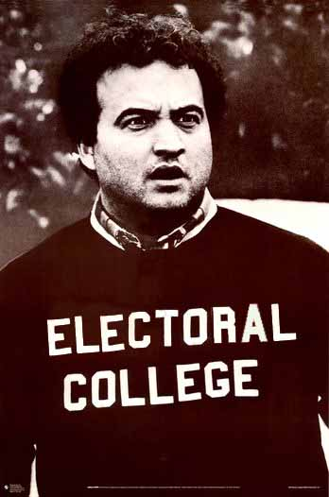
Proposal from the Original Convention and the Current System

Slide 3
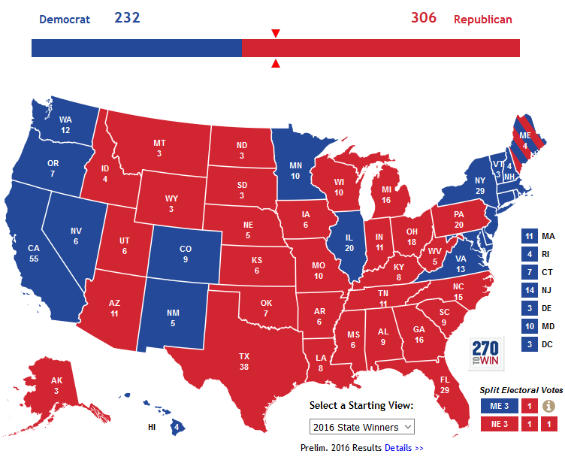
Election of 2016

Slide 4
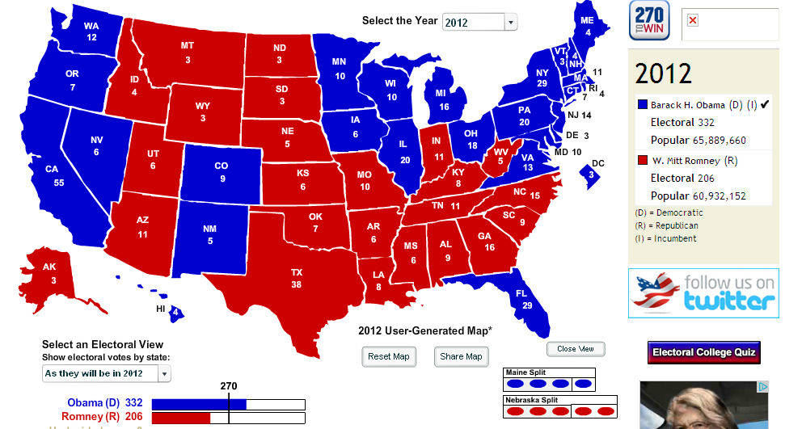
Election of 2012

Slide 5
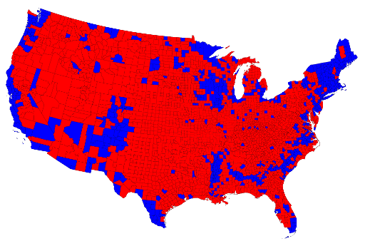
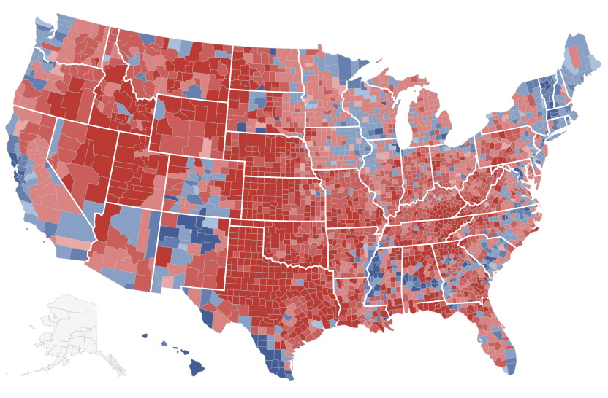
Electoral Vote by county…

Slide 6
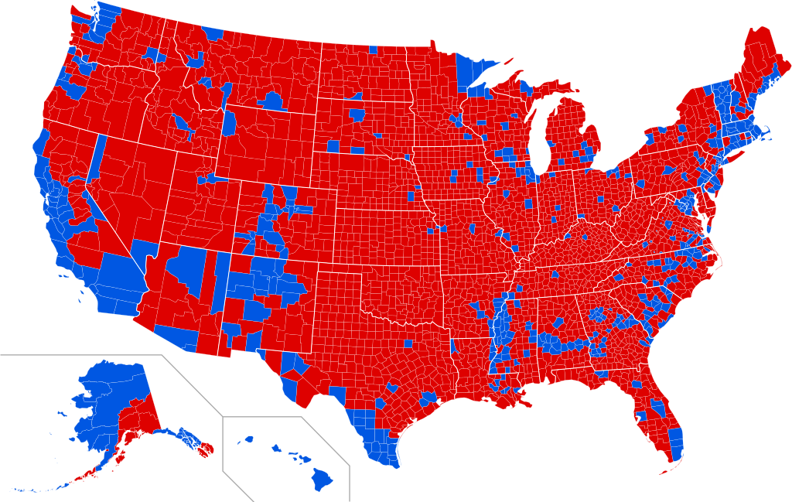
Electoral Votes by County 2016

Slide 7
Electoral Vote by county…

Slide 8
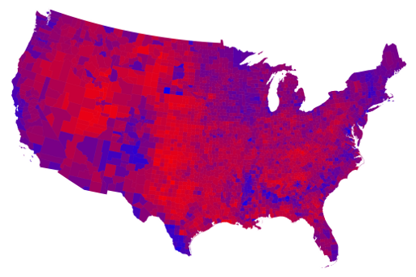
Electoral Vote by county…

Slide 9
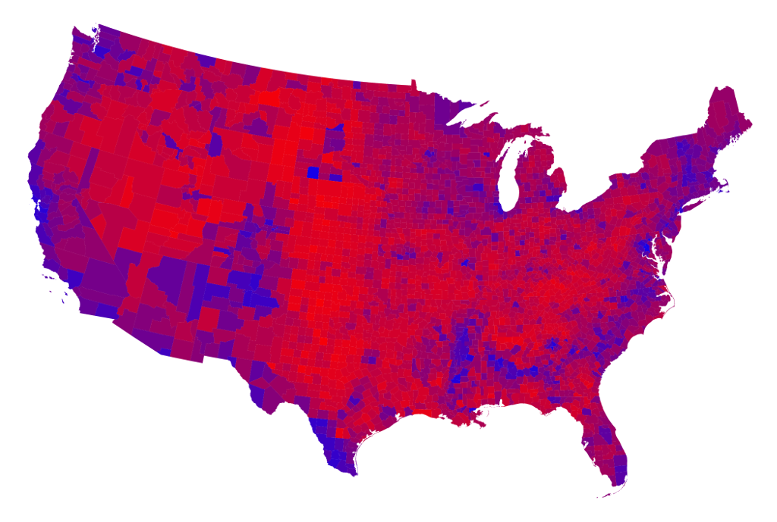
Elector vote by county 2016

Slide 10

Let’s review…

Slide 11
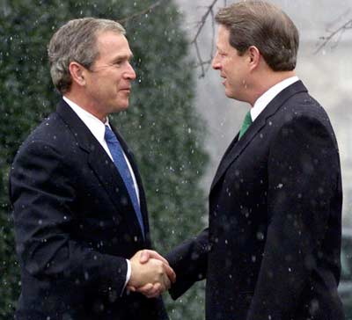
Flaws of the Electoral College
Oh……the election of 2000!

Slide 12
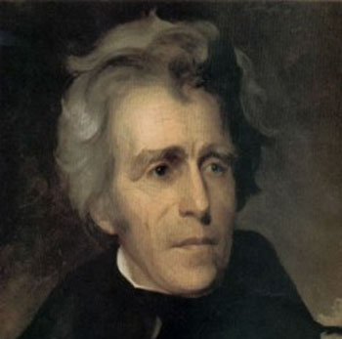
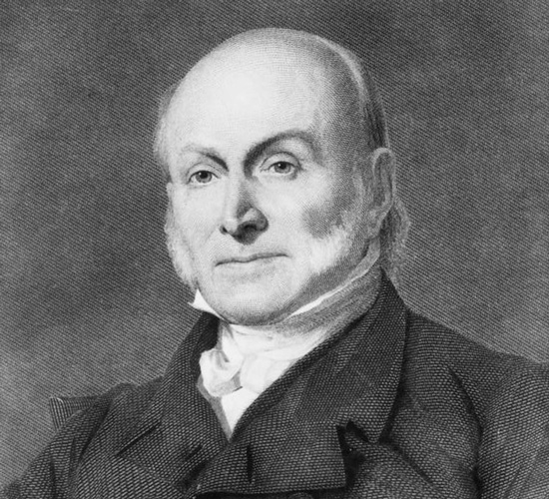
#1: It’s possible to win the popular vote but lose the electoral vote
1824→ Andrew Jackson (41.3% of the popular votes, John Quincy Adams 30.9% of the popular vote)
  Jackson received 99 of 261 electoral votes→ more than any other candidate but not enough to win

Slide 13
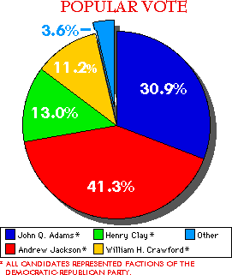

Slide 14
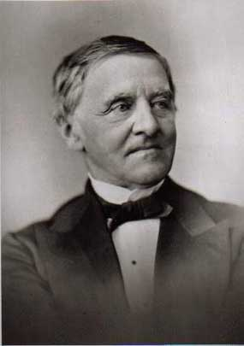
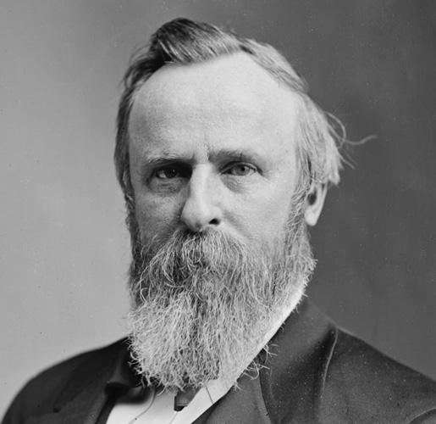
1876
Samuel J. Tilden
  4,288,546 popular votes
  184 electoral votes
Rutherford B Hayes
  4,034,311 popular votes
  185 electoral votes

Slide 15
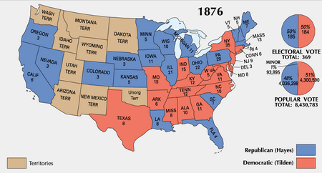

Slide 16
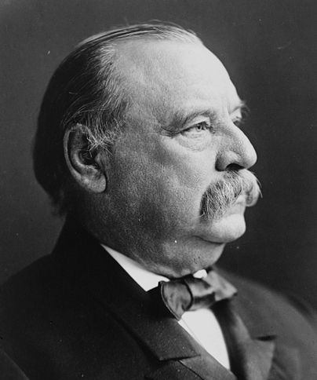
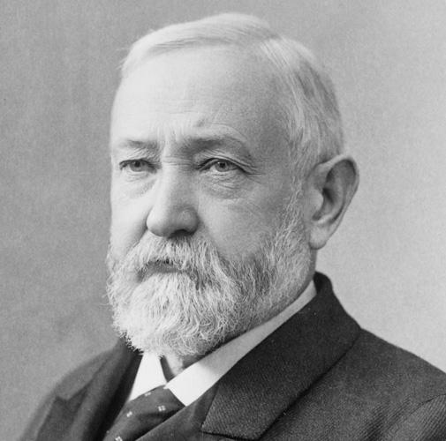
1888
Grover Cleveland
  5,534,488 popular votes
  168 electoral votes
Benjamin Harrison
  5,443,892 popular votes
  233 electoral votes

Slide 17
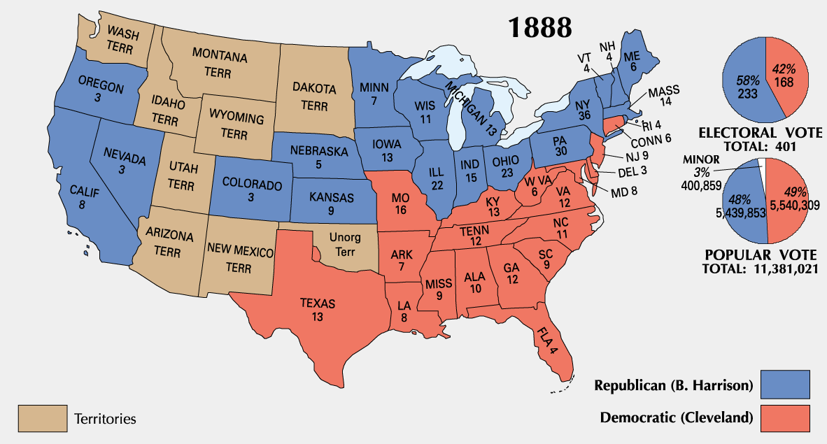

Slide 18
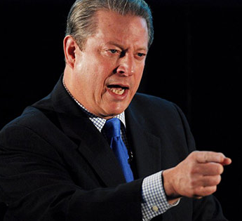

2000
Al Gore
  50,992,335 popular votes
  266 electoral votes
George W Bush
  50,455,156 (537,179 votes less)
  271 electoral votes
  Florida was decided by only 537 votes!

Slide 19
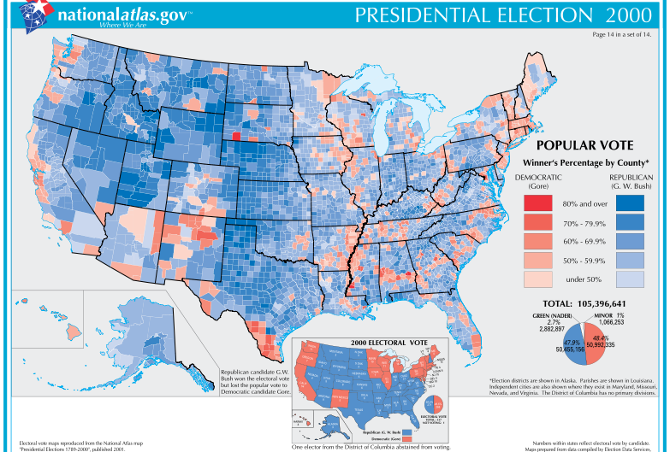

Slide 20
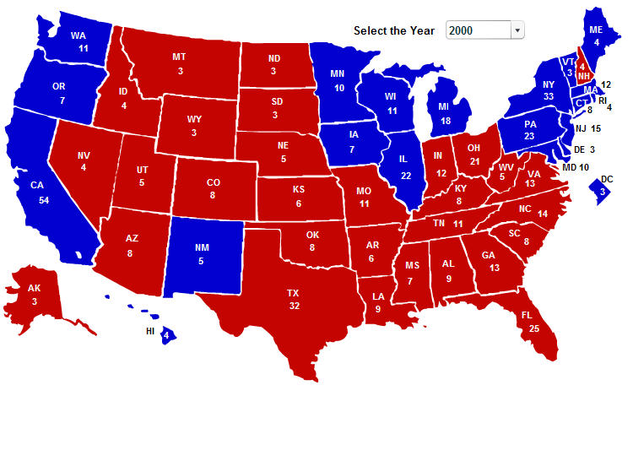

Slide 21

#2: Electors Don’t Have to Do What We Tell Them To
Electors have refused to vote for their party’s nominee
  1796
  1820
  1948
  1956
  1960
  1968
  1972
  1976
  1988
  2000
  2004→ an elector from MN voted for John Edwards (twice, Pres & VP)

Slide 22
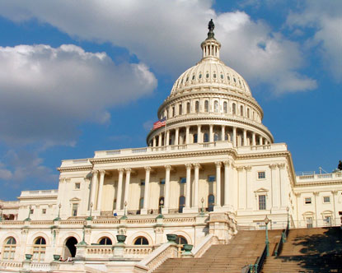
#3: The contest could be decided by the House
Problem: The voting is not done by members of the House but by state.
Why is that a problem?
A state could lose its votes if no candidate received a majority
If a 3rd party candidate were involved, the vote could be divided and no one would be declared winner by January 20

Slide 23
Criticisms, proposals, and reforms

Slide 24
Arguments for the Electoral College
original intent,
tradition,
federalism,
minority voting power,
state voting power (for both populous and less populated states),
avoidance of post-election controversies,
support of the two-party system,
political moderation

Slide 25

Problems with the Electoral College

Slide 26
What is the issue of small state bias?
What is the issue of middle state bias?
Ethnic power/bias?

Slide 27
Note taking guide…
Automatic Electors | Direct Election | District Plan | Proportional Plan | National Bonus Plan

Slide 28
Automatic plan…
Instead of having electors selected by party leadership cast votes for President, simply amend the Constitution and award the electors directly on election night.
Eliminates the problem of “faithless electors”

Slide 29
Direct election plan
Must receive at least 40% of the popular vote (prevents minor party victories splitting the nation)
For… it’s simple and democratic
More people would vote because their vote counts
Against… weaken the 2 party system and give rise to third parties. We are brought together in coalitions in the 2 party campaign and this would further divide us, not unite us.
Eliminates federalism and the role of the states
Imagine election of 2000 in EVERY state…they will fight for every vote

Slide 30
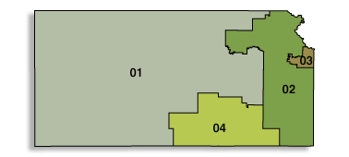
District Plan
Romney
Obama
Romney
Romney
2 Electors to Romney because of the popular vote
5-1 instead of 6-0

Slide 31
Advantages
Preserves the electoral college system, small states retain some advantages
Politically homogenous states could become invigorated by the two-party system carrying more relevance
Disadvantages… maintains small state bias, possibility of losing the popular vote and winning Electoral College

Slide 32
Proportional Plan in the states
Romney would get 4 electoral votes
…he won 60% of the vote
Obama would get 2 electoral votes
…he won 38% of the vote

Slide 33
How do they calculate it?
Rounding system (as shown with license plate)
Decimal system (some proposals take it down to the thousandths place)
      MR = 3.6 EV’s
      BO = 2.28 EV’s
      GJ = .12 EV’s

Slide 34
Advantages / Disadvantages
Preserves the EC system
Give weight to losing candidates even though they don’t win full state
Enfranchises voters in the “fly over” states
Campaigns become national in scope because we eliminate the “battleground” states that become the focus of the election
Disadvantages… could eliminate the 2-party system falsely inflating power and message of minor parties,
could easily produce EV deadlock with no person attaining the 270 needed to win

Slide 35
National Bonus Plan
Preserves the Electoral college system of 538 votes
Allows the winner of the popular vote to win 102 “bonus” votes in the election
Here’s what the election of 2000 would have looked like…

Slide 36
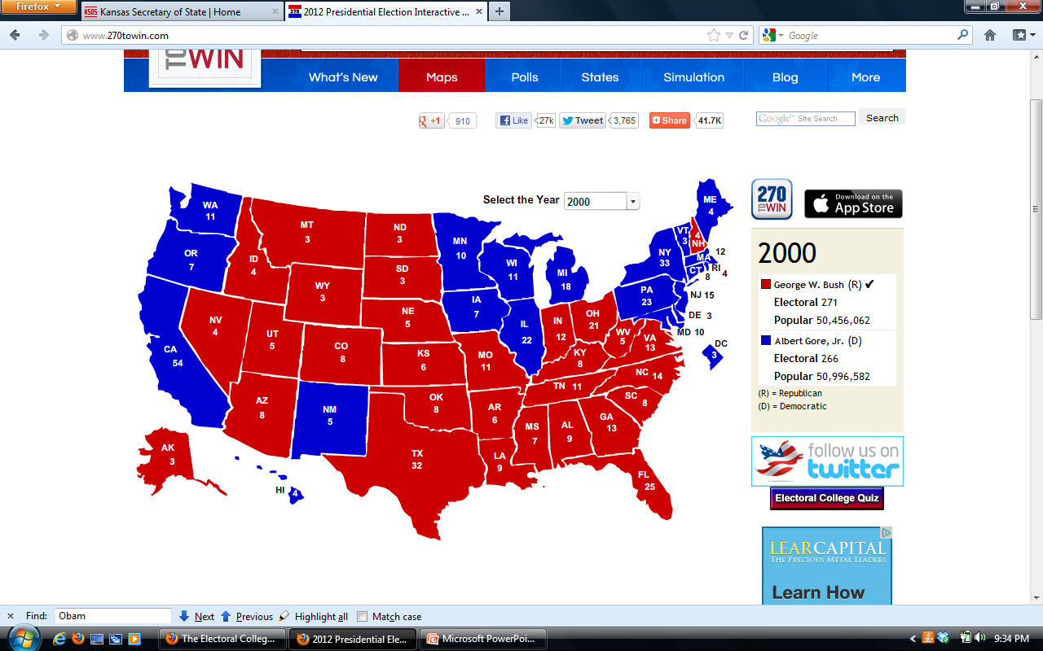
Election of 2000
(W. Bush v. Gore)
368

Slide 37
Would that have made things easier to handle the day after the election?

Slide 38
Advantages…
Encourages voters to participate in states where they may otherwise be disenfranchised (a la a Democrat in Kansas or a Republican in California) because their vote still counts in the system.
Disadvantages… maintains the inequality of the EV system as it is now, strong 2-party system only

Slide 39
So what’s the answer…
FRQ…
  How does the current Electoral System ensure state power and the 2 party system? Which reforms presented are most effective in addressing the current power of the parties? Which reforms are most likely to give disenfranchised voters or non-participating voters more voice than they currently have?
  Due at the end of the hour…

