Slide 1
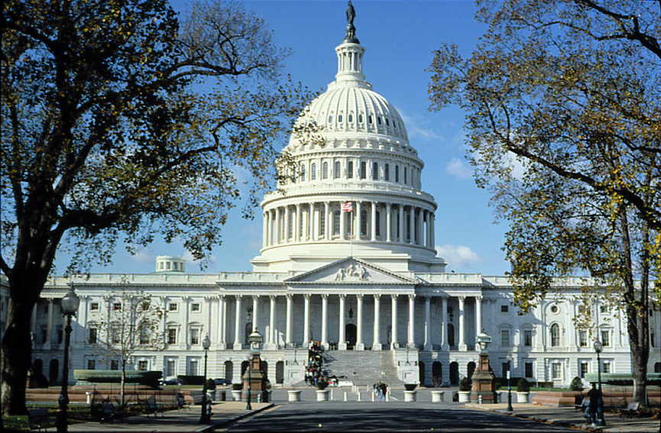
Congress

Slide 2
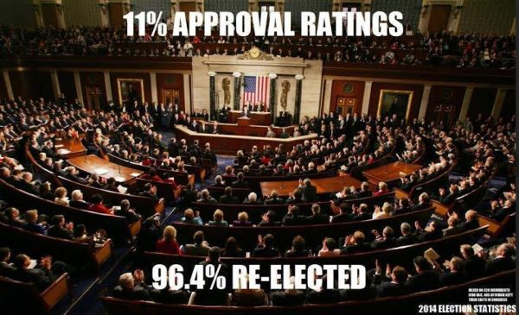

Slide 4
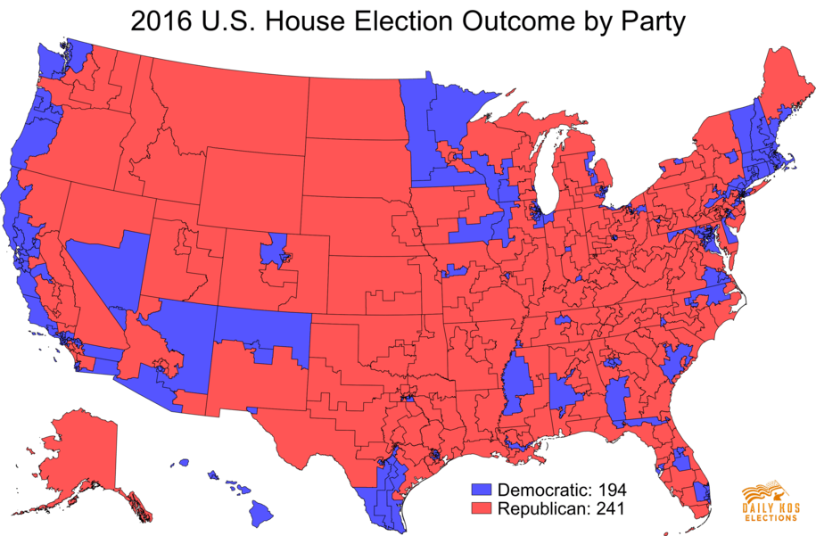

Slide 5
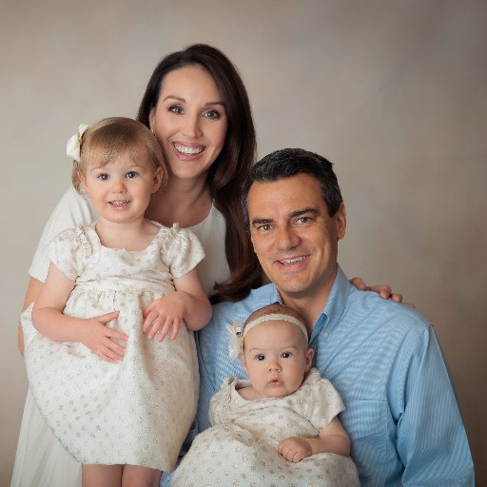
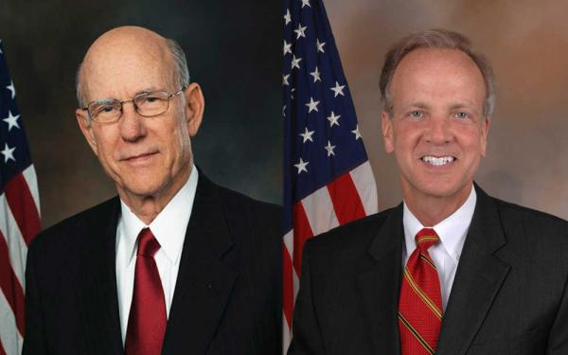
The Role of Legislators
How members of Congress vote and how they view their role as law makers
Four Roles:
Delegate
Partisan
Trustee
Politico

Slide 6
Delegate
Partisan
Trustee
Politico

Slide 7
Definitions
Delegate: Delegates see themselves as agents of those who elected them. They vote based on how they think the people in their home state or district would want them to vote. (delegates truly represent the will of the people)
Partisan: A partisan feels they must always vote along party lines, thus supporting their political party. However the party plans to vote, they follow. (loyal party members)
Trustee: A trustee believes that each question they face must be decided on its own merits. Independent judgment are their guides. They vote based on their own judgment and ideology.
Politico: A politico is a combination of the delegate, partisan, and trustee. A politico tries to keep everyone happy and thus is a true politician.

Slide 8
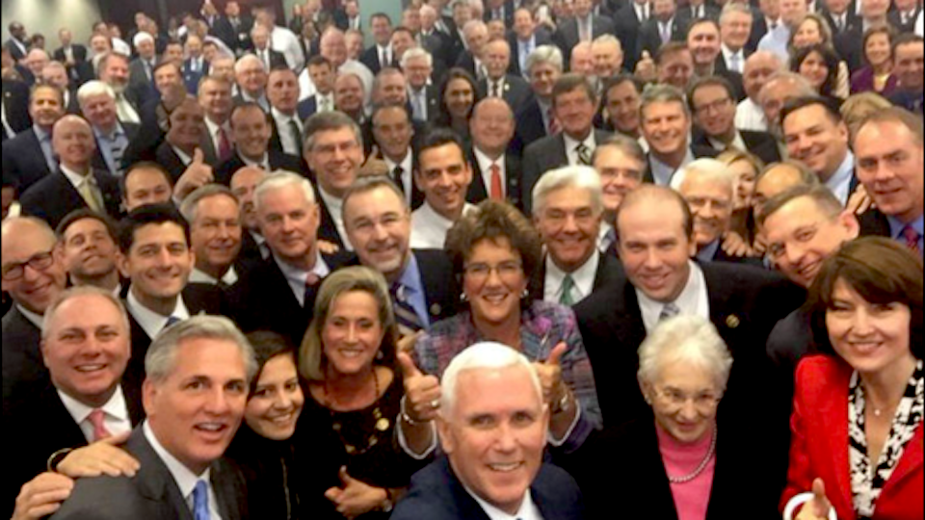
Thoughts…?

Slide 9
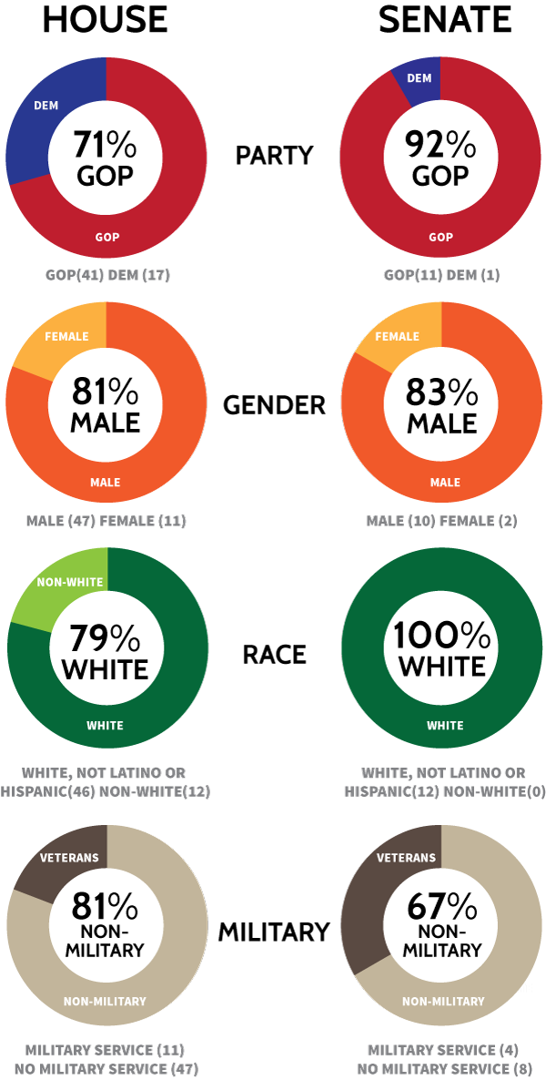
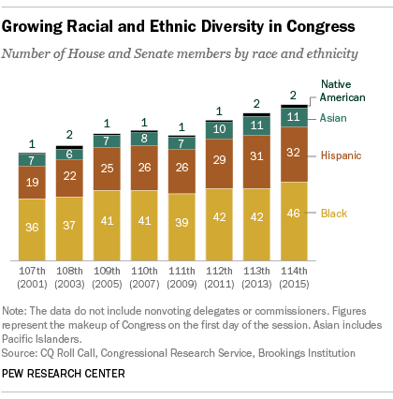
The 114th Congress…

Slide 10
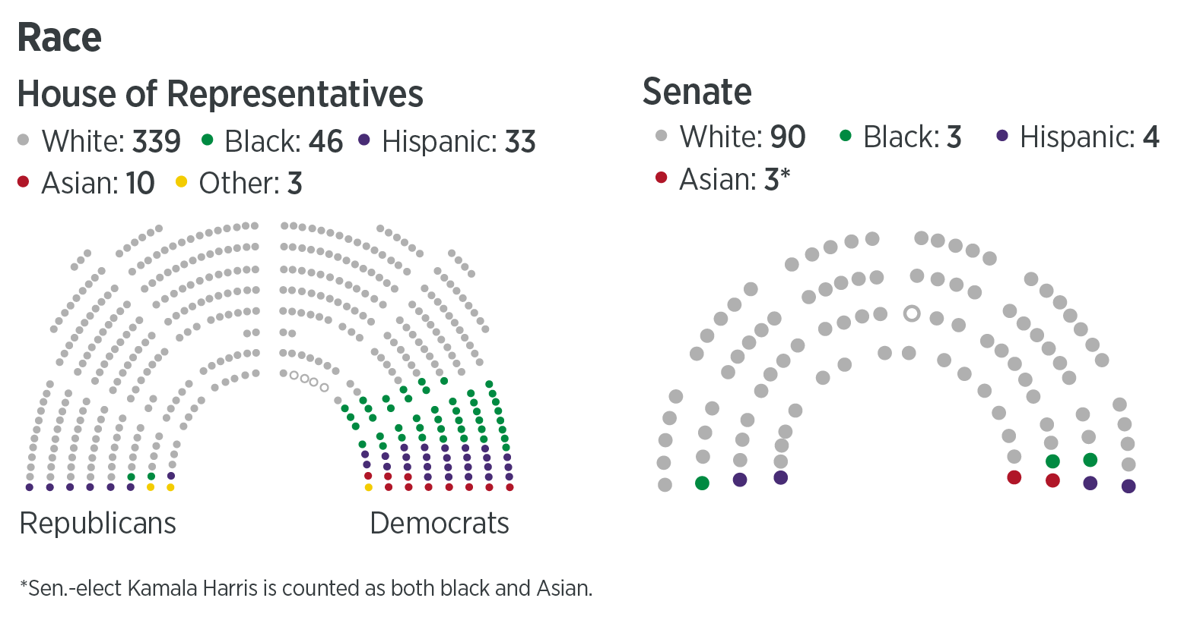
115th Congress

Slide 11
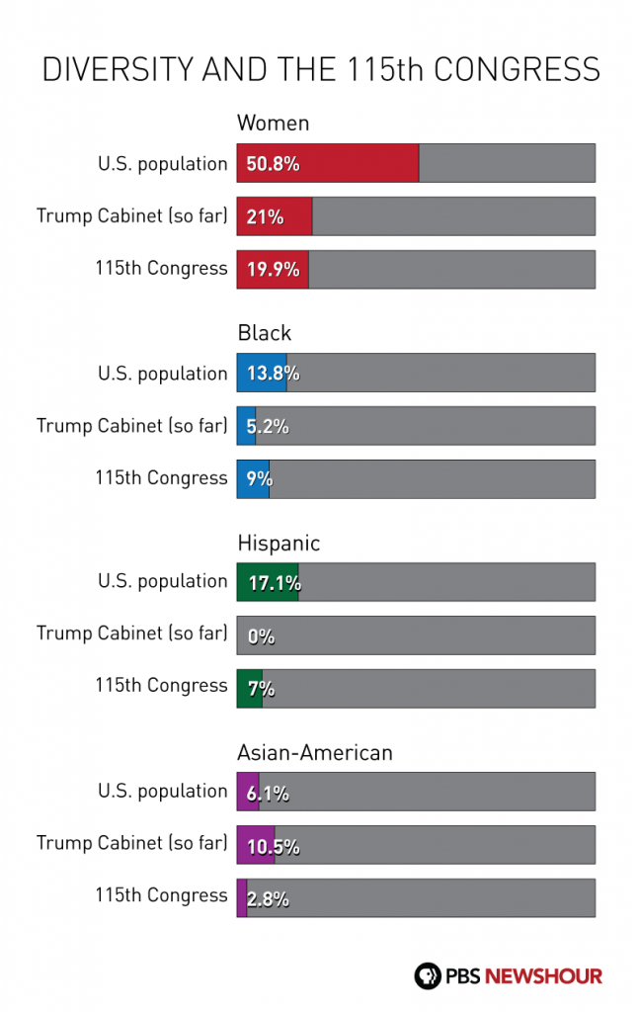

Slide 12
Types of representation…
Descriptive Representation
Substantive Representation

Slide 13
Who Serves in Congress?
Congress is becoming less white and less male, although women and ethnic minorities are still underrepresented.
Descriptive representation means that members have the same characteristics as constituents.
Substantive representation means that members of Congress will represent their constituents’ best interests.
Incumbents are elected at much higher rates than challengers. This is called the incumbency advantage.

Slide 14
Start here…get a computer!

Slide 15
Benefits of the Job
Congressional Staff
Staff who serve individual members of Congress, committees, and party leaders
Franking Privileges
Free use of mail system to communicate with constituent; machines duplicate a member’s signature in real ink

Slide 20
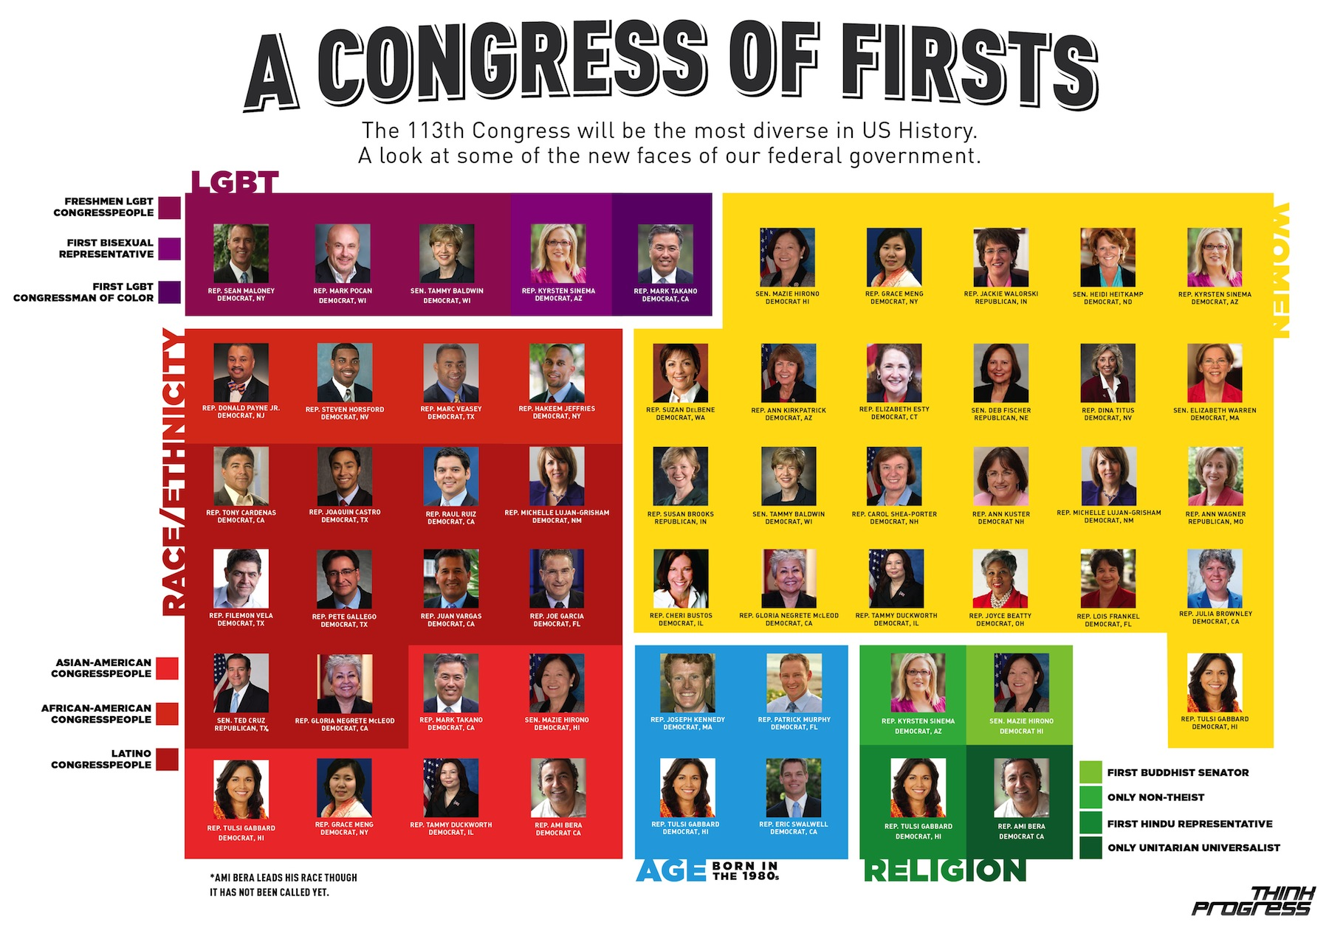

Slide 21
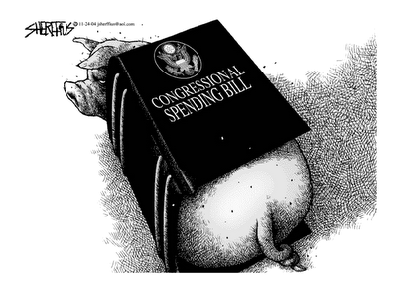
The Incumbency Advantage
Advertising:
The goal is to be visible to voters.
Frequent trips home & newsletters are used.
Credit Claiming:
Casework: providing help to individual constituents.
Pork Barrel: federal projects and grants that benefit a congressional district or state.
Earmark: a provision in a bill that benefits a particular group.

Slide 22
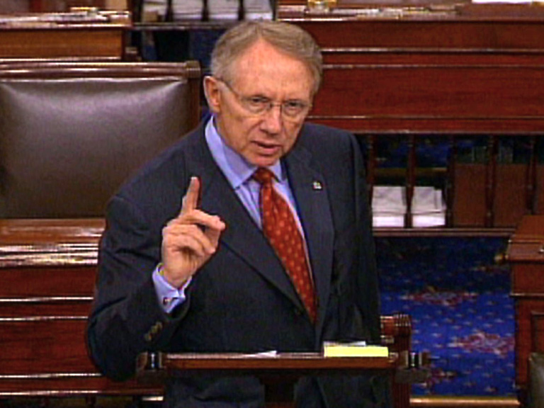
The Incumbency Advantage
Position Taking:
Portray themselves as hard working, dedicated individuals.
Occasionally take a partisan stand on an issue.
Weak Opponents:
Most opponents are inexperienced in politics.
Most opponents are unorganized and underfunded.

Slide 23
Incumbency in the House and Senate
The House has a higher rate of incumbency reelection than the Senate
House members serve in small, often safe districts
House members serve two year terms.
House members run for reelection almost all of the time.

Slide 24
Why Incumbents Sometimes Lose
Incumbents may become involved in a scandal.
Incumbents may be redistricted out of their seat and may face another incumbent in their new district.
Redistricting may cause a seat to become competitive.
There might be a “throw the bums out” sentiment.

Slide 25
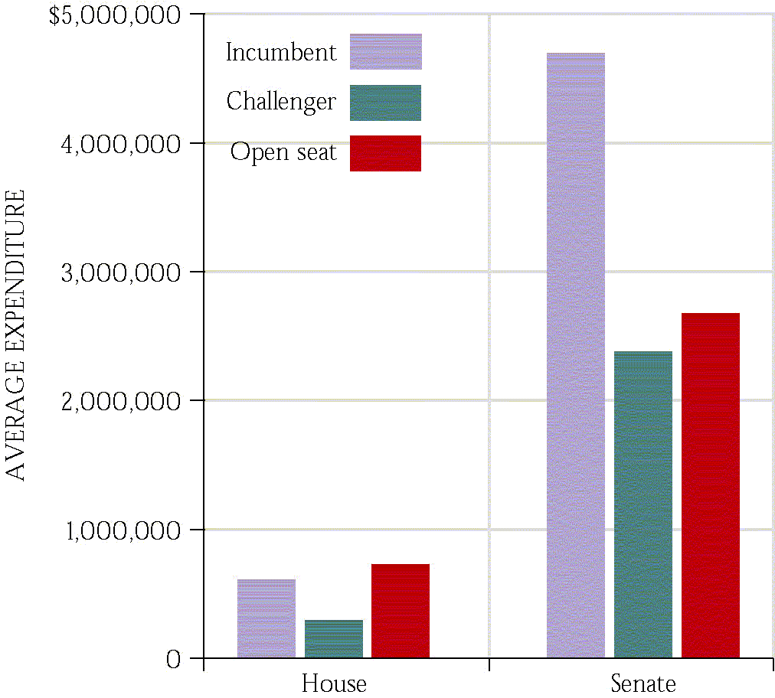
Spending in Congressional Elections
Open seats are expensive.
PACs contribute directly to candidates.
527s and 501(c)(3)s spend independently.
Spending lots of money does not guarantee a win.

Slide 26
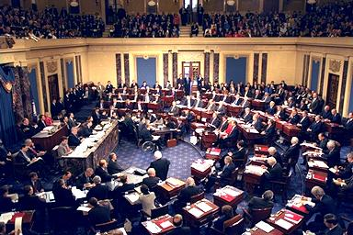
How Congress is Organized to Make Policy
Bicameral: A two house legislature
The House
435 members, 2 year terms of office.
Initiates all revenue bills, more influential on budget.
Limited debates.
The Senate
100 members, 6 year terms of office.
More influential on appointments and foreign affairs.
Unlimited debates, including the filibuster to talk a bill to death.

Slide 27
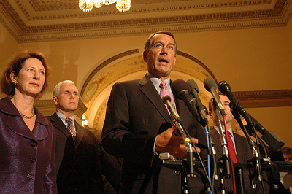
How Congress is Organized to Make Policy
The House
Lead by Speaker of the House- elected by House members.
Major role in committee assignments and legislation.
Majority leader, minority leader, and whips
The Senate
Officially lead by Vice President.
Really lead by Majority Leader- chosen by party members.
Minority leader and whips

Slide 28
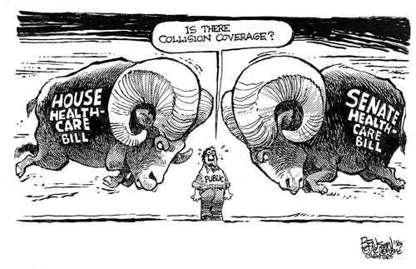
House-Senate Differences
Senate
Unlimited debate
Filibuster
Cloture requires a vote of 60 Members policy generalists
Emphasizes foreign policy
More informal & personal
House
Debate limited to 1 hour
Members policy specialists
Emphasizes tax & revenue policy
More formal & impersonal

Slide 29
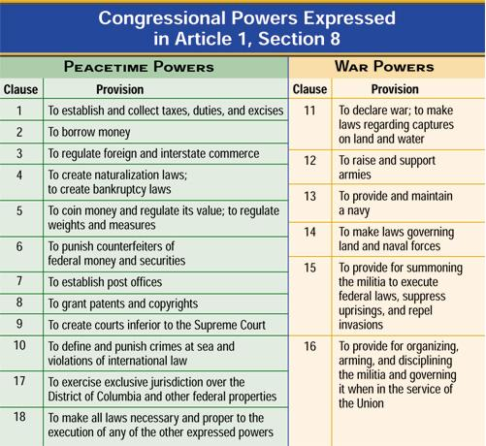
Powers of Congress…

Slide 30
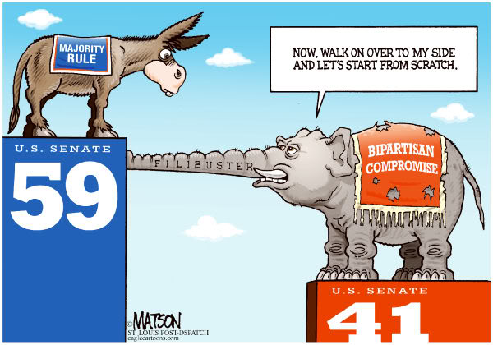

Slide 31
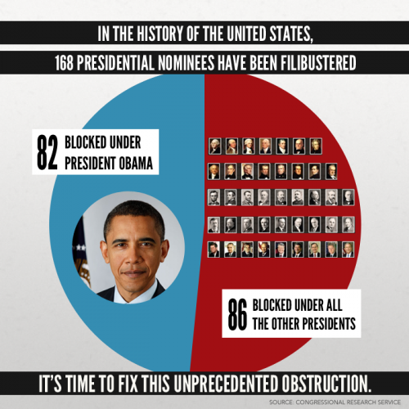
The fillibuster…

Slide 32
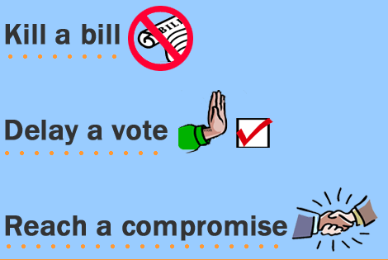
The fillibuster (examples)…
Longest in history…
Strom Thurmond (24:18 against the Civil Rights Act of 1957)
Alfonse D’Amato (23:30 against a military bill that cut “pork”)
Wayne Morse (22:26 on Tidelands Oil Bill)
Robert La Follette (18:23 against a Treasury Loan bill)
William Proxmire (16:12 against an increase in the debt ceiling)

Slide 33
Green Eggs and Ham
https://www.youtube.com/watch?v=0-4FQAov2xI

Slide 34
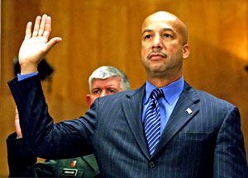
Legislative Committees: Function & Purpose
Oversight Hearings: Members of the bureaucracy are called by congressional committees to testify about matters investigated by the committee.
New Orleans Mayor Ray Nagin testified before the Senate Homeland Security and Governmental Affairs Committee on Hurricane Katrina (Feb., 2006)

Slide 35
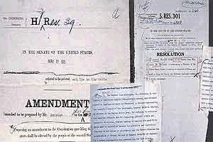
Legislative Committees: Function & Purpose
Consider bills: Committees may send bills to the floor, kill them, or amend them.
A bill with a member’s mark-up notes

Slide 36
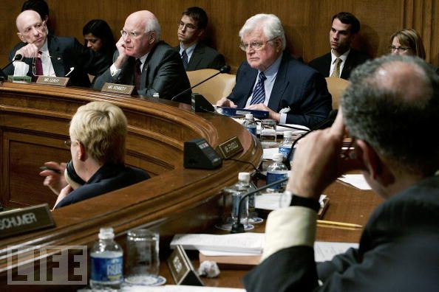
How Congress is Organized to Make Policy
Four types of committees:
Standing committees: subject matter committees handle different policy areas.
Joint committees: Made up of House & Senate members.
Conference committees: resolve differences in House and Senate bills.
Select committees: created for a specific purpose.

Slide 37
Some Important Committees
House Rules Committee: assigns “rules” to bills, including whether debate will be allowed.
House Appropriations Committee: sets funds for specific projects and programs.
House Ways and Means Committee: considers tax bills
Senate Finance Committee: considers tax bills

Slide 38
How Congress is Organized to Make Policy
The Committees and Subcommittees
Getting on a Committee
Members want to get on the right committee.
Members want committee assignments that will help them get reelected and gain influence.
New members express their committee preferences to the party leaders.
Support of the party is important in getting on the right committee.
Parties make an effort to grant requested committee assignments.
A discharge petition is used to bring a bill to the whole House or Senate, without a report by a committee. This is used to bypass committee chairs who have refused to consider a bill or are stalling a bill in committee.

Slide 39
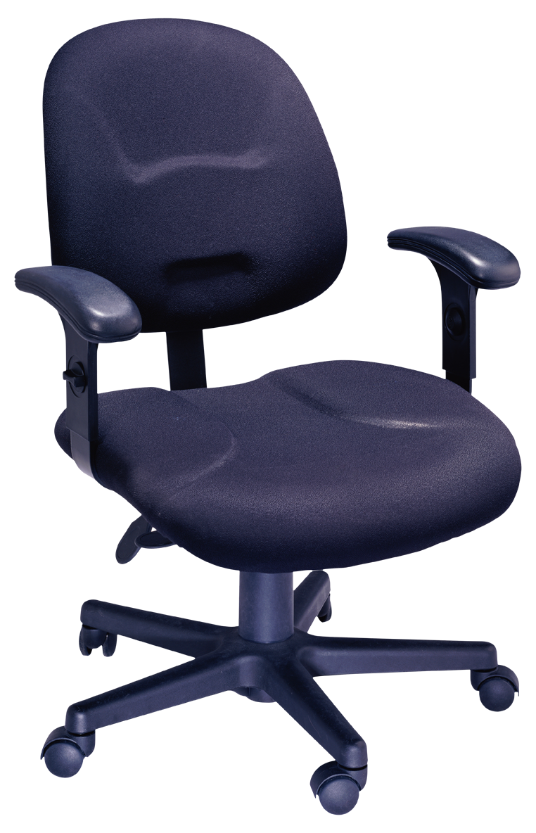
How Congress is Organized to Make Policy
Getting Ahead on the Committee: Chairs and the Seniority System.
The chair is the most important position for controlling legislation.
Seniority on the committee is a general rule, and members may choose the chair of their committee.
Majority party always gets chairman
Committee numbers will reflect the percentage of Democrats and Republicans in the body as a whole.

Slide 40
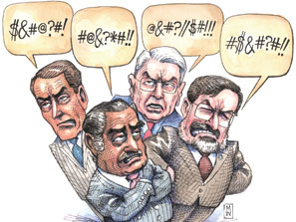
How Congress is Organized to Make Policy
Caucus: A group of members of Congress sharing some interest or characteristic.
Caucuses pressure for committee meetings and hearings and for votes on bills.
Caucuses can be more effective than lobbyists.

Slide 41
How Congress is Organized to Make Policy
Congressional Staff
Personal staff: Work for the member. Mainly providing constituent service, but help research and write bills.
Committee staff: organize hearings, research & write legislation, target of lobbyists.
Staff Agencies: CRS, GAO, CBO provide specific information to Congress.

Slide 42
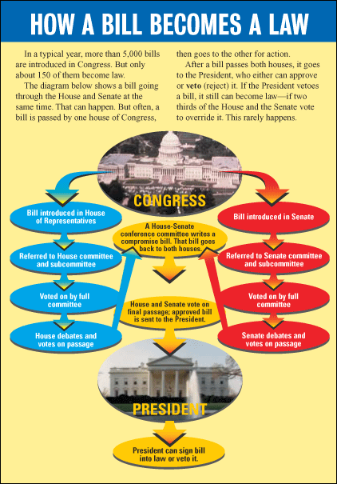
The Congressional Process
Legislation:
Bill: A proposed law.
Anyone can draft a bill, but only members of Congress can introduce them.
More rules in the House than in the Senate.
Party leaders play a vital role in steering bills through both houses.
Countless influences on the legislative process, including interest groups, caucuses, the president, and leadership.

Slide 43
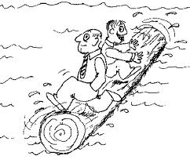
Logrolling
Logrolling means exchanging votes for favors.
“I’ll vote for your bill if you vote for my bill.”

Slide 44
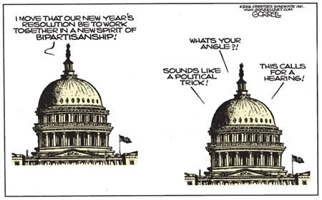
Title: Resolution Artist: Bob Gorrell
Date: 12/28/06 Source: http://www.gorrellart.com/

Slide 45
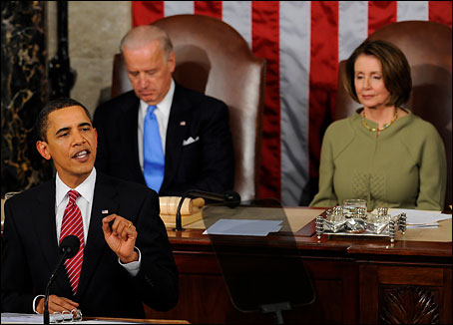
The Congressional Process
Presidents and Congress: Partners and Antagonists
Presidents have many resources to influence Congress, including electoral support.
In order to “win” in Congress, the president must win several battles in each house.
Presidents have the power of veto to ultimately influence legislation.

Slide 46
The Congressional Process

Slide 47
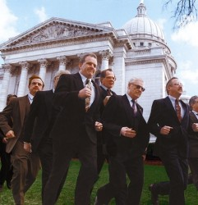
The Congressional Process
Party, Constituency, and Ideology
Party Influence: Party leaders cannot force party members to vote a particular way, but they can promise electoral support and committee memberships.
The Instructed Delegate role is that members of Congress should use their best judgment.
The Representative role is that members of Congress should vote in accordance with their constituents’ wishes (if they can figure out what they are).

Slide 48
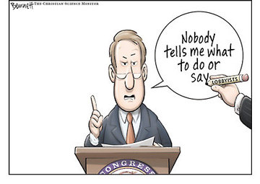
The Congressional Process
Lobbyists and Interest Groups
There are over 26 lobbyists for every member of Congress- the bigger the issue, the more lobbyists will be working on it.
Lobbyists can be ignored, shunned and even regulated by Congress.
Ultimately, it is a combination of lobbyists and others that influence members of Congress.

