Slide 1
Think about this…
Is Donald Trump a “legitimate” president?

Slide 2
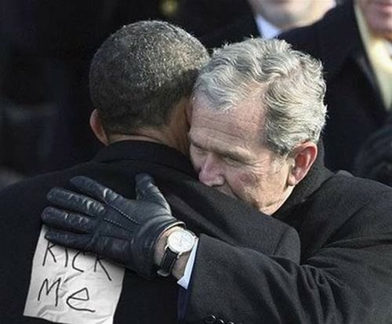
The Constitutional Convention
Compromises and the
“Economics” of the Constitution

Slide 3
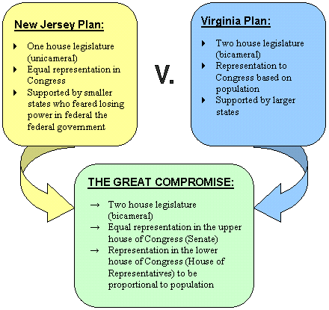
Representation

Slide 4
Just a bundle of compromises…
Conflicts | It was really about… | Resolutions | Rearing its ugly head again…
Large State v. Small State | Representation | “Great Compromise” | Sectionalism
Strong Central govt v. state govts | Power in govt | Federalism … “sharing of power” | Scope of Government Power
North v. South | Economics and politics of slavery | 3/5 compromise Inaction on slave trade | Slavery
S
S
S

Slide 5
Economics of slavery…
Why wouldn’t the South EVER have allowed the convention to touch slavery? What did they stand to lose economically?
What is today’s “value” of a slave?
Typical slave plantation?
Do the math…
$90,000,000
in captial

Slide 6
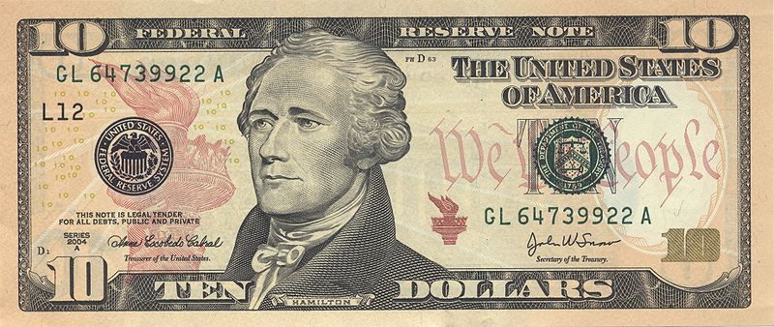
Economic Issues
States had tariffs on products from other states
Paper money was basically worthless (14 currencies)
Congress couldn’t raise money

Slide 7
The Agenda in Philadelphia

Slide 8
The Madisonian Model
To prevent a tyranny of the majority, Madison proposed a government of:
Limiting Majority Control
Separating Powers
Creating Checks and Balances
Establishing a Federal System

Slide 9
The Madisonian Model
The Constitution and the Electoral Process

Slide 10
The Madisonian Model
Whom does each branch represent?
Elite power
Aristocrats
States
The people
Where is our democracy in this model… what is it based on?

Slide 11
The Madisonian Model

Slide 12
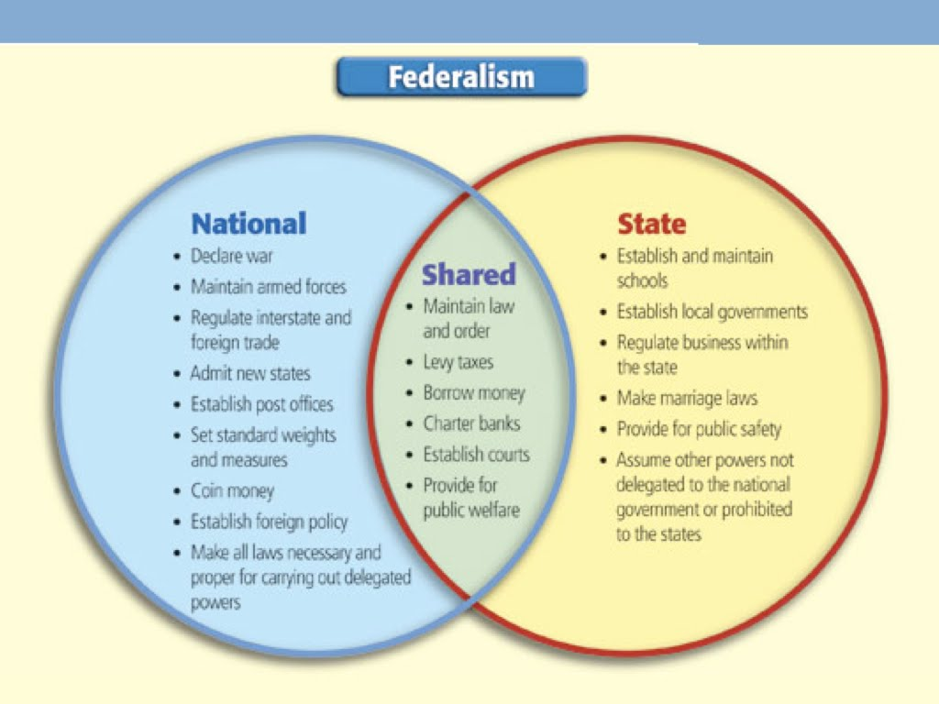

Slide 13
Ratification

Slide 14
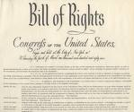
Ratifying the Constitution
Federalist Papers
A collection of 85 articles written by Alexander Hamilton, John Jay, and James Madison under the name “Publius” to defend the Constitution
Bill of Rights
The first 10 amendments to the U.S. Constitution, drafted in response to some of the Anti-Federalist concerns about the lack of basic liberties

Slide 15
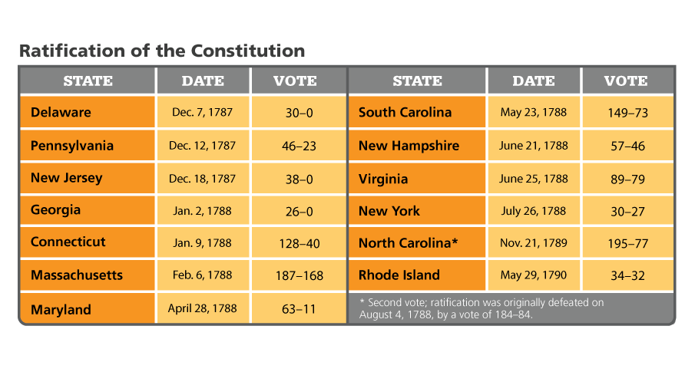
The Fight for Ratification
The battle between Federalists and Anti-Federalists continued throughout the ratification process. Analyze Charts In which States was ratification won by only a narrow margin?

Slide 16
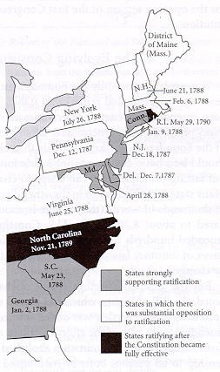
Ratifying the Constitution
Ratification
9/13 states were needed to ratify.
Lacking majority support, the Federalists specified that the Constitution be ratified by state conventions, not state legislatures.
New Hampshire’s approval (the ninth state to ratify) made the Constitution official six months later.

Slide 17
Summary
The Constitution was ratified to strengthen the powers of the national government.
Protection of individual rights guaranteed through the Bill of Rights.
Formal and informal changes continue to shape our Madisonian system of government.

