Slide 1
The Courts and Civil Liberties
A deep discussion of the cases…

Slide 2
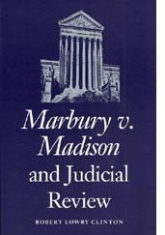
Marbury v. Madison

Slide 3
Marbury v. Madison
Jefferson (Republican) defeats Adams (Federalist) in the Election of 1800

Slide 4
Marbury v. Madison
1. On his last day, Adams fills courts
with as many Federalist judges as
possible
They were called “midnight judges” - Adams waited until 9 o’clock on his last night as President to appoint them.

Slide 5

Marbury v. Madison
2. Jefferson becomes President the next day but some of Adams’ judges have not yet received their official forms
a. Jefferson says they cannot
be judges

Slide 6
Marbury v. Madison
b. Jefferson orders James Madison (Secretary of State) not to give out the papers to the judges

Slide 7
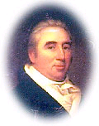
Marbury v. Madison
3. William Marbury is one of the
judges affected by Jefferson’s
decision

Slide 8

Marbury v. Madison
  a. Marbury demands that the
  Supreme Court examine the
  case and force the executive branch to hand out papers

Slide 9
Marbury v. Madison
Marbury says Judiciary Act of 1789
gives the Supreme Court the right to
do this
What was Judiciary Act of 1789?
Created federal court system with 3 levels and outlined the powers of each – district, court of appeals, Supreme Court

Slide 10
Marbury v. Madison
4. John Marshall, the chief justice
and a Federalist, listens to
Marbury’s case
How do you think Jefferson reacted?
How do you think Marshall reacted?

Slide 11
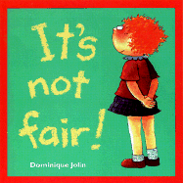
Marbury v. Madison
a. Marshall agrees that Marbury
had been treated unfairly
AND…..

Slide 12
Marbury v. Madison
  Judiciary Act would allow SC to force Madison into making
  Marbury a judge
BUT….

Slide 13
Marbury v. Madison
c. Marshall has to decide is this
constitutional or unconstitutional?

Slide 14

Marbury v. Madison
- Marshall decides that forcing the
government to make Marbury
judge would be unconstitutional

Slide 15
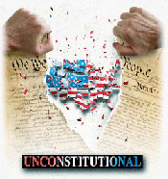
Marbury v. Madison
5. Marshall’s ruling establishes Judicial Review - Supreme Court can declare act of Congress unconstitutional

Slide 16
Marbury v. Madison
Judicial review has increased the
Supreme Court’s legal authority…
making it a much stronger branch

Slide 17
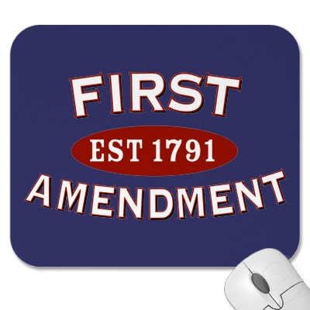
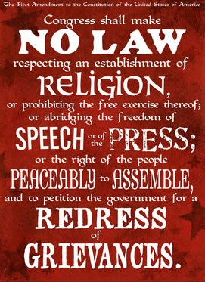
Understanding Civil Liberties
Civil liberties and the scope of government
Today’s government is huge and commands vast, powerful technologies
Since Americans can no longer avoid the attention of government, strict limitations on governmental power are essential -- limitations that are provided by the Bill of Rights
(Freedom v. Order dilemma)
In general, civil liberties limit the scope of government

Slide 18
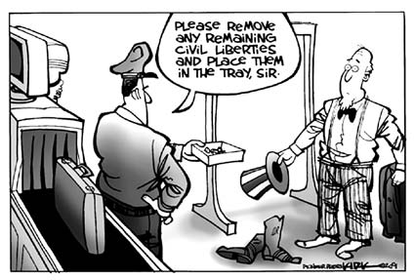
The Bill of Rights -- Then and Now
Civil liberties -- individual legal and constitutional protections against government
***** essential for democracy *****
Civil liberties set down in the Bill of Rights
Courts are arbiters of these liberties
First ten amendments (ratified in 1791) comprise Bill of Rights
Challenge -- people cherish rights until their own are usurped

Slide 19
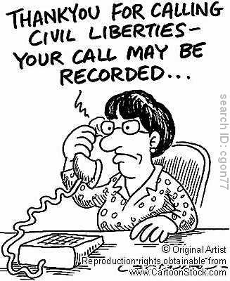
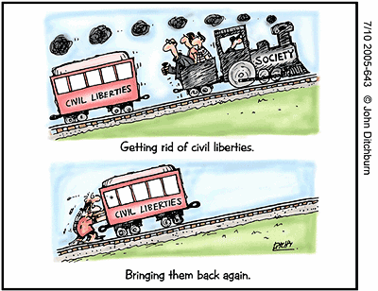
The Bill of Rights -- Then and Now
Civil Liberties
Civil liberties include freedom of speech, freedom of religion, and freedom of the press, as well as guarantees of a fair trial
Civil Rights
                Civil rights sometimes reserved for those positive acts of government that seek to make constitutional guarantees a reality for all people

Slide 20
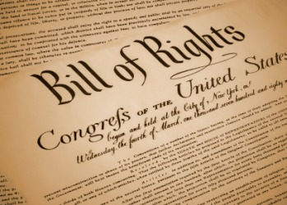
The Bill of Rights and the states
The scope of the Bill of Rights
                In 1791, every state constitution included a bill of rights
                First ten amendments were intended to restrict the new federal government, not the existing state governments
Note First Amendment begins with the words, “Congress shall make no law…”

Slide 21

The Bill of Rights and the states
Barron v. Baltimore (1833)
John Marshall -- Bill of Rights “contains no expression indicating an intention to apply them to the state government. The court cannot so apply them.”
Supreme Court established a precedent that the freedoms guaranteed by the Bill of Rights did not restrict the state governments

Slide 22
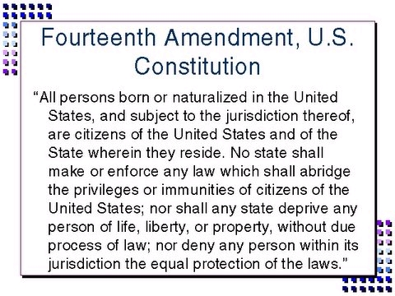

Slide 23
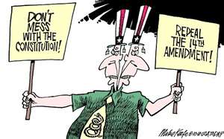
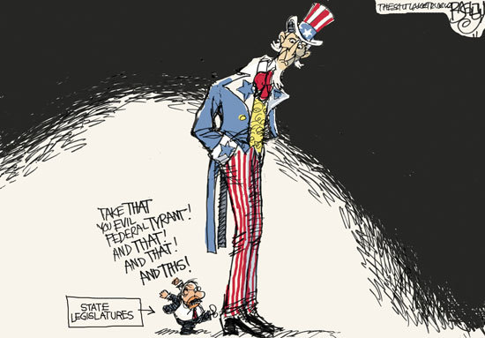
The Bill of Rights and the states
Fourteenth Amendment
Contains two keys clauses that have had a significant impact on Supreme Court decisions and U.S. politics:
  Due Process Clause
  Equal Protection Clause

Slide 24
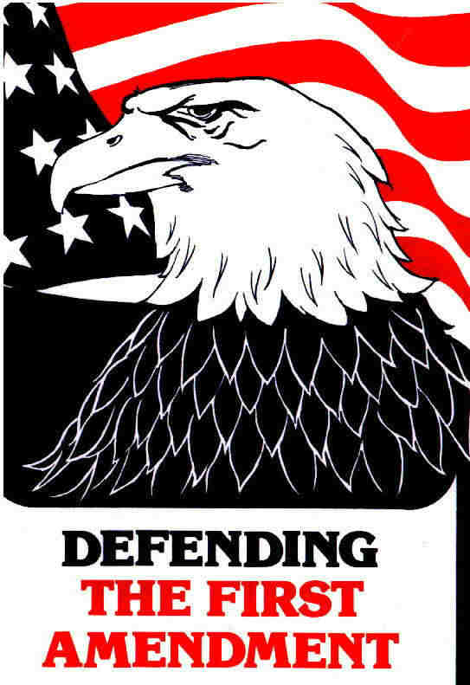
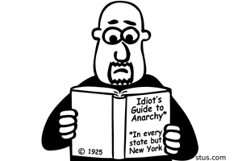
The Bill of Rights and the states
Gitlow v. New York (1925)
Court says freedoms of speech and press “were fundamental personal rights and liberties protected by the due process clause of the Fourteenth Amendment from impairment by the states”

Slide 25
The Incorporation Doctrine
Barron v. Baltimore, Supreme Court ruled that federal courts could not stop enforcement of state laws that restricted the rights enumerated in the Bill of Rights
Gitlow v. New York began the incorporation process of using the Due Process Clause of the Fourteenth Amendment to extend most of the requirements of the Bill of Rights to the states
Incorporation process did not occur at once -- gradual process by which Supreme Court has used a series of individual decisions to incorporate the Bill of Rights into the Due Process Clause of the Fourteenth Amendment

Slide 26
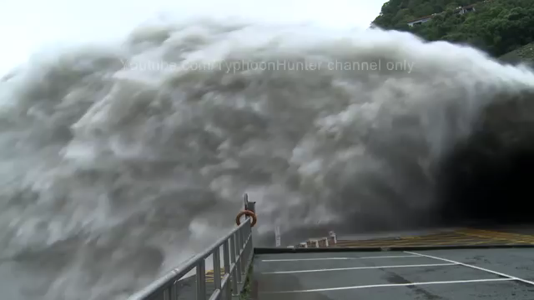

The Incorporation Doctrine
Total Incorporation?
Selective Incorporation?

Slide 27

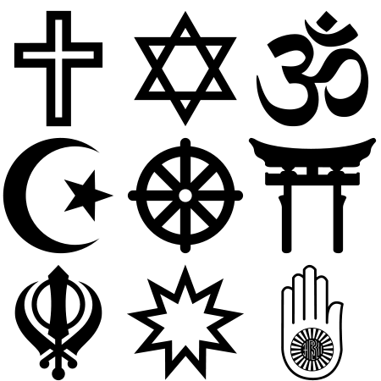
Freedom of Religion
The First Amendment
America’s religious liberties originated in colonial opposition to government-sponsored churches
1st Amendment contains two fundamental guarantees of religious freedom:
  Establishment Clause prohibiting “an establishment of religion…”
  Free Exercise Clause prohibits government from interfering with the practice of religion
Note: both these protections have been extended to the states by the Due Process Clause of the Fourteenth Amendment

Slide 28
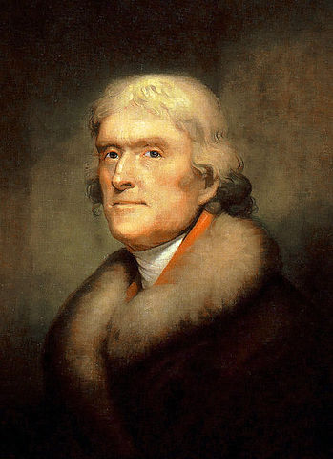
Freedom of Religion
Establishment clause
“Congress shall make no law respecting an establishment of religion.”
  Clearly prohibits an establishment of a national church
What else was meant by this? TJ argued that 1st Amendment created a “wall of separation” between church and state, which would prohibit not only favoritism but any support for religion at all
"It does me no injury for my neighbor to say there are twenty gods, or no God. It neither picks my pocket nor breaks my leg.” -- TJ

Slide 29
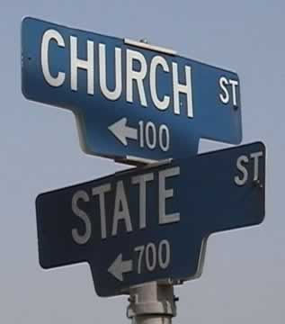
Freedom of Religion
Establishment clause
School prayer: Engel v. Vitale (1962)
NY State Board of Regents approved a prayer for recital each morning in New York public schools
Engel (a parent in the district) argued that the Regents’ prayer violated the Establishment Clause of the First Amendment as applied to the states through the Fourteenth Amendment
Supreme Court ruled that state-sponsored prayer in public schools was an unconstitutional violation of the Establishment Clause that “breaks the constitutional wall of separation between Church and State.”

Slide 30

Freedom of Religion
Establishment clause
Aid to parochial schools: Lemon v. Kurtzman (1971)
Supreme Court declared that aid to church-related schools must meet the following three tests:
The test (Lemon Test) --
  Statute must have a secular purpose
  Primary effect of the statute should not be to advance or inhibit religion
  Statute must not excessively entangle government with religion

Slide 31
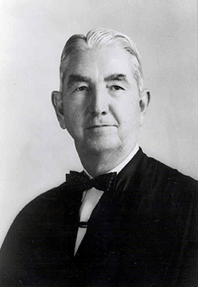
Freedom of Religion
Establishment clause
Zelman v. Simmons-Harris (2002)
Court upheld (it’s OK) program that provided some families in Cleveland, Ohio, with vouchers that could be used to pay tuition at religious schools
"The place of religion in our society is an exalted one, achieved through a long tradition of reliance on the home, the church and the inviolable citadel of the individual heart and mind. We have come to recognize through bitter experience that it is not within the power of government to invade that citadel, whether its purpose or effect be to aid or oppose, to advance or retard. In the relationship between man and religion, the State is firmly committed to a position of neutrality.”
-- Justice Tom Clark Abington School District v. Schempp (1963)
(School-sponsored Bible reading in public schools in the United States to be unconstitutional)

Slide 32
Freedom of Religion
Free Exercise Clause
General Points
First Amendment’s Free Exercise Clause guarantees each person the right to believe what they want
Religion cannot make an act legal that would otherwise be illegal
Government can act when religious practices violate criminal laws, offend public morals, or threaten community safety
  Example, in Oregon v. Smith (1990), SC banned the use of illegal drugs in religious ceremonies

Slide 33
Freedom of Religion
Free Exercise Clause
Limits on the Free Exercise Clause: Reynolds v. United States (1879)
Issue – Polygamy “duty to marry many women”
SC made an important distinction between religious beliefs and religious practices
Court cannot restrict what a person believes because that “lies solely between a man and his God.”
(However) society has a right to legislate against religious activities that violate a law of the land
SC rules against Reynolds, arguing that permitting polygamy would “make the professed doctrines of religious belief superior to the law of the land, and in effect to permit every citizen to become a maw unto himself.”

Slide 34
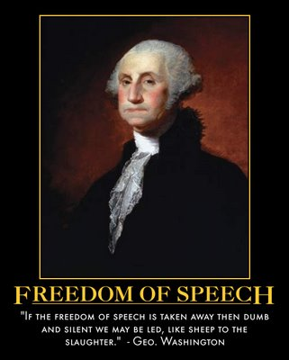
Freedom of Speech and Press
Does “no law” in the First Amendment
really mean “no law”?
Is freedom of expression absolute? -- Not always!
IMPORTANT -- Must find a balance between freedom of expression and competing values like public order, national security, and the right to a fair trial
What exactly is speech?
(like picketing) -- non verbal – symbolic speech?

Slide 35
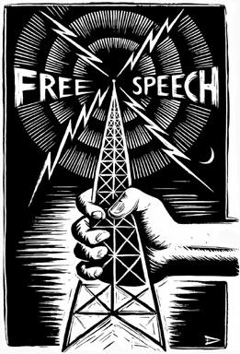
Freedom of Speech and Press
The Defense of Free Speech
The First Amendment
Framers believed right to free speech is a fundamental natural right
1st AM clearly states that, “Congress shall make no law… abridging the freedom of speech or of the press.”
First and Fourteenth Amendments protect free speech from incursions of both federal and state governments

Slide 36
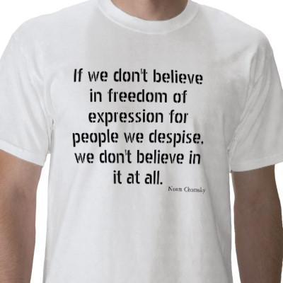
Freedom of Speech and Press
The Defense of Free Speech
Protections of unpopular views
            Guarantees of free speech are intended to protect expressions of unpopular views
            “The freedom to differ,” Justice Jackson wrote, “ is not limited to things that do not matter much.”
            Even if a doctrine is “wrong,” it does not follow that it should be silenced
English philosopher John Stuart Mill argued that wrong or offensive ideas force us to sharpen our own views
IF we believed in free expression, we must believe in its power to overcome error in a fair debate

Slide 37
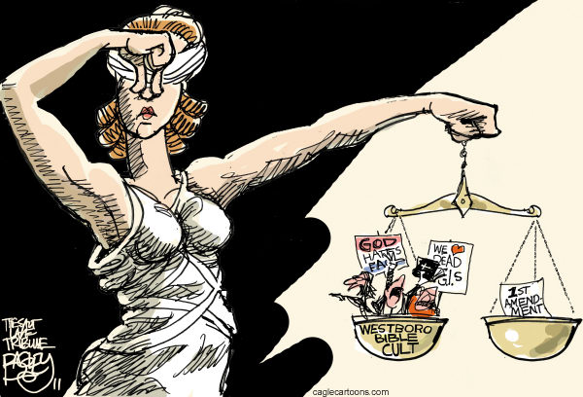

Slide 38
Freedom of Speech and Press
The “Clear and Present Danger” Test
Schenck v. United States (1919)
Espionage Act of 1917 prohibited forms of dissent deemed to be harmful to the nation’s war effort in World War 1
Charles Schenck opposed America’s participation in World War I so he mailed 15,000 leaflets to potential draftees comparing military conscription to slavery and urged his readers to “assert your rights” by resisting the military draft
Government responded by arresting Schenck for violating the Espionage Act
Schenck argued Espionage Act unconstitutional because it violated the 1st Amendment’s promises of free speech

Slide 39
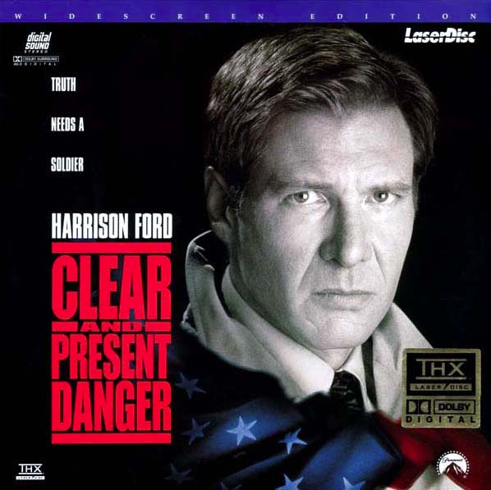
Freedom of Speech and Press
The “Clear and Present Danger” Test
Justice Oliver Wendell Holmes wrote, “[T]he character of every act depends on the circumstances in which it is done. The most stringent protection of free speech would not protect a man in falsely shouting fire in a theatre, and causing a panic… The question in every case is whether the words are used in such circumstances and are of such a nature as to create a clear and present danger that they will bring about substantive evils that Congress has the right to prevent.”

Slide 40
Freedom of Speech and Press
The “Clear and Present Danger” Test
Clear and present danger test created a precedent that First Amendment guarantees of free speech are not absolute
Smith Act of 1940 forbade advocacy of violent overthrow of American government
Free speech advocates did little to stem the relentless persecution known as McCarthyism during the “cold war” of the 1950s, when Senator Joseph McCarthy’s unproven accusations that many public officials were Communists created an atmosphere in which broad restrictions were placed on freedom of expression

Slide 41
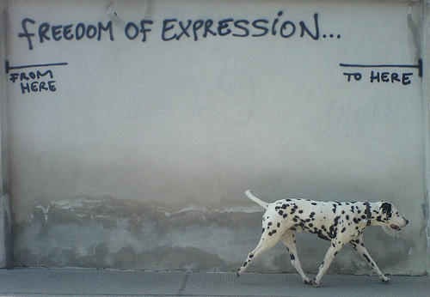
Freedom of Speech and Press
The “Clear and Present Danger” Test
1960s, political climate changed Court narrowed interpretation of Smith Act so that government could no longer use it to prosecute dissenters Brandenburg v. Ohio (1969)
  SC limited the clear and present danger test by ruling that the government could punish the advocacy of illegal action only if “such advocacy is directed to inciting or producing imminent lawless action and is likely to incite or produce such action.”

Slide 42
Freedom of Speech and Press
Limits on Free Speech
Libel and Slander
libel -- publication of statements known to be false that tend to damage a person’s reputation
slander -- spoken defamation
Not protected by the First Amendment!
Libel / slander involve freedom of expression issues that involve competing values
  If public debate is not free, no democracy
  Conversely, some reputations may be unfairly damaged in process

Slide 43
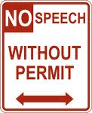
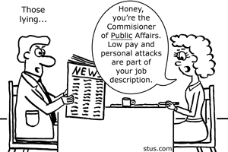
Freedom of Speech and Press
Limits on Free Speech
Libel and Slander
Court says statements about public figures are libelous only if made with malice and reckless disregard for the truth
New York Times v. Sullivan (1964), SC ruled statements about public figures are libelous only when both false and purposely malicious
Private persons only need to show that statements about them were defamatory falsehoods and that the author was negligent

Slide 44
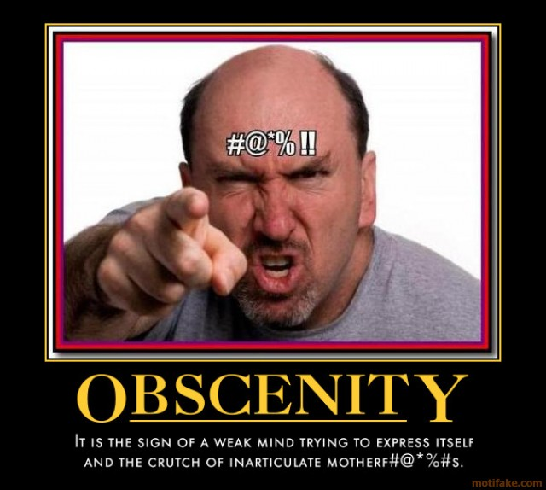
Freedom of Speech and Press
Limits on Free Speech
Obscenity
                Public standards vary from time to time, place to place, and person to person
                Work that some call “obscene” may be “art” to others
                No nationwide consensus exists that offensive material should be banned

Slide 45
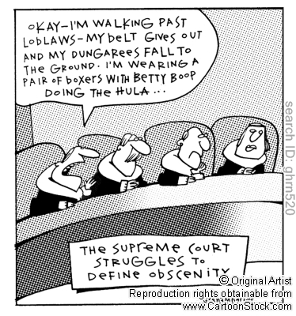
Freedom of Speech and Press
Limits on Free Speech
Obscenity
Roth v. United States (1957), Supreme Court ruled that “obscenity is not within the area of constitutionally protected speech or press.”
Problem –
What is obscene???

Slide 46
Freedom of Speech and Press
Limits on Free Speech
Obscenity
Miller v. California (1973)
Court tried to clarify what could be classified as obscene
Chief Justice Warren Burger wrote that materials were obscene if the work, taken as a whole, appealed to a “prurient interest” in sex; and if it showed “patently offensive sexual contact”; and if it “lacked serious artistic, literary, political, or scientific merit.”
Miller, Court ruled decisions should be made to reflect standards of local (not national) communities

Slide 47
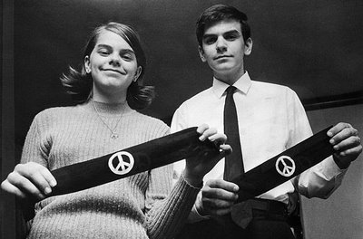
Freedom of Speech and Press
Limits on Free Speech
Symbolic speech
Symbolic speech includes forms of nonverbal communication such as carrying signs, wearing armbands, or burning flags
Tinker v. Des Moines Independent School District (1969)
  Free expression case
  Justice Abe Fortas states that students and teachers do not “shed their constitutional right to freedom of speech or expression at the school house gate.”

Slide 48
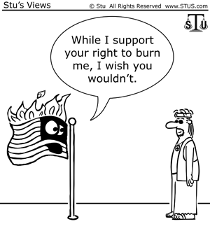
Freedom of Speech and Press
Limits on Free Speech
Symbolic speech
Texas v. Johnson (1989), SC ruled that flag burning is a form of symbolic speech protected by 1st Am.
Note SC has ruled 1st Amendment does not protect symbolic speech intended to incite illegal actions
  Example, states may make it a crime to burn a cross with the intent to threaten racial terror

Slide 49
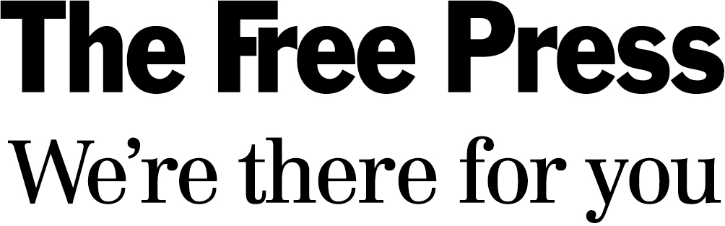
Freedom of Speech and Press
Free press versus free trial
Bill of Rights is a source of potential conflicts between different types of freedoms
Constitution clearly meant to guarantee the right to a fair trial as well as the right to a free press
Problem:
Trial may not be fair if pretrial press coverage makes it impossible to select an impartial jury

Slide 50
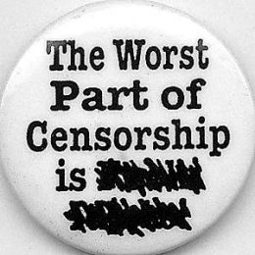
Freedom of Speech and Press
Prior Restraint
Prior restraint attempt to limit freedom of press by preventing material from being published
  Prior restraint is thus a form of censorship
Supreme Court has repeatedly ruled that prior restraint is a violation 1st Amendment protection of freedom of press
            Important test cases have included Near v. Minnesota (1931) and New York Times Company v. United States (1971)

Slide 51
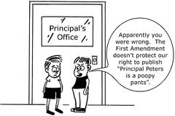
Freedom of Speech and Press
Prior Restraint
Hazelwood School District v. Kuhlmeier (1988)
Supreme Court ruled school administrators can exercise “editorial control over the style and content of student speech in school-sponsored expressive activities so long as their actions are reasonably related to legitimate pedagogical concerns.”

Slide 52
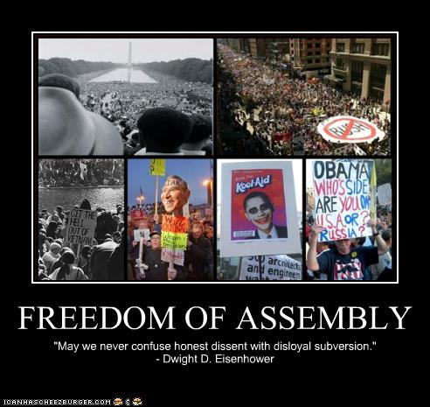
Freedom of Assembly
Freedom of assembly
Constitutional basis for forming interest groups / political parties, for picketing and protesting in groups
Two facets of freedom of assembly
  Right to assemble
  Right to associate

Slide 53
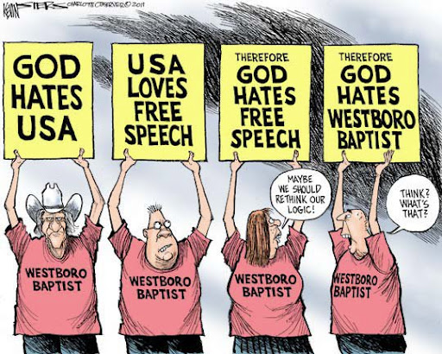
Freedom of Assembly
Right to assemble
Right to gather together in order to make a statement within reasonable limits
  Called time, place, and manner restrictions
    Includes rights to parade, picket, protest
Supreme Court has generally upheld the right of any group -- no matter how controversial or offensive – to peaceably assemble on public property
  Balance between freedom and order
  When does protest verge on harassment?
    Westboro Baptist Church

Slide 54
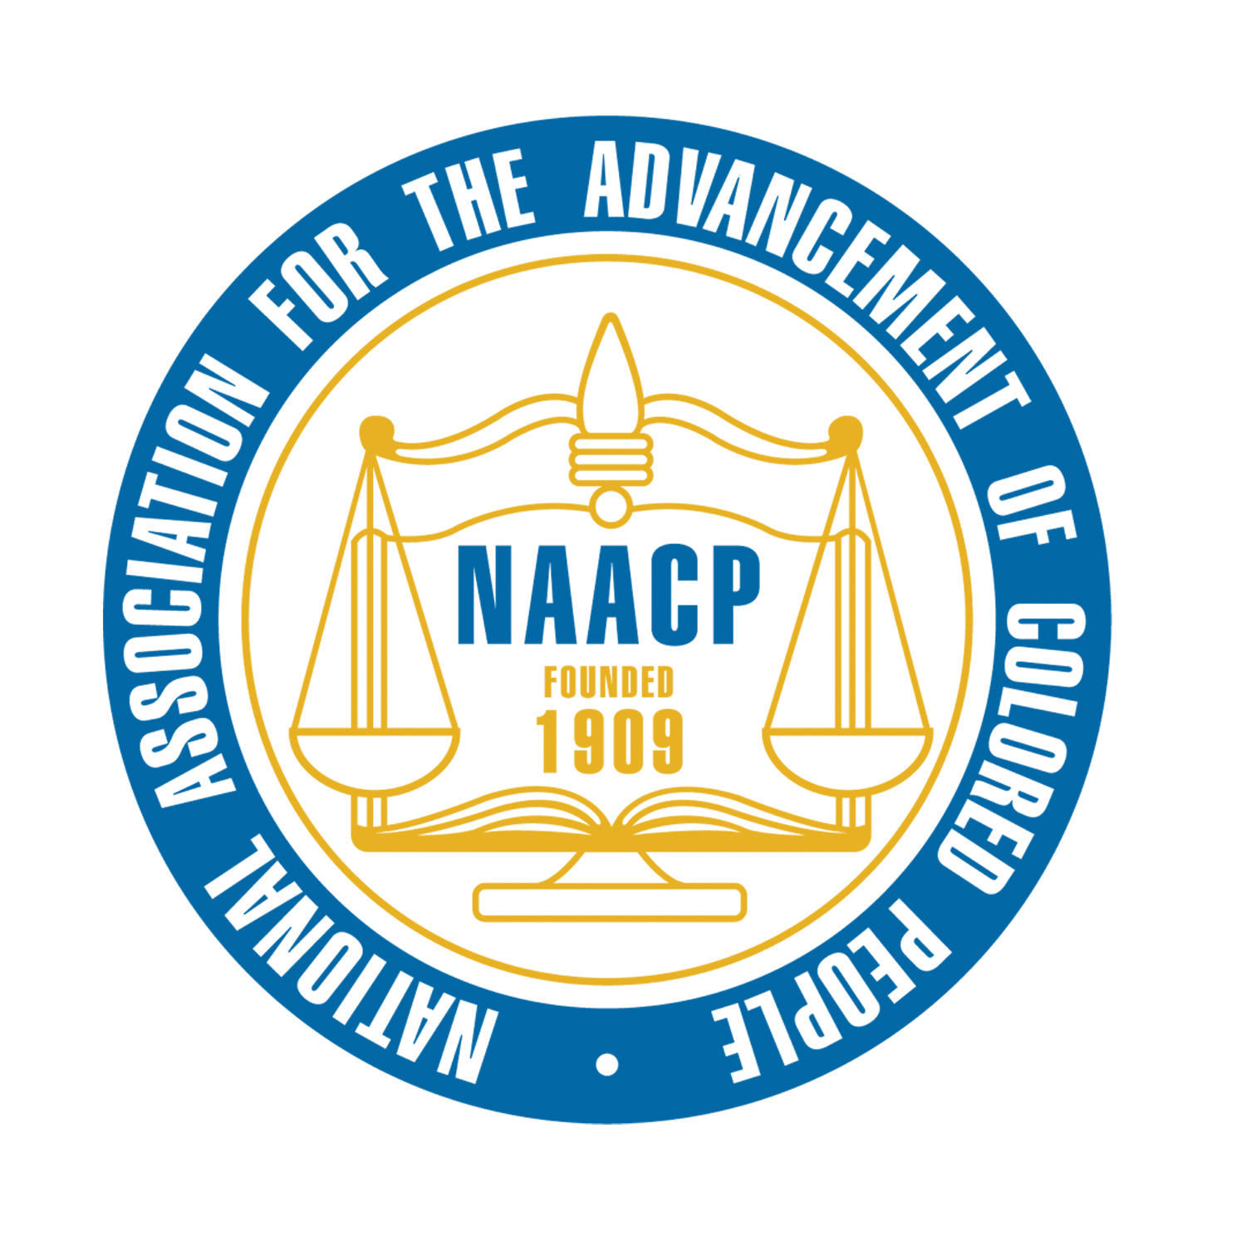
Freedom of Assembly
Right to associate
Freedom to associate with people who share a common interest
Includes right to meet with people who want to create political change
Court found Alabama’s attempt to require NAACP to turn over its membership list to be an unconstitutional restriction of freedom of association
  NAACP v. Alabama (1958)

Slide 55
Rights of the Accused
Interpreting defendants’ rights
First Amendment guarantees freedoms of religion, speech, press, assembly
Most of remaining rights in the Bill of Rights concern rights of people accused of crimes
  Rights were originally intended to protect accused in political arrests and trials
  Today -- protections in Fourth, Fifth, Sixth, Eighth Amendments are primarily applied in criminal justice cases
Language of the B of R vague, defendants’ rights are not well defined
  Incorporation -- these rights at state level as well

Slide 56
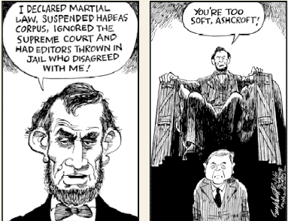
Rights of the Accused
Rights in the original Constitution
Constitution expressly states, “The Privilege of the Writ of Habeas Corpus shall not be suspended, unless when in cases of Rebellion or Invasion the public safety may require it.”
            Writ of habeas corpus is a court order directing that a prisoner be brought before a court and that court officers show cause why the prisoner should not be released
Writ of habeas corpus thus prevents unjust arrests and imprisonments

Slide 57
Rights of the Accused
Rights in the original Constitution
Bills of Attainder
Constitution prohibits Congress and the state legislatures from passing a bill of attainder
  Legislative act that provides for the punishment of a person without a court trail
Ex post facto laws
Constitution prohibits Congress and the state legislatures from enacting ex post facto laws
  Ex post facto law is a law applied to an act committed before the law was enacted

Slide 58
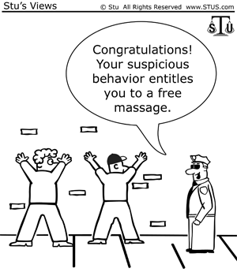
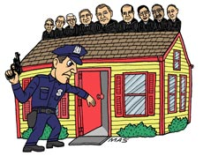
Rights of the Accused
Search and Seizures
4th Amendment declares, “The right of the people to be secure in their persons, houses, papers, and effects, against unreasonable searches and seizures, shall not be violated….”

Slide 59
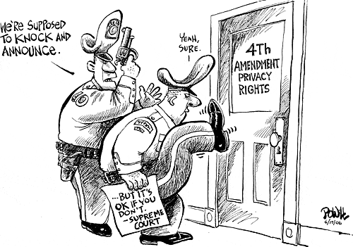
Rights of the Accused
The exclusionary rule
Exclusionary rule prohibits evidence obtained by illegal searches or seizures from being admitted in court
Supreme Court first established the exclusionary rule in Weeks v. United States (1914)
                Mapp v. Ohio (1961)
                Case illustrates process of incorporation by which the Fourth Amendment was applied to the states through the Due Process Clause of the Fourteenth Amendment

Slide 60
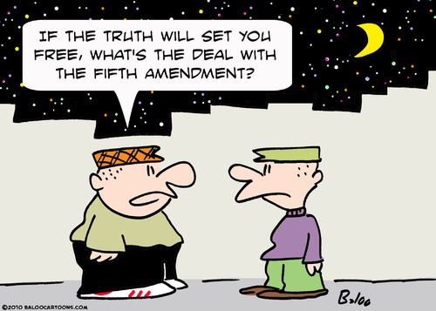
Rights of the Accused
The Miranda Rule
The Fifth Amendment forbids forced self-incrimination, stating that no person “shall be compelled to be a witness against himself.”
Suspects cannot be compelled to provide evidence that can be used against them
Burden of proof rests on police and prosecutors, not the defendant
Right applies to congressional hearings and police stations, as well as to courtrooms

Slide 61
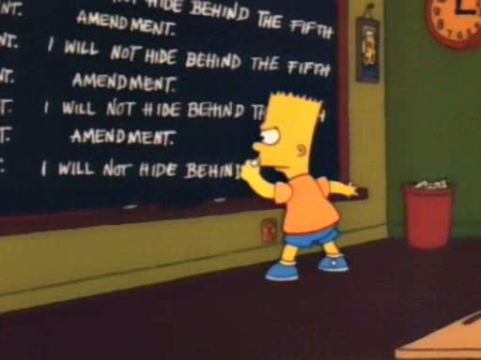

Slide 62
Rights of the Accused
Miranda v. Arizona (1966)
Set guidelines for police questioning of suspects
Suspects must be informed of their constitutional right to remain silent
Suspects must be warned that what they say can be used against them in a court of law
Suspects must be told that they have a right to have a lawyer present during
Questioning, and that a lawyer will be provided if the accused cannot afford one
"You have the right to remain silent. Anything you say can and will be used against you in a court of law. You have the right to have an attorney present during questioning. If you cannot afford an attorney, one will be appointed for you. Do you understand these rights? "

Slide 63
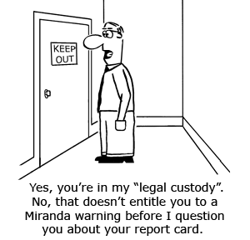
Rights of the Accused
Arizona v. Fulminante (1991)
Court held that a coerced confession is “harmless error” if other evidence is sufficient for conviction
If law enforcement officials encourage persons to commit crimes (such as accepting bribes or purchasing illicit drugs) that they otherwise would not commit, convictions for these crimes will be overturned by the courts

Slide 64
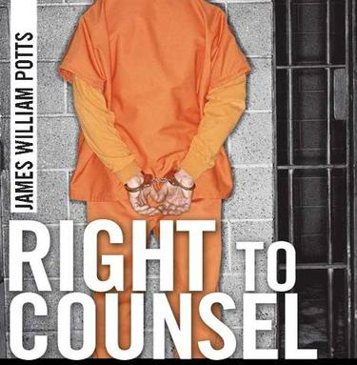
Rights of the Accused
The Right to Counsel
6th Amendment states, “The accused shall enjoy the right… to have the assistance of counsel for his defense.”
Note when Sixth Amendment was ratified,
that right did not apply to
people tried in states courts

Slide 65
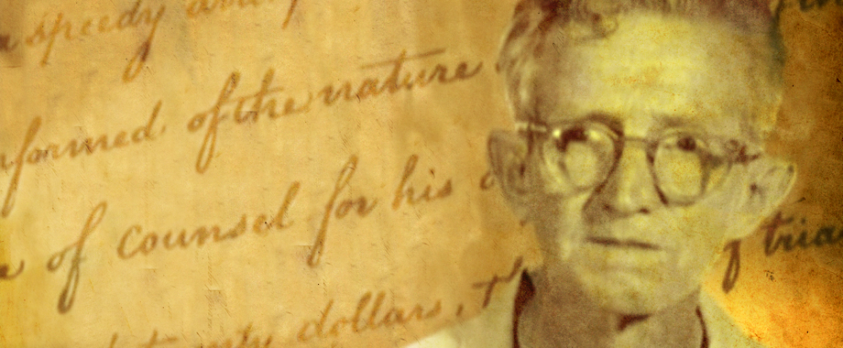
Rights of the Accused
The Right to Counsel
Gideon v. Wainwright (1963)
Gideon was accused of breaking and entering a Florida poolroom and stealing a small amount of money
Judge refused Gideon’s request for a court-appointed free lawyer
Gideon appealed his conviction, arguing that by refusing to appoint a lawyer to help him, the Florida court violated his rights promised by the Sixth and Fourteenth Amendments
Unanimous decision, the Supreme Court ruled that to those accused of major crimes under state laws
This landmark case illustrates the process of incorporation, by which the Sixth Amendment was applied to the states through the Due Process Clause of the Fourteenth Amendment.

Slide 66
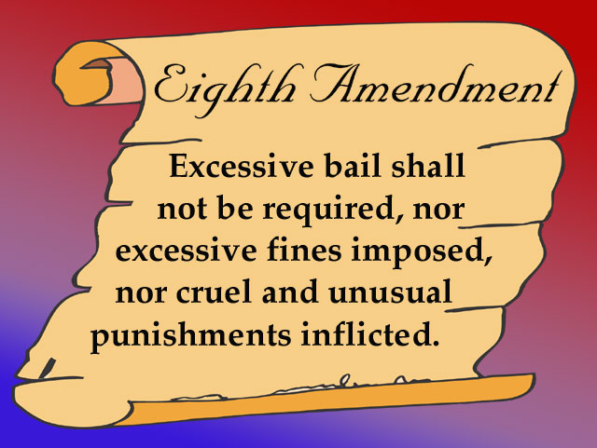
Rights of the Accused

Slide 67
Rights of the Accused
Eighth Amendment -- forbids cruel and unusual punishment
What does that mean???
Most constitutional debate over cruel and unusual has centered on death penalty
Gregg v. Georgia (1976)
  found death penalty is “an extreme sanction, suitable to the most extreme of crimes”
Court has recently held constitutionally unacceptable to execute 16- or 17-year-olds or mentally challenged persons
death sentences in steep decline today due to DNA testing and public concerns over wrongful sentences

Slide 68
The rights to privacy and
abortion rights
The right to privacy
Justice Louis D, Brandeis defined privacy as “the right to be left alone.”
Bill of Rights doesn’t specifically grant Americans a right to privacy
  (However) following constitutional provisions imply a right to privacy:
    1st AM’s guarantee of freedom of religion
    3rd AM’s prohibition against the government forcing citizens to quarter soldiers in their homes
    4th AM’s protection against unreasonable searches and seizures
    5th AM’s rule that private property cannot be seized without “due process of law.”

Slide 69
The rights to privacy and
abortion rights
Griswold v. Connecticut (1965)
Estelle Griswold challenged constitutionality of an 1879 Connecticut law that prohibited the use of “any drug, medicinal article or instrument for the purpose of preventing conception.”
Supreme Court ruled the Connecticut law criminalizing the use of contraceptives violated the right to marital privacy
Justice William O. Douglas argued that the right to privacy was found in the unstated liberties implied by the explicitly stated state rights in the Bill of Rights or “penumbras”
  penumbras -- unstated liberties implied by explicitly stated rights

Slide 70
The rights to privacy and
abortion rights
Right to privacy established in Griswold v. Connecticut set an important precedent for
Roe v. Wade
Roe v. Wade (1973)
Jane Roe (A pseudonym for Norma McCorvey) challenged constitutionality of a Texas law allowing abortions only to save the life of the mother
Roe argued that the decision to obtain an abortion should be protected by the right to privacy implied in the Bill of Rights
The Supreme Court struck down the Texas law by a vote of 7 to 2

Slide 71
The rights to privacy and
abortion rights
Challenges to Roe
Webster v. Reproductive Health Services (1989)
Supreme Court upheld a Missouri law prohibiting abortion (except those preserving the mother’s health) in any publicly operated hospital or clinic in Missouri
Planed Parenthood of Southeastern Pennsylvania v. Casey (1992)
Supreme Court ruled that a state may place reasonable limits that do not place an “undue burden” on a woman’s right to have an abortion
  Example, a state may impose a 24-hlour waiting period and require parental consent for minors

Slide 72
Whole Woman’s Health v. Hellerstedt

Slide 73
Understanding Civil Liberties
American government:
Democratic (because it is governed by officials elected by the people and answerable to them)
and
Constitutional (because it has a fundamental organic law, the Constitution, that limits the things government can do)
Democratic and constitutional components of government can produce conflicts, but they also reinforce one another

Slide 74
Understanding Civil Liberties
Civil liberties and democracy
Individual rights may conflict with other values
Rights guaranteed by the First Amendment are essential to a democracy
Individual participation and the expression of ideas are crucial components of democracy
However
So is majority rule, which can conflict with individual rights
Rights guaranteed by Fourth, Fifth, Sixth, and Eighth Amendments protect all Americans
but
They also make it harder to punish criminals

Slide 75
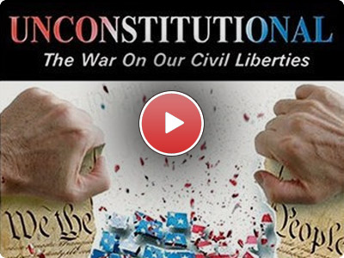
Understanding Civil Liberties
Civil liberties and democracy
Ultimately, the courts decide what constitutional guarantees mean in practice:
  Federal courts are the branch of government least subject to majority rule
  Courts enhance democracy by protecting liberty and equality from the excesses of majority rule

