Slide 1
The courts are the least democratic branch of government; thus they are the most dangerous branch
Prove or disprove this statement

Slide 2
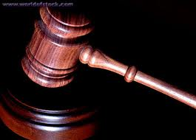
Actions of the Courts
Judicial Activism & Judicial Restraint

Slide 3
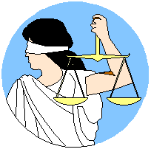
The Myth of our Judicial System. . .
Justice is color-blind

Slide 4
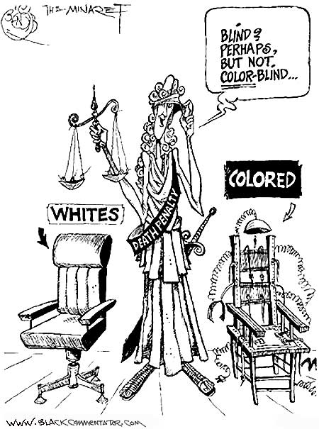
THE
REALITY?

Slide 5
The policy choices a court makes are based on interpretations of existing law.
“Judges’ decisions are a function of what they would prefer to do,
tempered by what they think they ought to do,
but constrained by what they perceive is feasible to do”

Slide 6
Five sources that have guided interpretation of the Constitution:
(1) the text and structure of the Constitution,
(2) intentions of those who drafted, voted to propose or ratify the provision in question (Founder’s Intent)
(3) prior precedents (usually judicial),
(4) the social, political, and economic consequences of alternative interpretations
(5) natural law. Law determined by nature; law binding moral behavior from it

Slide 7
A Court/Judge is a Judicial Activist when they:
stray from precedent,
make policy with their rulings
make a decision contrary to the wishes of the other branches or people

Slide 8
Constitutional Interpretation
Strict Construction – interpret the language literally with little reference to outside sources
Congress shall enact “no laws”….
Original Intent – try to apply the provisions of the constitution according to the notions of the drafters and other of the Founders
Contextual – apply the provisions of the Constitution according to the current conditions of the country

Slide 9
Activism v Restraint
Judicial Restraint
Believe the court’s job is to stay out of policymaking and legislating
Not making policy in the place of the other branches of government
Not stepping into second guess the decisions of the Congress or state legislatures
Tend to be conservative
Strict constructionists – see, read, and interpret the Constitution as it was written in 1787

Slide 10
Judicial Activism
Confronting problems
Judges should make bold policy decisions and even chart new constitutional ground
Initiative of the courts allows Congress to avoid deciding some difficult political issues
Judge is comfortable as a legislative actor/policymaker when “necessary and proper”
Generally to protect individuals from business or government
Tends to be liberal
Loose constructionists – see the Constitution as a living document that is meant to meet the changes of a society over time to make it effective

Slide 11
REASONS FOR INCREASE IN JUDICIAL ACTIVISM
Growth in size and scope of govt.
Laws are unclear and need interpretation
Constitution guidelines are vague and do not provide specific direction
Judges see their ROLE as “solving problems”, not settling disputes

Slide 12
Judicial Restraint
A judge or court that exercises judicial restraint will
Defer to the legislative and executive branches rather than asserting their own view

Slide 13
Views of Judicial Activism
Pro (those for)
Federal Courts must correct injustices when the other branches won’t.
Check on Congress and the Executive.
Last resort for those that have no political influence.
Con (those against)
Judges have no special expertise beyond the law.
They are not elected, and do not fear public opinion as much as elected officials.
Formulate new policies based on their own judicial philosophy.

Slide 14
Checks on Judicial Power
Constitution is vague thus the Judicial branch can check the legislative branch.
The Judicial Branch is checked, however, by Congress
Congress can change the jurisdiction and the number of judges and district courts whenever they feel like it.
Judges can be impeached by Congress.
Judges must be confirmed by the Senate

