Slide 1
Welcome to AP GaP…
Who is this crazy guy in a bow tie?

Slide 2
Welcome to Economics…
Who is this crazy guy in a bow tie?

Slide 3
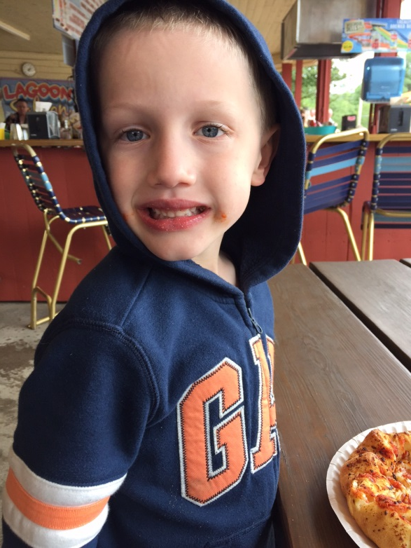
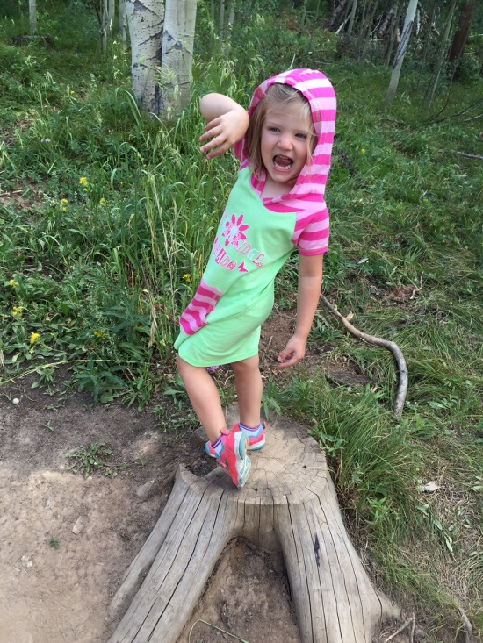

Slide 5
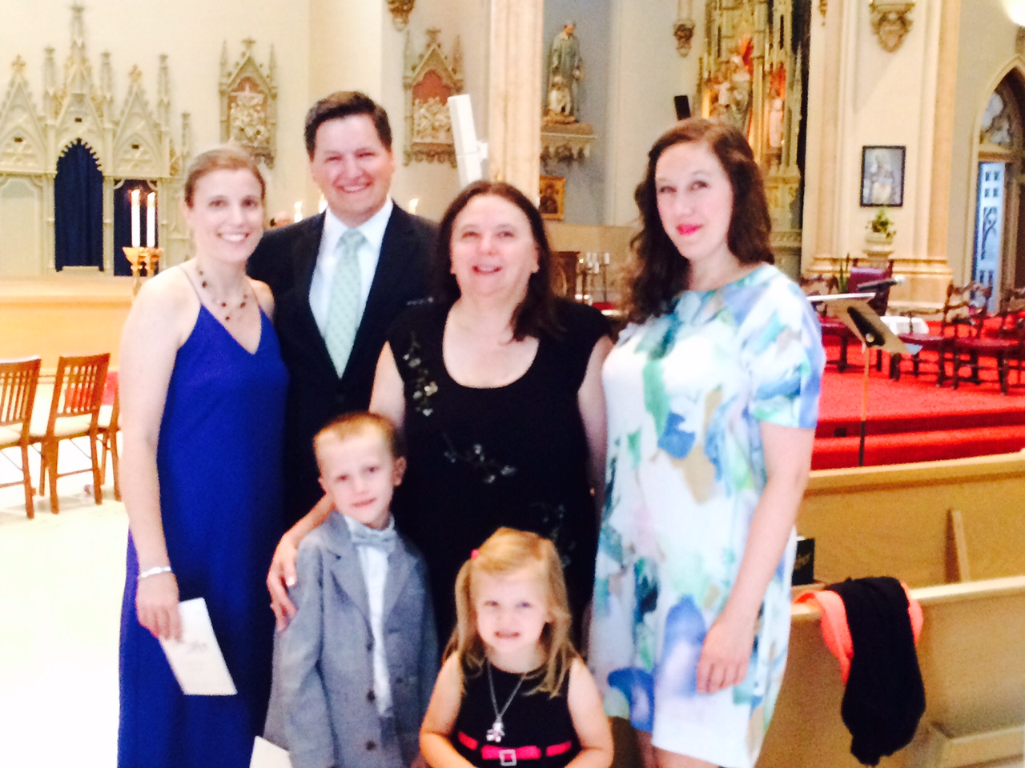

Slide 6
What do I need for this class?
Dedicated 3 subject notebook
Access to the internet (at home or at school is fine)
Optional:
If you have a laptop, iPad, or tablet, bring it with you to class. You will use it on certain days

Slide 7
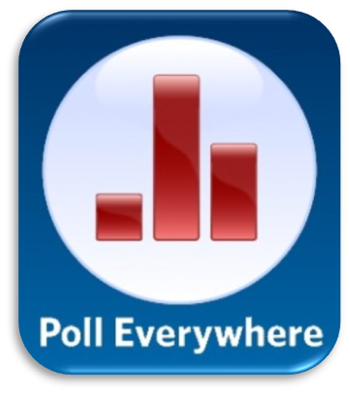
What apps do I need for this class?

Slide 8
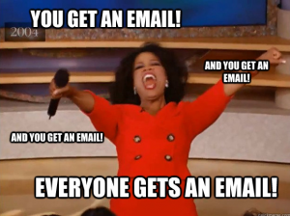
Please get in the habit of using your school email!!!!!

Slide 9
Course website…what’s there?
Assignments
Review Questions
Flipped Resources
Supplemental resources
“2 minute drill”
Let’s go there… http://barikmo.weebly.com

