Slide 1
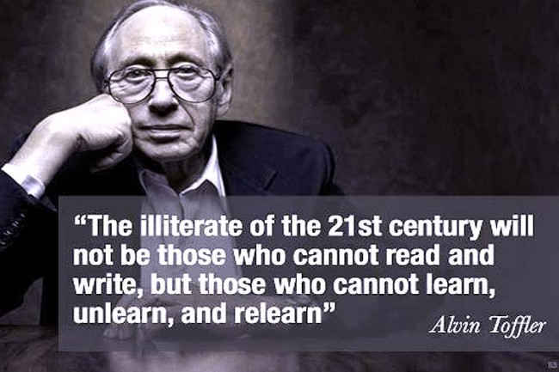
…Learning Targets…
Analyze the current “culture of learning” in our schools
Assess your level of engagement and preparedness for “scholarship”
Explore major questions facing us in our content area

Slide 2
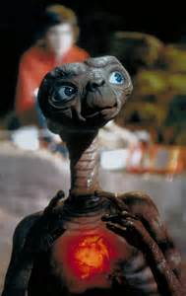
Brainstorm…
How is the room set up?
Is it active or passive?
What do people do to “get an A”?
What is the student/teacher relationship?
How do they assess learning?
Regurgitation or mastery?

Slide 3
Notes:
Poll Title: If an alien landed at Blue Valley High... https://www.polleverywhere.com/free_text_polls/kPqyE747v0s99KH

Slide 4
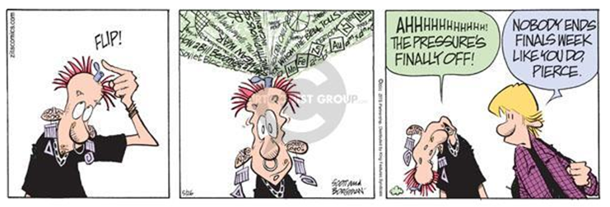

Slide 6
From Drive by Daniel Pink
Algorithmic
v.
Heuristic work

Slide 7
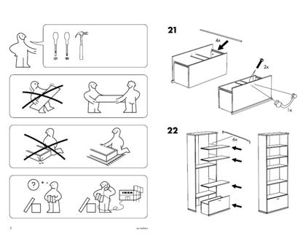
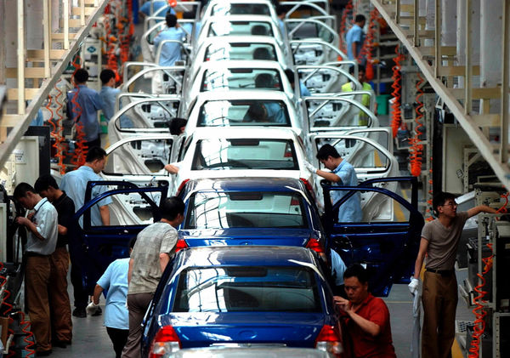
Algorithmic work…

Slide 8
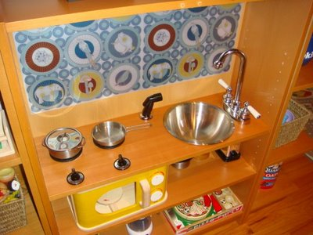
Heuristic work…

Slide 9
Why is that important?
“If you need me to motivate you, I probably won’t hire you!”

Slide 10
Solve the problem…
First Research project
Collaborate, innovate, communicate the answer to your questions in new ways.
Apply history, current/modern day perspectives, up-to-date news items to your presentation
You will have 4 mins to present your work next week (on Block day!)
“Slides” can have no more than 10 words on each slide and must have something visual on each one
No more than 5 slides for the presentation

Slide 11
Economics Topics / Questions
Should the government regulate a minimum wage? Should it be higher, lower, or not exist at all?
Should the government provide safety net programs like Medicare/Medicaid/ Social Security?
Are illegal immigrants “taking” our jobs?
Should we lower the tax rates and tax Americans less?
Should we be worried about the economic growth of countries like China and India?
Is outsourcing a bad thing for our economy?
Is our national debt a problem? What should be done about it?
Is capitalism good for the poor?
Does it make sense to allow people to “sell” their body parts in a free market? What the economic benefits/costs with your answer?

Slide 12
Government Topics / Questions
Should the government be able to collect our phone / web records in the name of national security?
Should the police be able to “stop and frisk” anyone without cause or suspicion?
Should the government regulate guns/ personal firearms? If so, what are the limits?
Is our national debt a problem?
Is our democracy an effective voice for our citizens? If so, what makes it so effective? If not, what stands in our way?
Does the 1st Amendment guarantee of free speech allow “hate speech” (like the messages of Westboro Baptist Church)? Should “hate speech” be banned?
Should governments seek to shed the images of the Confederate Battle Flag from public displays? Should we honor Confederate figures?
Should people be able to claim 1st Amendment religious liberty when deciding what customers to serve (i.e. wedding cake decorators not working with gay couples) or what services to provide (birth control to women)? Why? Why not?
Is “gerrymandering” the reason we have a political polarization in this country? If so, how do we change it? If not, what is the root cause of this polarization?

Slide 13
“If you’re not prepared to be wrong, you’ll never come up with anything original.”
Sir Ken Robinson

Slide 14
For Monday… Read Dr. Edmund Morgan’s speech
For him, what are the characteristics of scholars?
What makes his request challenging for students today?
How well do we do in asking your to be scholar’s as Morgan describes?
What stands in the way of that?

Slide 15
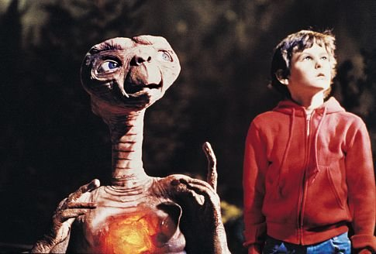
Tomorrow…
Please bring your 3 Subject notebook with you to class!
You will be writing a letter to your future self!

